Slide 1
By T.V. Kosormygina
“Sosny” school December, 2016

Slide 2
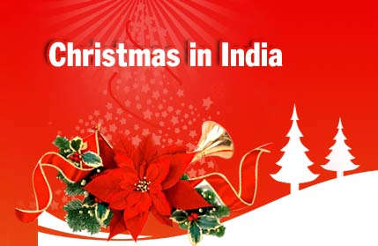
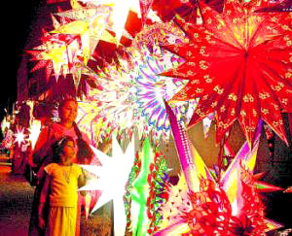
After three hundred years of colonization, Christianity and English are an essential part of the Indian culture. Besides, Indians are people who just need a reason to celebrate a festival and Christmas seems to be a good reason too.
Almost all festivals are celebrated in India with equal enthusiasm. Christmas is celebrated in the country not only with gaiety and spirit of the season, but with a unique Indian flavor.

Slide 3
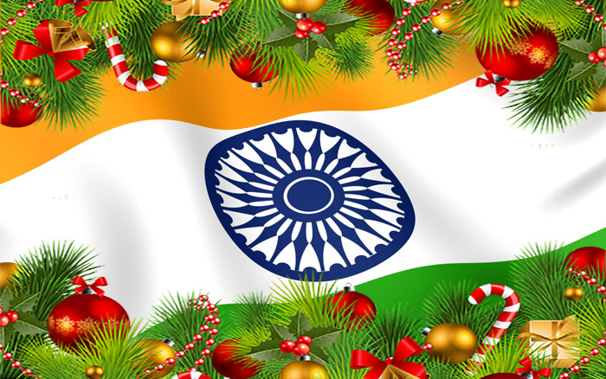
Compared to other religious festivals, Christmas is quite a small festival in India, due to the number of people who are the Christians (about 2.3%) compared to people who belong to other religions. However, the population of India is over 1 billion people, so there are over 35 million Christians in India!

Slide 4
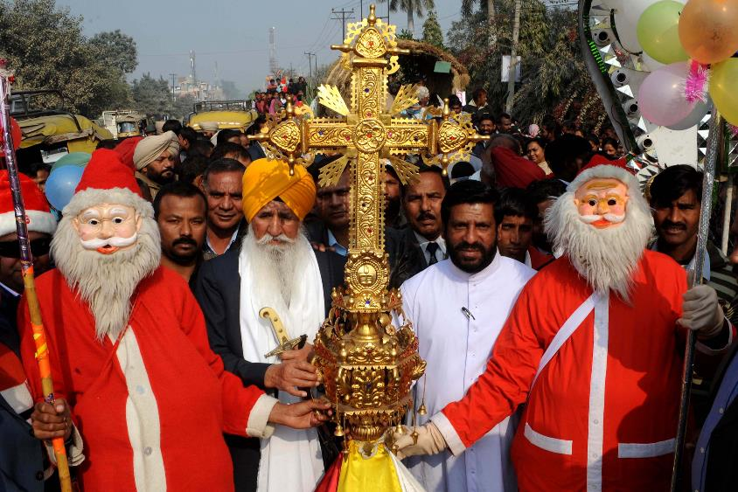
Christmas in India is quite different from the European celebrations. Christmas holidays are not as popular as in Europe because of the small part of the total population.

Slide 5
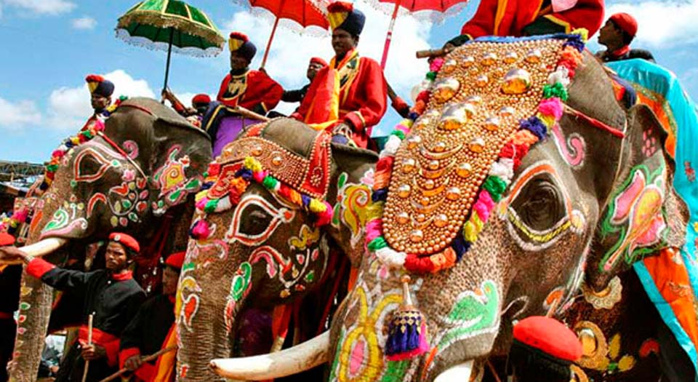
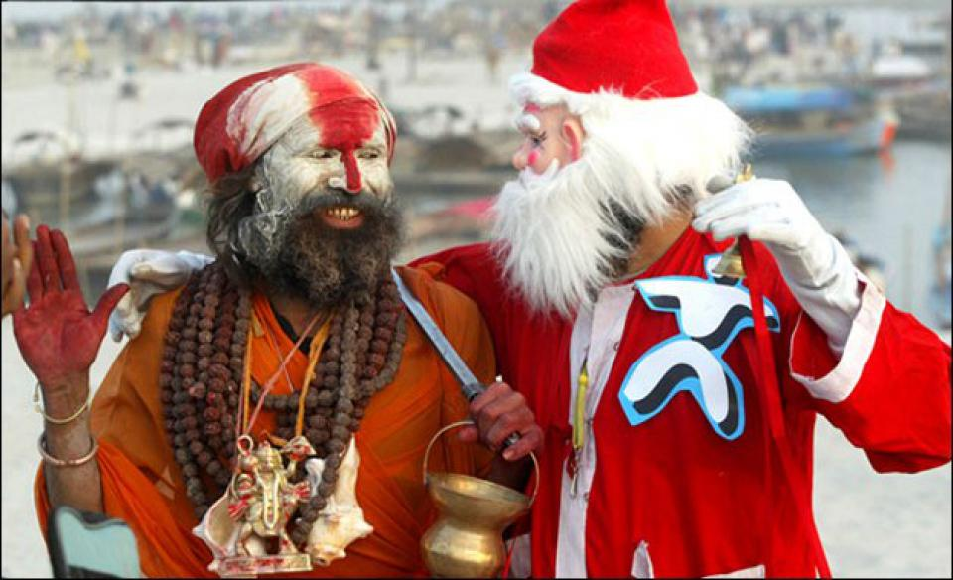
Christmas Day is a national holiday in India, and the day off from work and official duties often prompts people of other faiths to have large family dinners at this time as well.
Though they make up a small portion of India’s population, the Christians have freedom to worship and celebrate this season. Above all, it is a time for peace and well-being within families and communities.

Slide 6
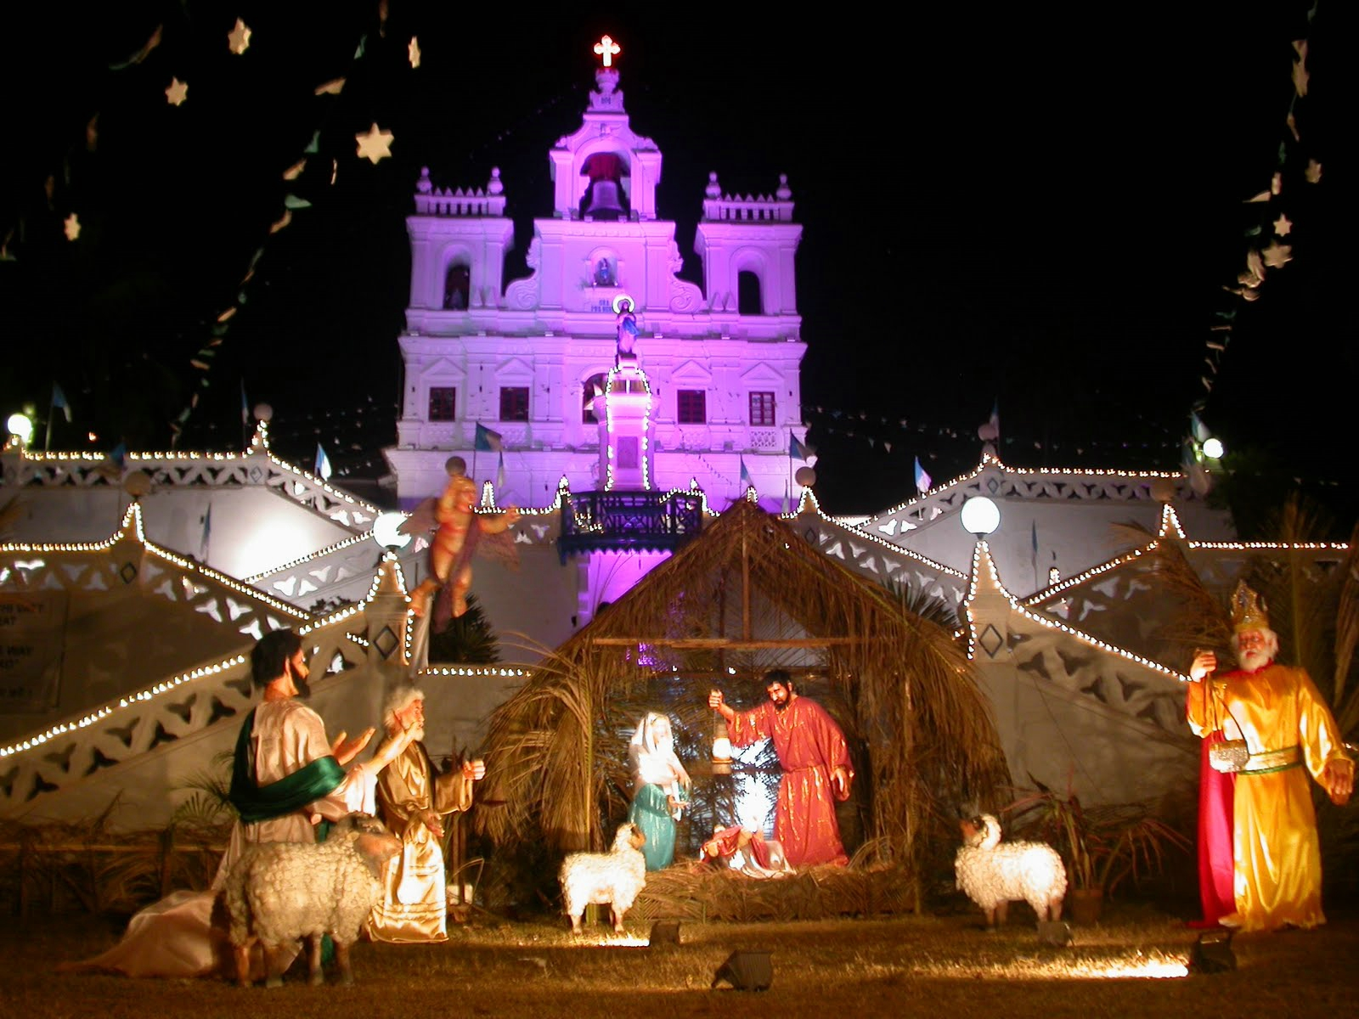
Many different languages are spoken in India. In Hindi Happy/Merry Christmas is 'Śubh krisamas' (शुभ क्रिसमस); Urdu it's 'krismas mubarak' (کرسمس); in Sanskrit it's 'Krismasasya shubhkaamnaa';

Slide 7
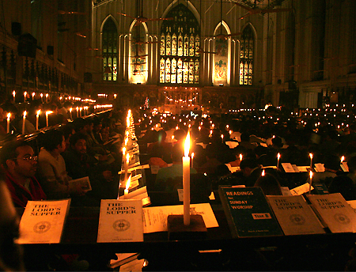
For the Indian Christians, especially the Catholics, the Midnight mass on Christmas Eve is a very important service and has a great religious significance. Every year, on the night of 24th December, all members in Christian families visit their local churches to attend the Midnight mass.

Slide 8
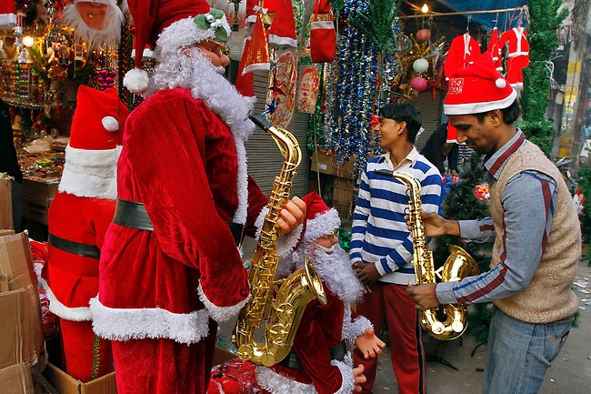
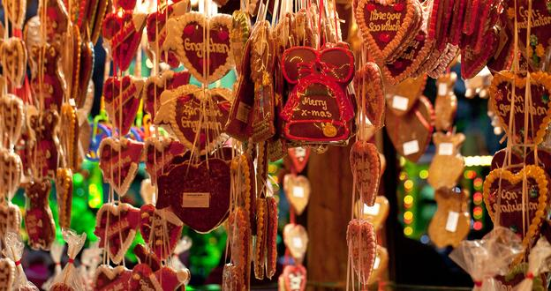
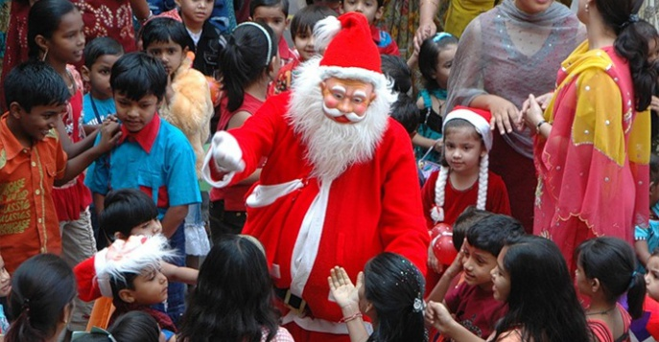
People love parties and with the weather being fine for partying, there is no stopping them. Most parts of India are going through winter in December. Schools are closed and most companies give a Christmas holiday off. It becomes truly a holiday festival.

Slide 9
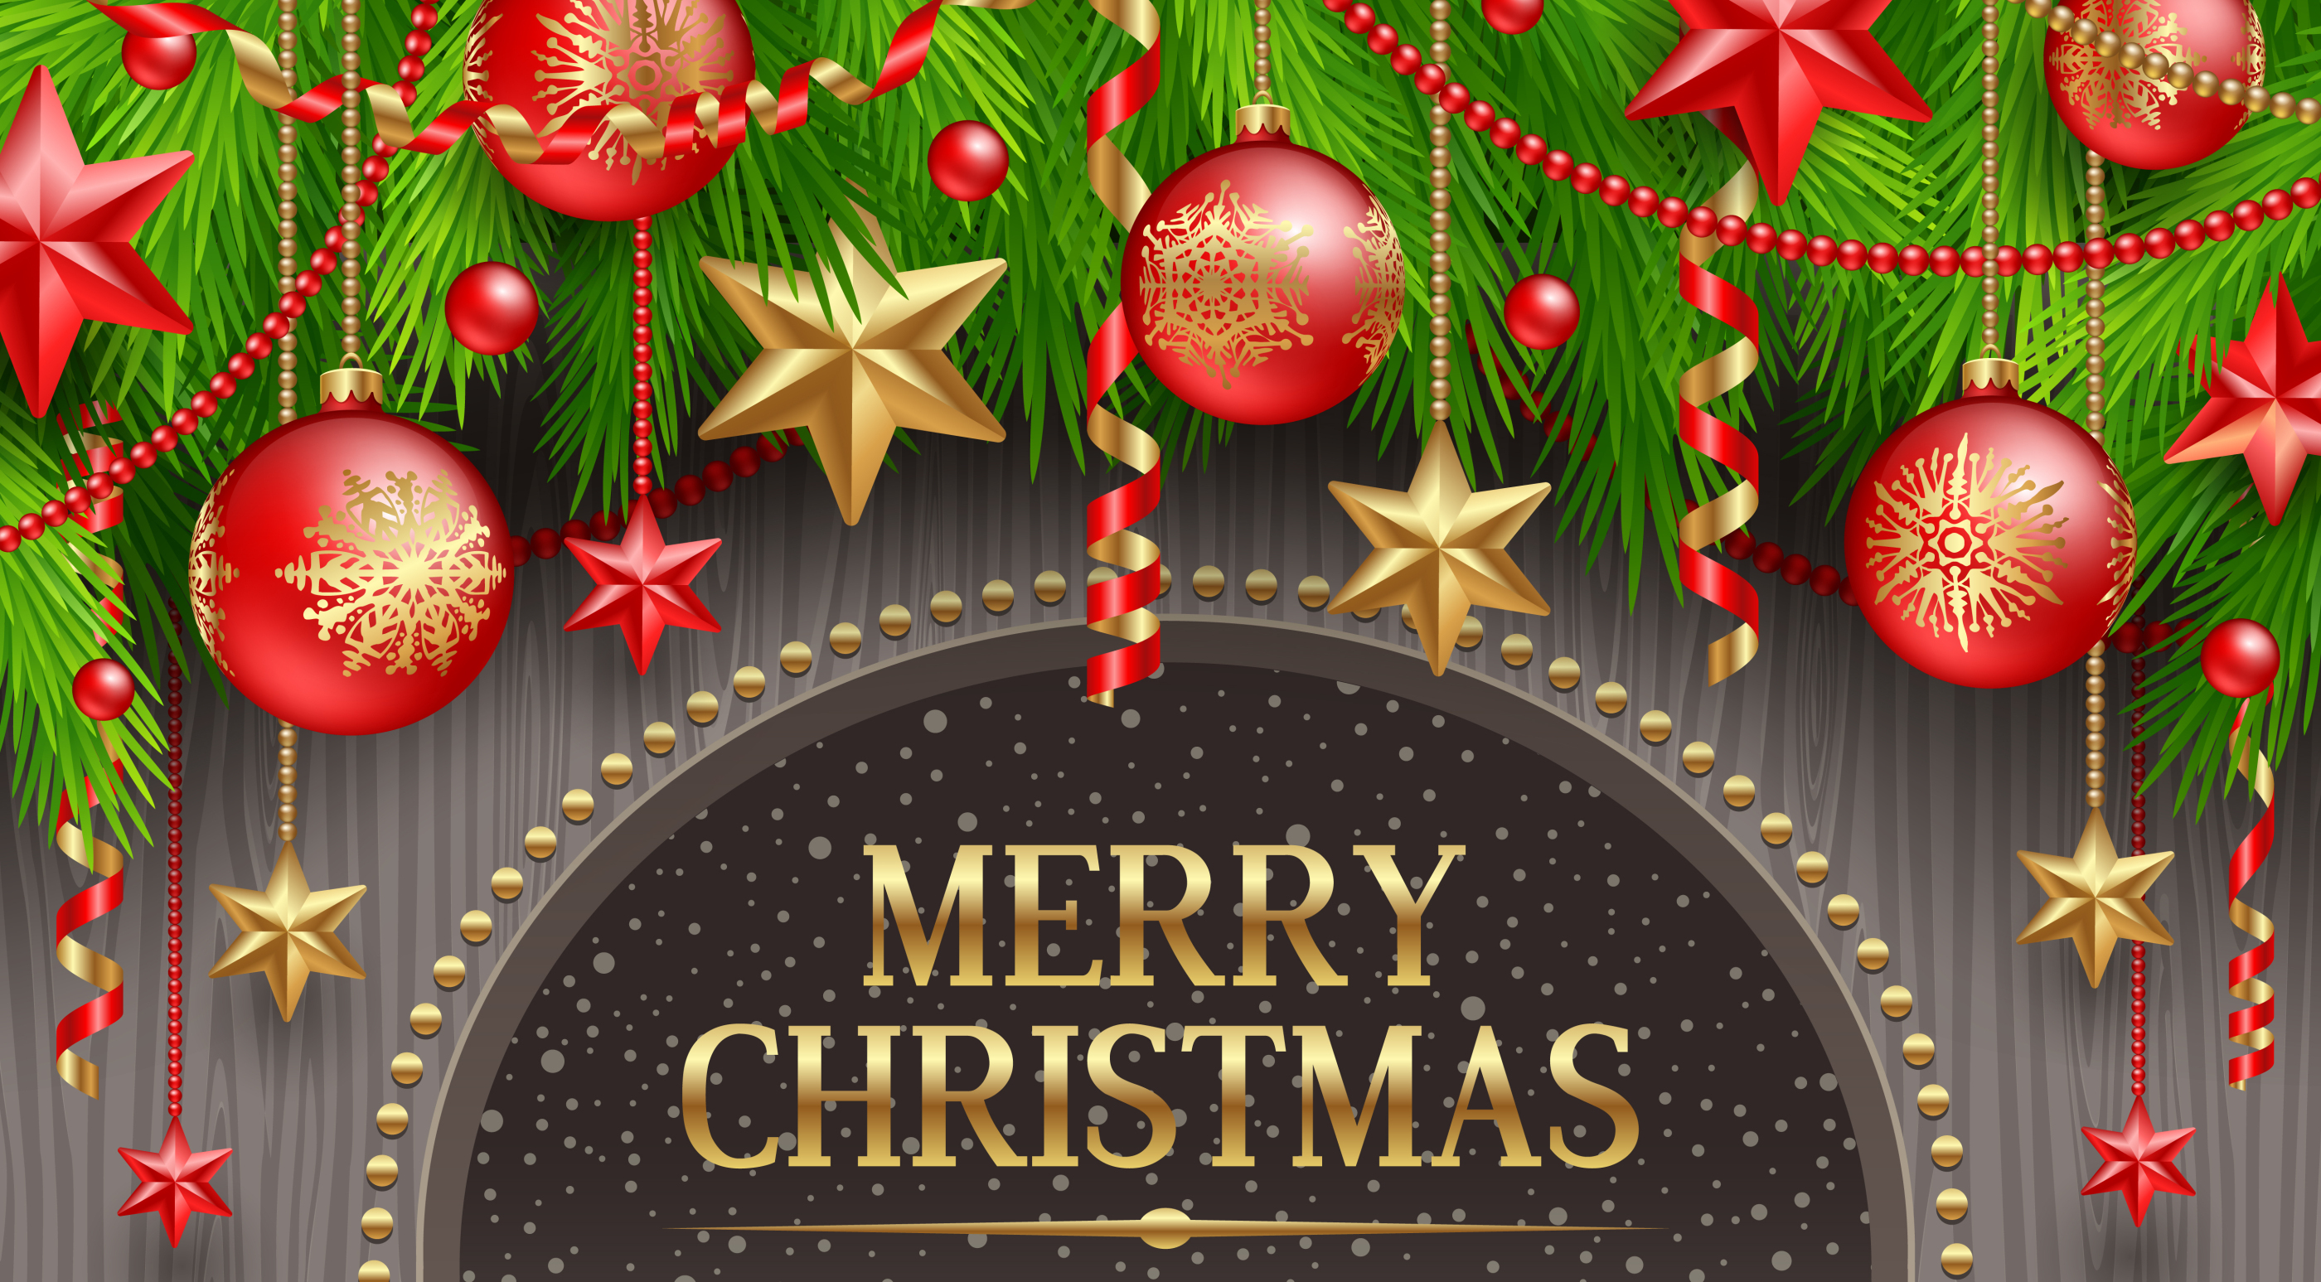
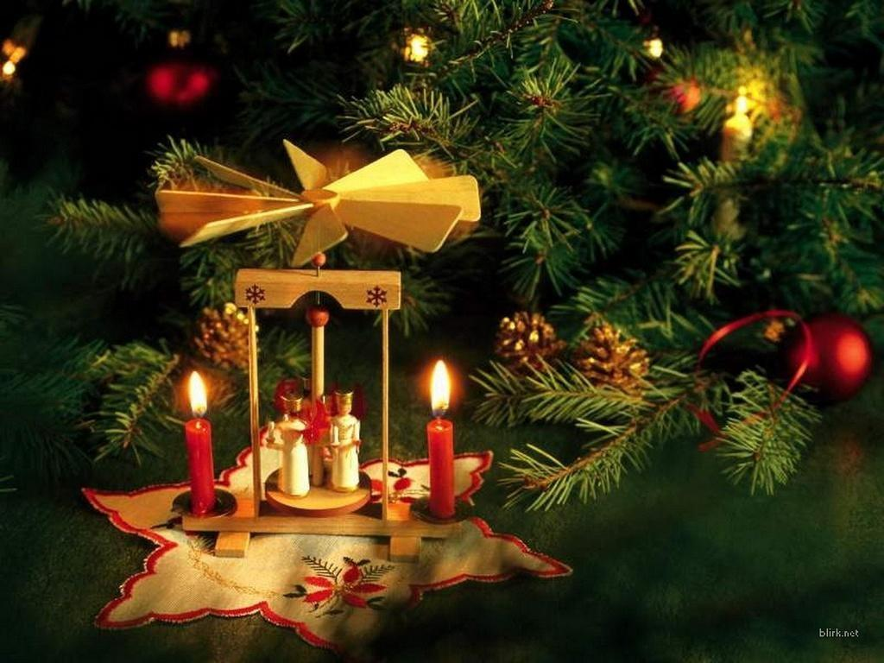
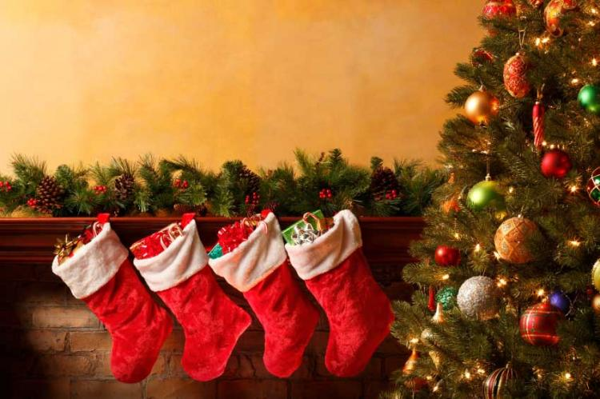
Most houses have an artificial Christmas tree decorated with all the trappings and some create the "nativity scene", as a central part of the decorations.

Slide 10
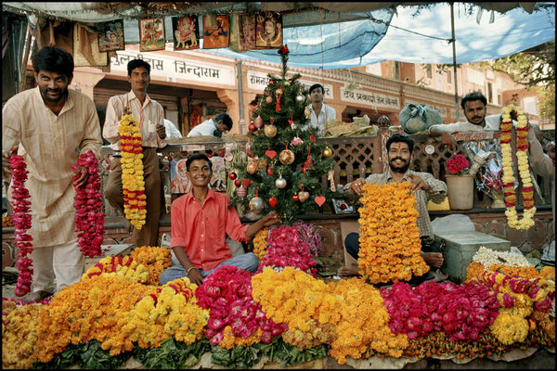
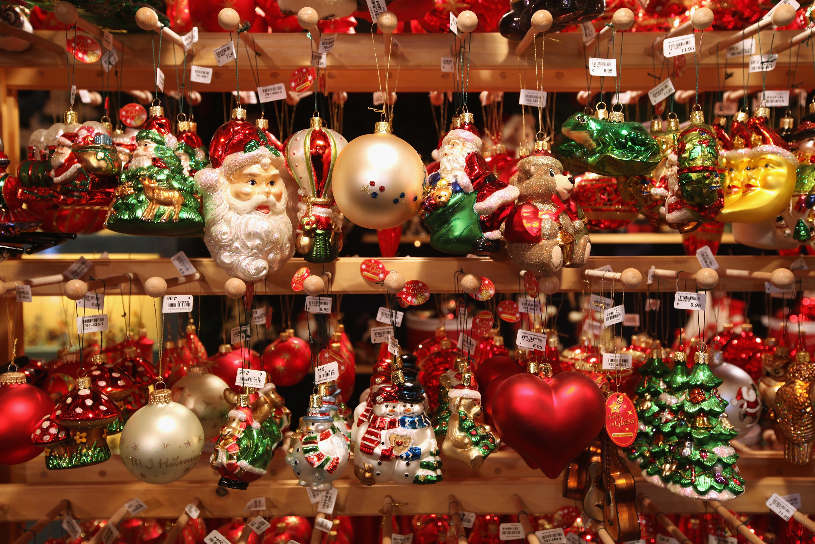
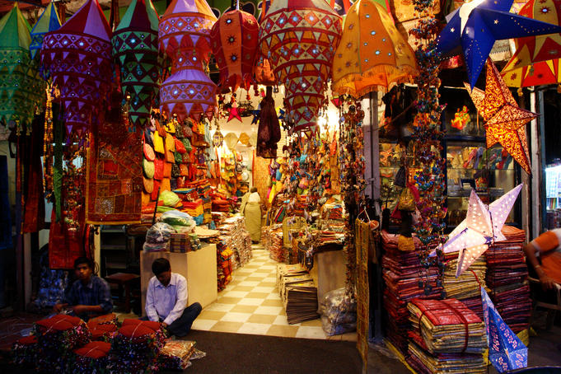
The markets are flooded with the trees and Santa dolls, the whistles, the candy sticks and silver balls and bells. Nothing is missing except for the snow, which is replaced with lots of cotton wool.

Slide 11
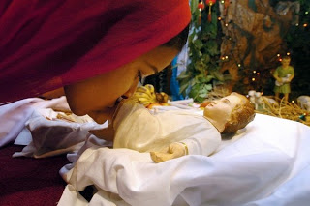
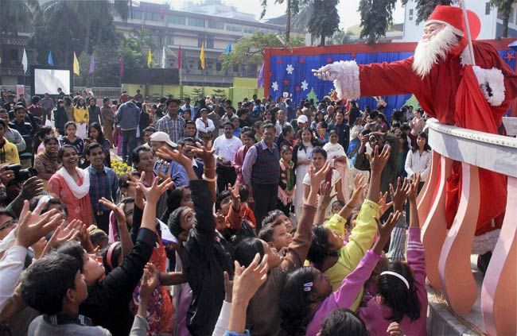
There are still lots of people, old and young alike, in India who secretly believe in Santa Claus as the harbinger* of good times and cheer.
The choir singers singing the Christmas carols, as they go from one street to another before Christmas tolls the bell for goodness.
*Harbinger - предвестник

Slide 12
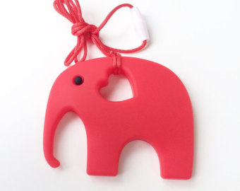
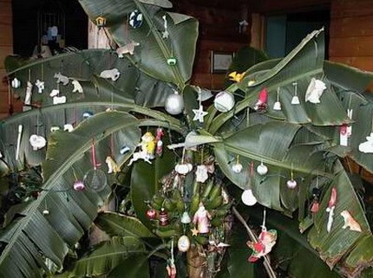
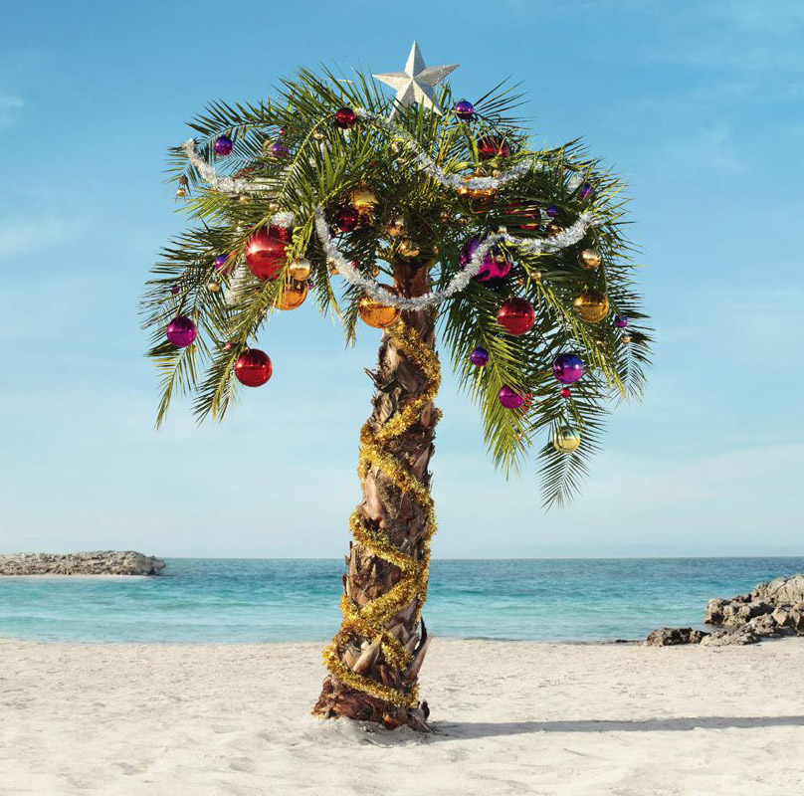
Christmas Tree
According to Christmas tradition, the Indians decorate their houses with the leaves of bananas and palms as well as mango trees - with bananas. Bright elephant toys play the roles of Christmas animals.

Slide 13
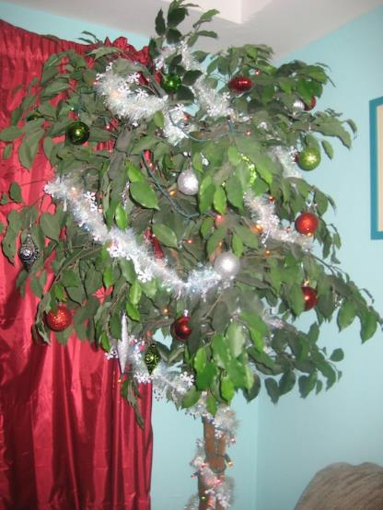
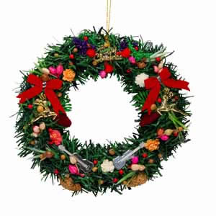
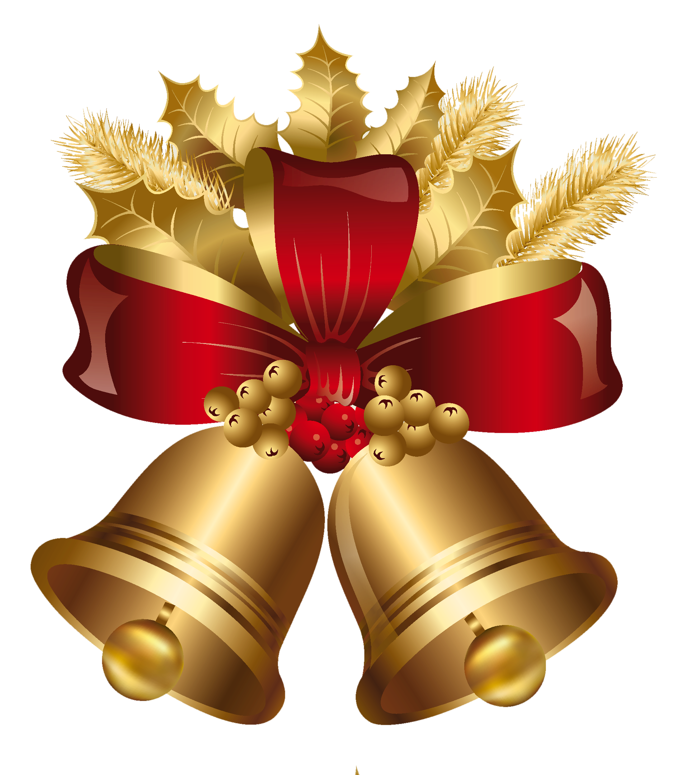
There aren’t any fir trees
in India. Instead of having traditional
Christmas Trees, a banana or a mango tree is decorated (or whatever tree people can find to decorate!). Sometimes people use mango
leaves to decorate
their homes.

Slide 14
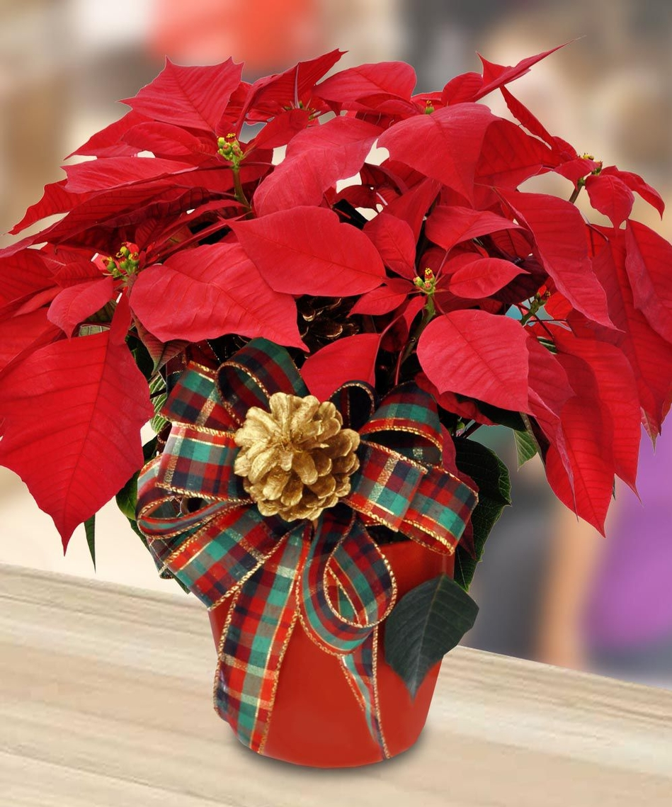
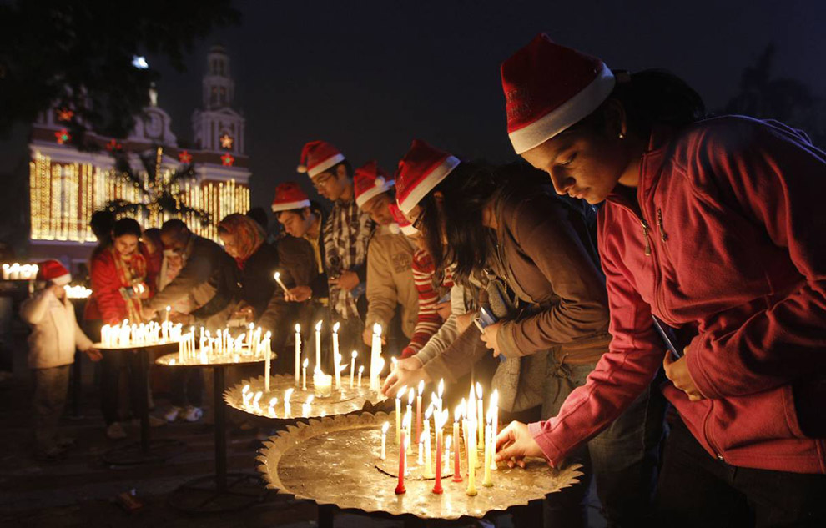
Тhis night,
churches in India are decorated with Poinsettia flowers and candles.

Slide 15
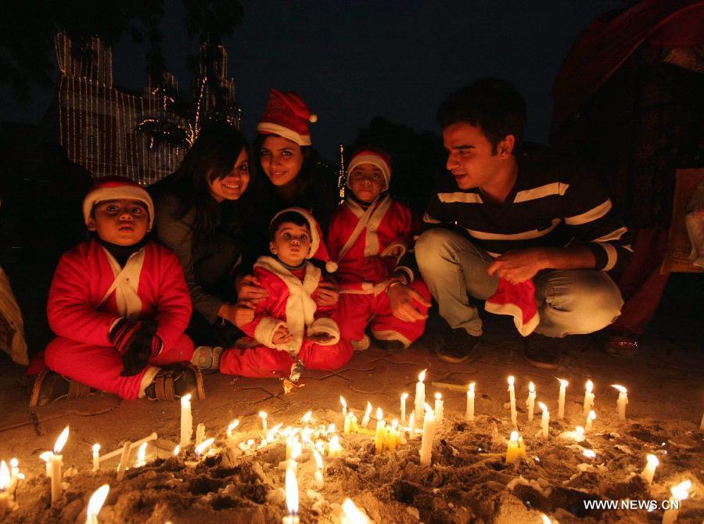
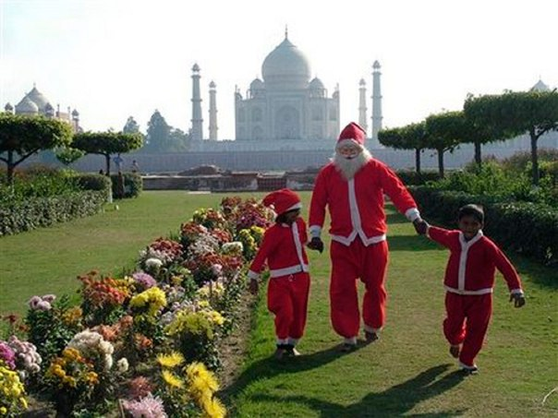
In India, Father Christmas or Santa Claus delivers presents to children from a horse and a cart. He's known as 'Christmas Baba' in Hindi, 'Baba Christmas' in Urdu (both of those mean Father Christmas). Prayers and cheers abound as India celebrates Christmas.

Slide 16
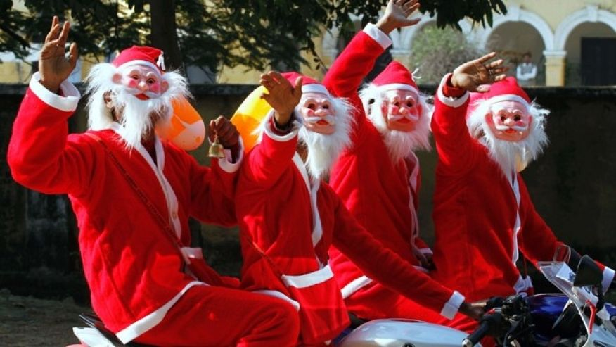
Nowadays Indian Santa Clauses have changed their horses (not deer!) to motorbikes!

Slide 17
The Indian Santa Claus doesn’t look like the European one.
It can be an old Indian or a young student dressed in Santa Claus’s costume.

Slide 18
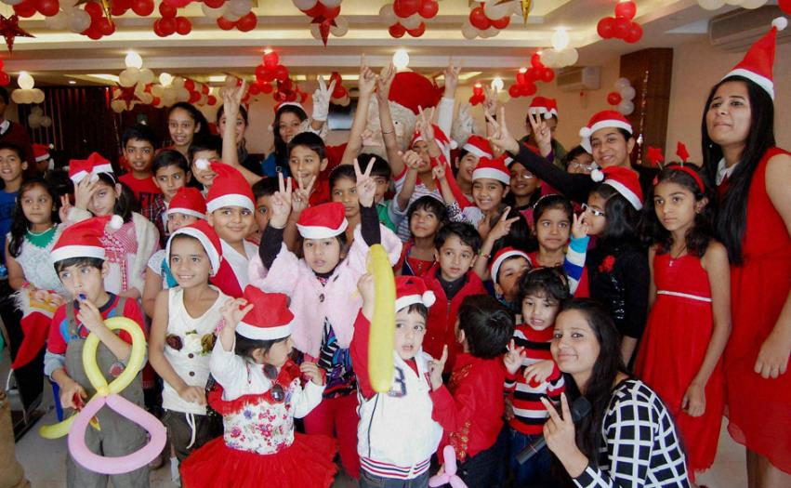
In India, Father Christmas or Santa Claus is held to be the giver of presents to children. As in the US, he is believed to deliver presents at the house of every kid who behaves well during the whole year.
.

Slide 19
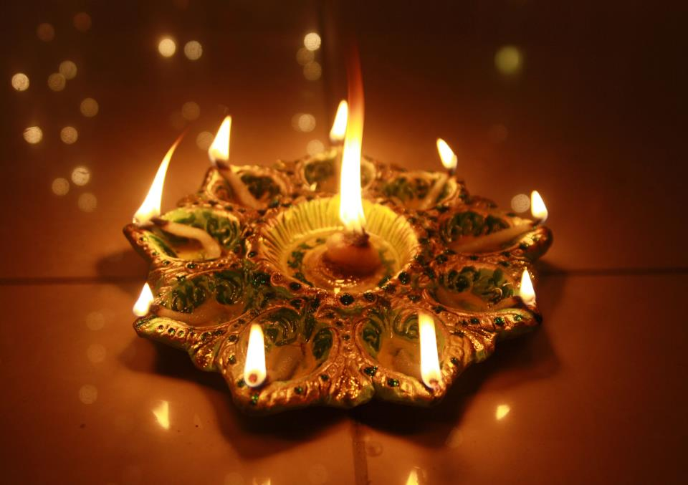
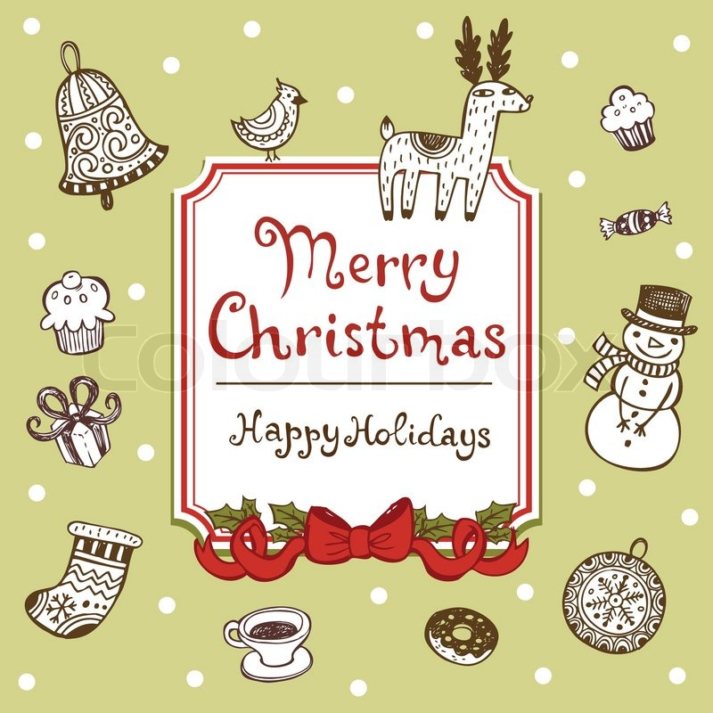
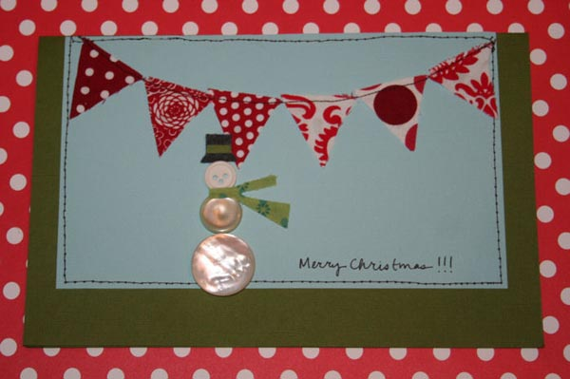
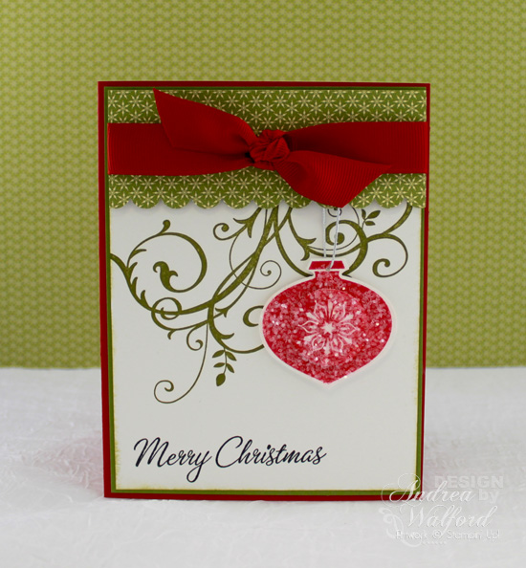
Christmas Preparations
Exchanging messages, greeting cards and gifts are part of Christmas and the New Year celebration.
The age-old tradition of planning new resolutions for the coming year is a common sight. A few of the most popular resolutions include losing weight, developing good habits, and working hard.

Slide 20
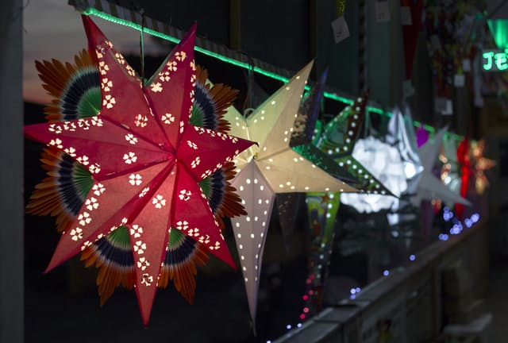
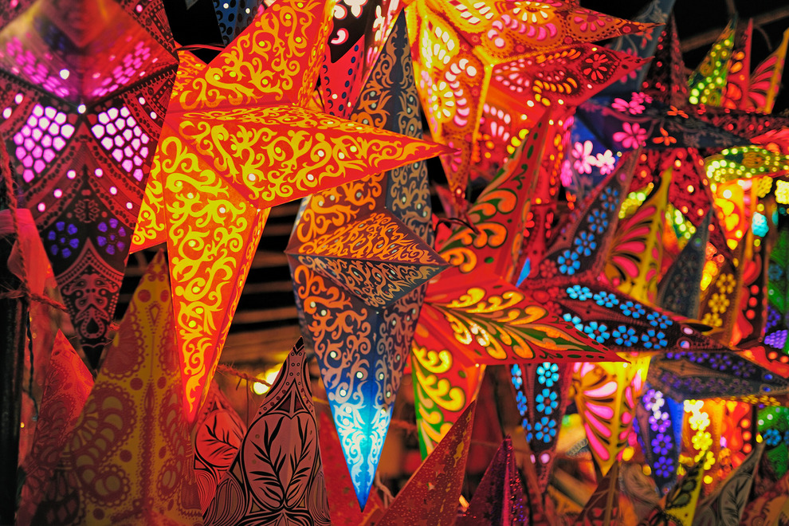
Giant Paper Lanterns
At Christmas Eve Christians
in Goa hang out giant paper lanterns, in the shape of stars, between the houses so that the stars float above you as you walk down the road.

Slide 21
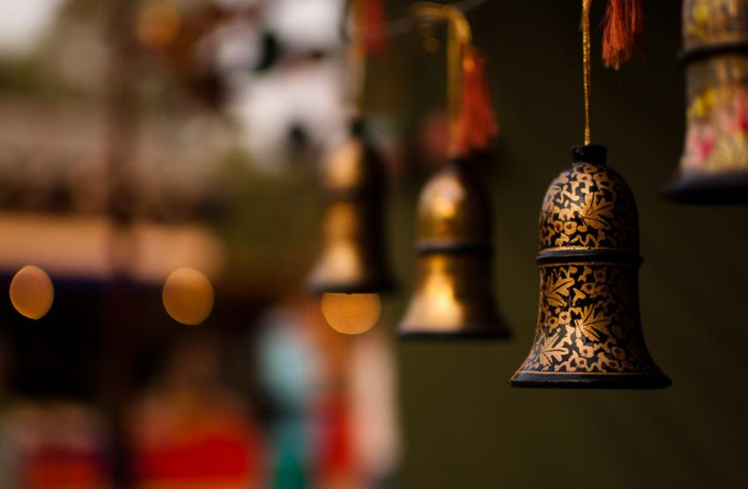
Delhi bells made of Kashmir paper-mache is also one of cute little things symbolizing Indian Christmas.

Slide 22
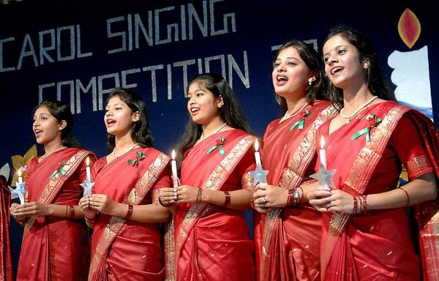
Carol Singing
Carol singing and sending cards are a must for every educated Indian. Christmas carols spread holiday cheer from door to door with charming beautiful songs.

Slide 23
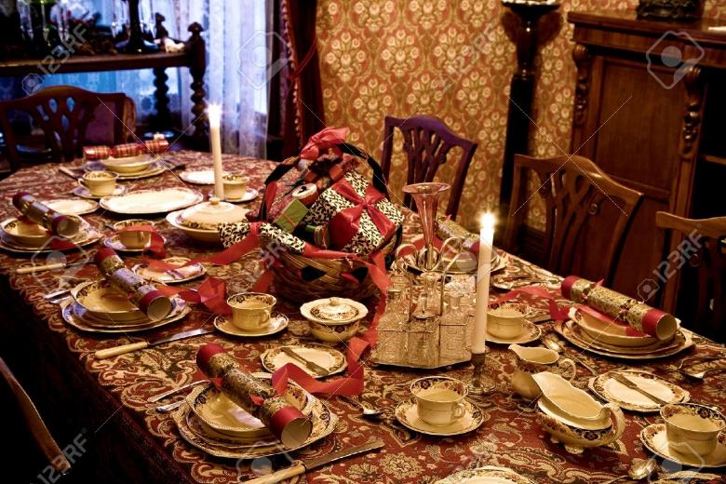
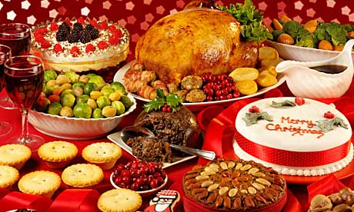
Formal
Christmas
Table
Settings
There is a festive mood and the usual motto is
"eat, drink, dance and celebrate”.

Slide 24
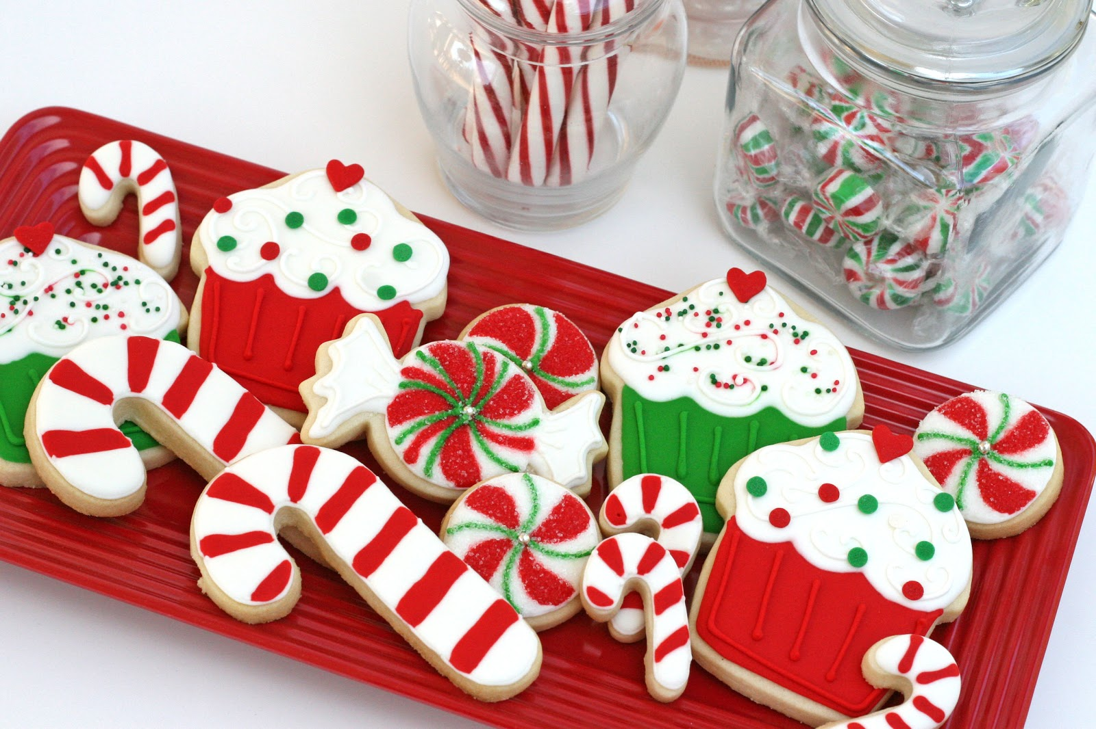
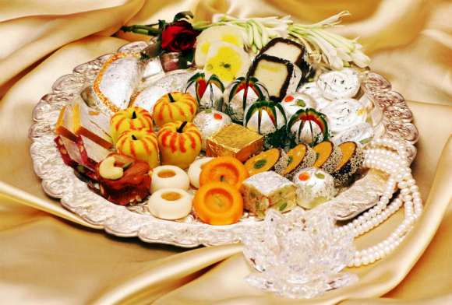
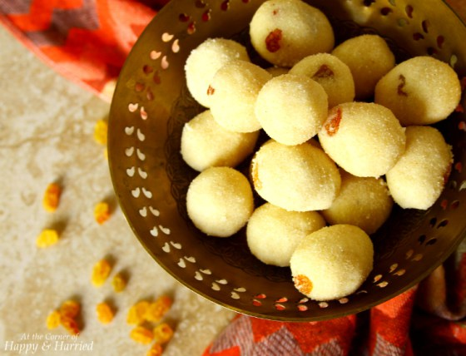
Baking Christmas cookies is one of Christmas traditions in India. Christmas sweets — mainly originating from Goa and adapted in the rest of
the country — are traditionally called "kuswar”. Making these sweets is a family affair.

Slide 25
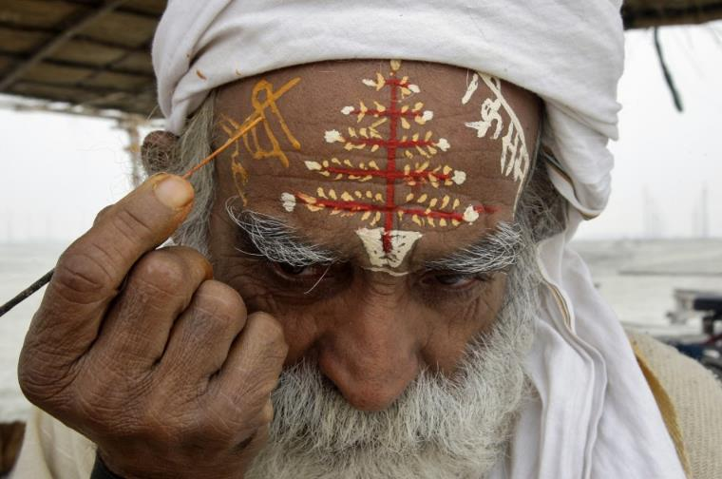
Everybody wishes a Merry Christmas and a Happy New Year.
One of the Indian citizens is writing New Year’s wishes on his forehead.

Slide 26
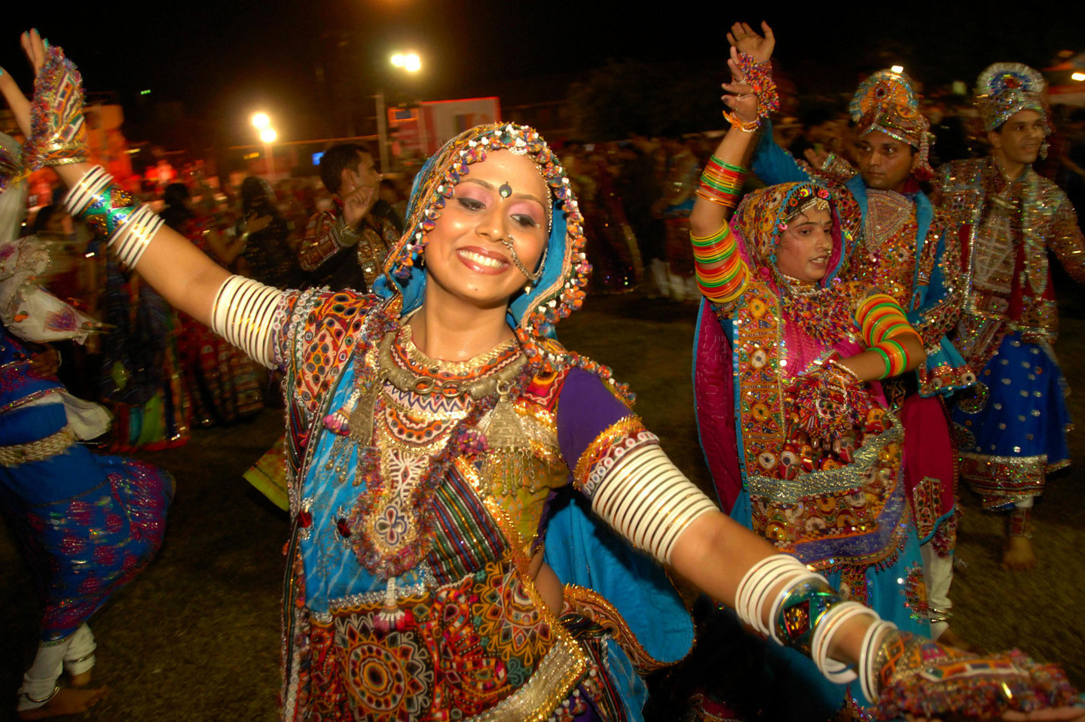
Parties and dancing is an integral part of the festivities, and
many Indians participate in them wholeheartedly.

Slide 27
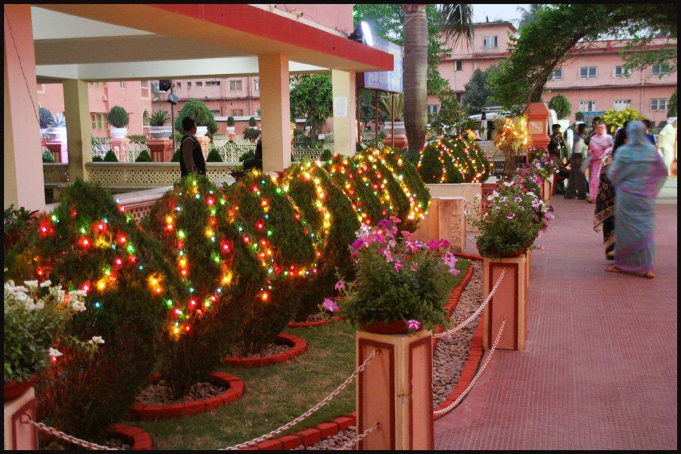
You shouldn’t be unpleasant or irritated on the first day of a New Year. The mood on this day determines the whole year.

Slide 28
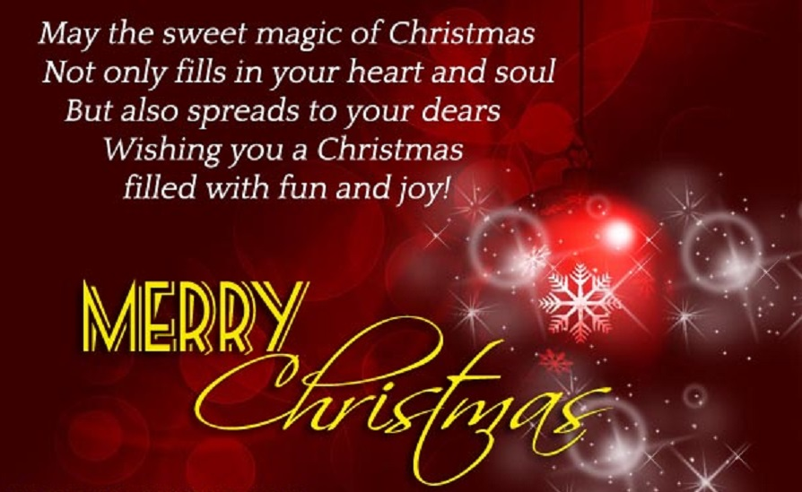
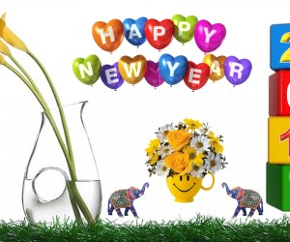
Christmas Cards
There are a lot of Christmas cards and greetings in India as well as in Europe.

Slide 29
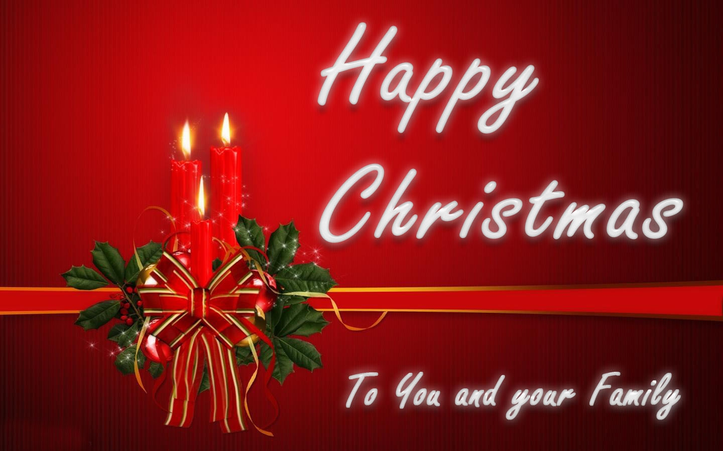
On the Christmas season wishing for others with greeting cards is considered one of the easiest and simple ways.
Indians add more joy to the wonderful festival of Christmas by sharing beautiful Merry Christmas cards with their families and friends.

