Slide 1
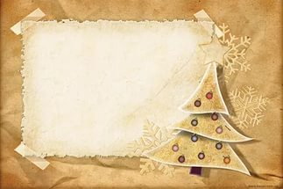
CHRISTMAS
SEASON IN AUSTRALIA
By T.V. Kosormygina
“Sosny” school
December, 2016

Slide 2
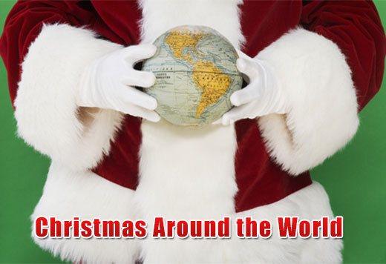
Christmas is one of the biggest
celebrations for the people belonging to the Christian faith. But it would be wrong to assume that it is only celebrated among the Christians.

Slide 3
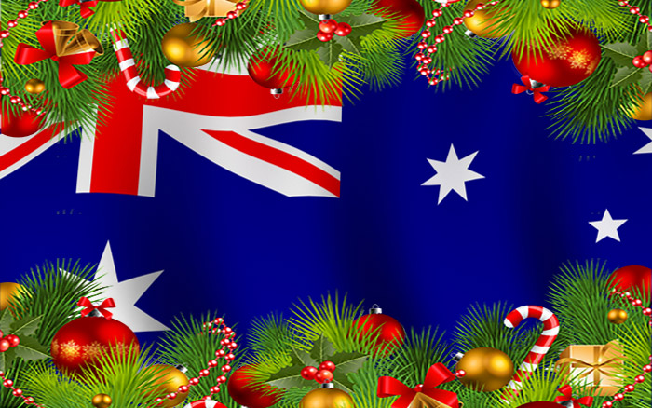
With the world becoming a global village, Christmas is now celebrated in many countries around the world. Caroling, feasting, and gift-giving along with prayers and wishing Christmas is celebrated with high spirits in different parts of the world.

Slide 4
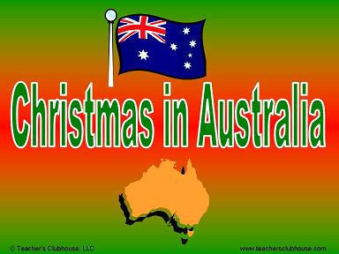

Slide 5
Christmas in Australia happens to be in summer and during the long 6-week vocation from school. However, they try their best to deny the reality of a summer Christmas.
Most of the Australian families spend a large part of the day at the beach. You'll find a lot of kids there playing with their new surfboards, building sand-castles rather than snowmen.

Slide 6
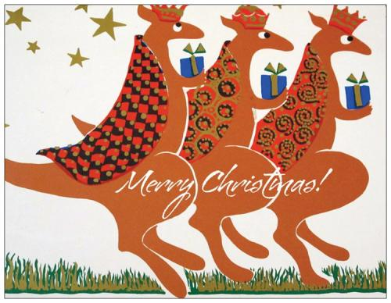
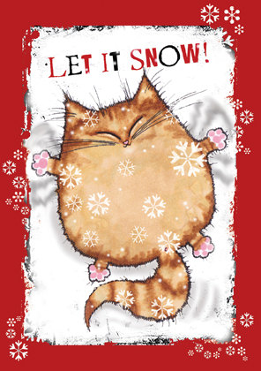
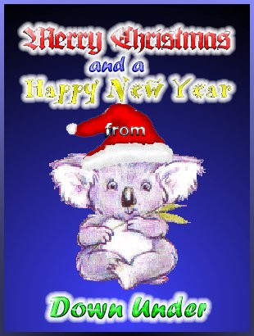
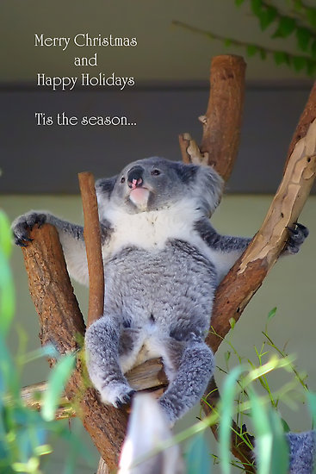
Christmas cards
Christmas cards are not as popular as they are in the Northern Hemisphere, so don't be offended if you
don't get any.

Slide 7
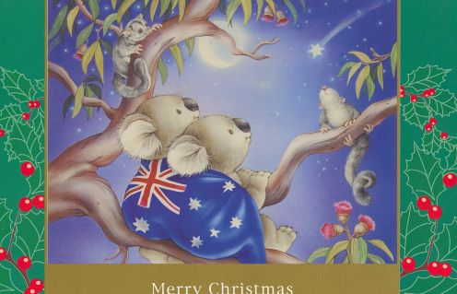
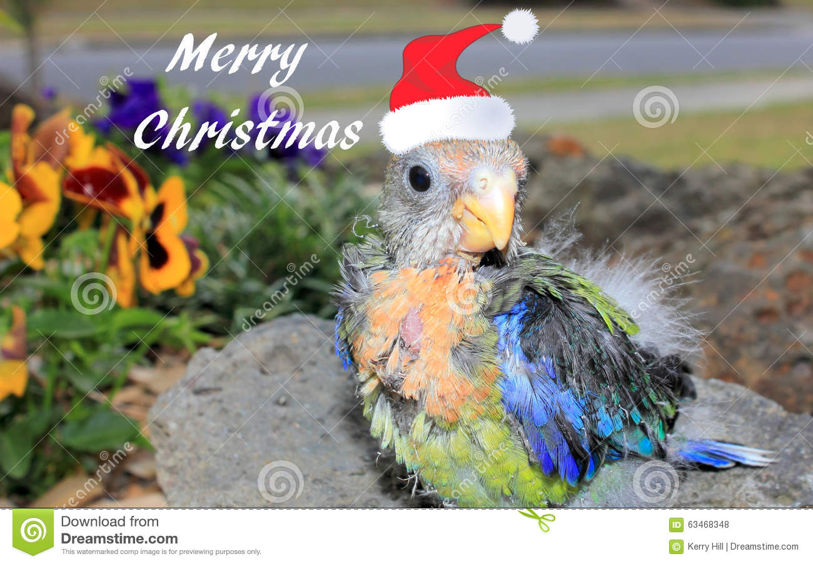
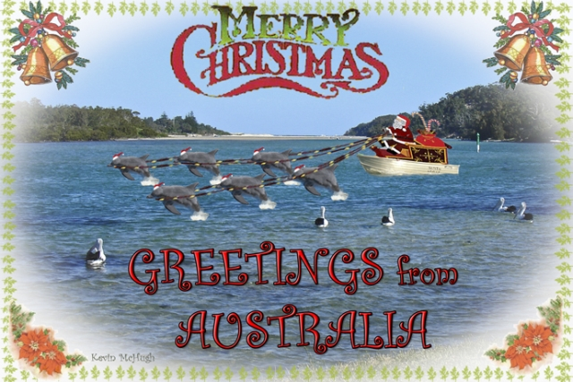
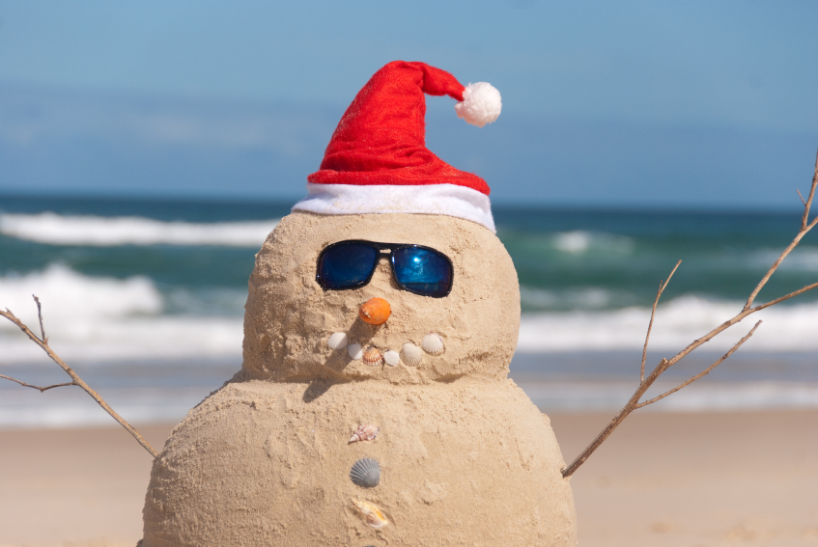
Publishers print Christmas cards with native Australian animals and landscape.

Slide 8
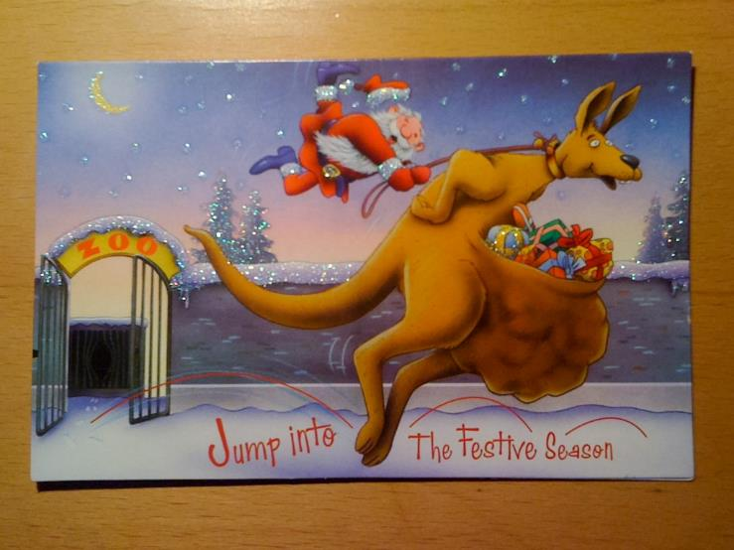
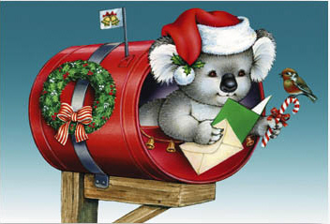
Austrailians see themselves as inhabitants of the Asian Pacific region. So Christmas has got an Australian identity. You can hardly find a snowflake on Christmas cards these days, but there are still some.

Slide 9
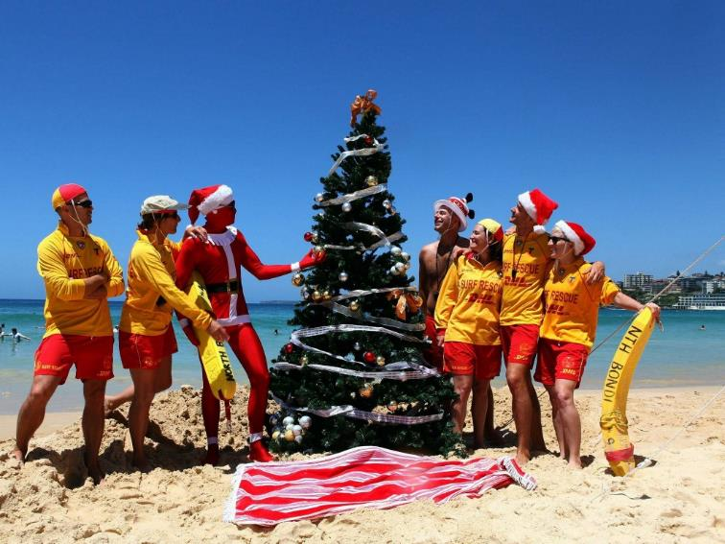
Now they have their own Christmas in Australian style. People try to recreate the kind of Christmas that they used to have in Europe. Indeed one of the most typical Australian Christmas presents is a beach towel.
Christmas presents

Slide 10
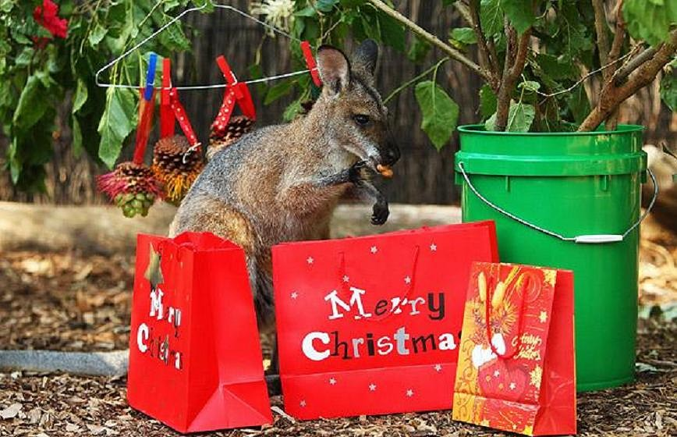
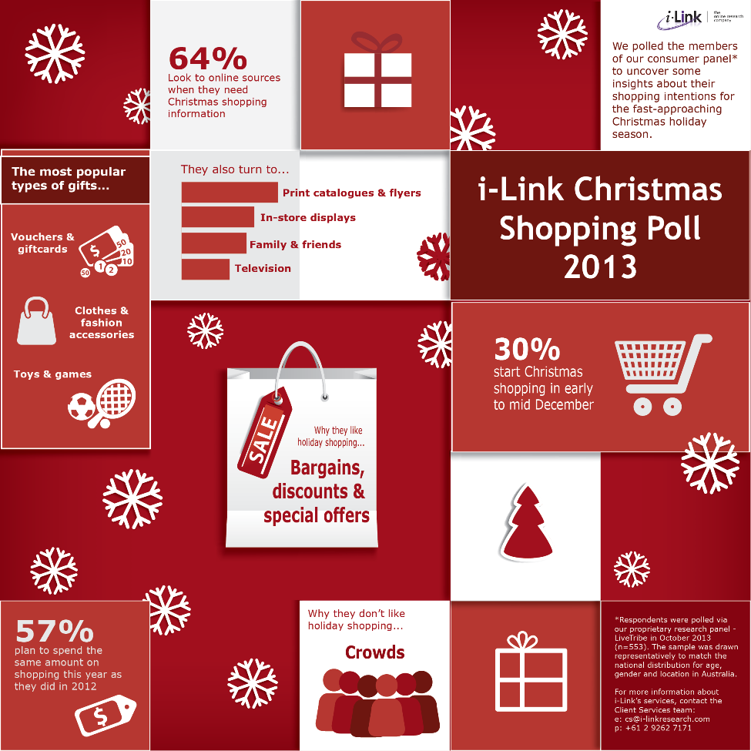
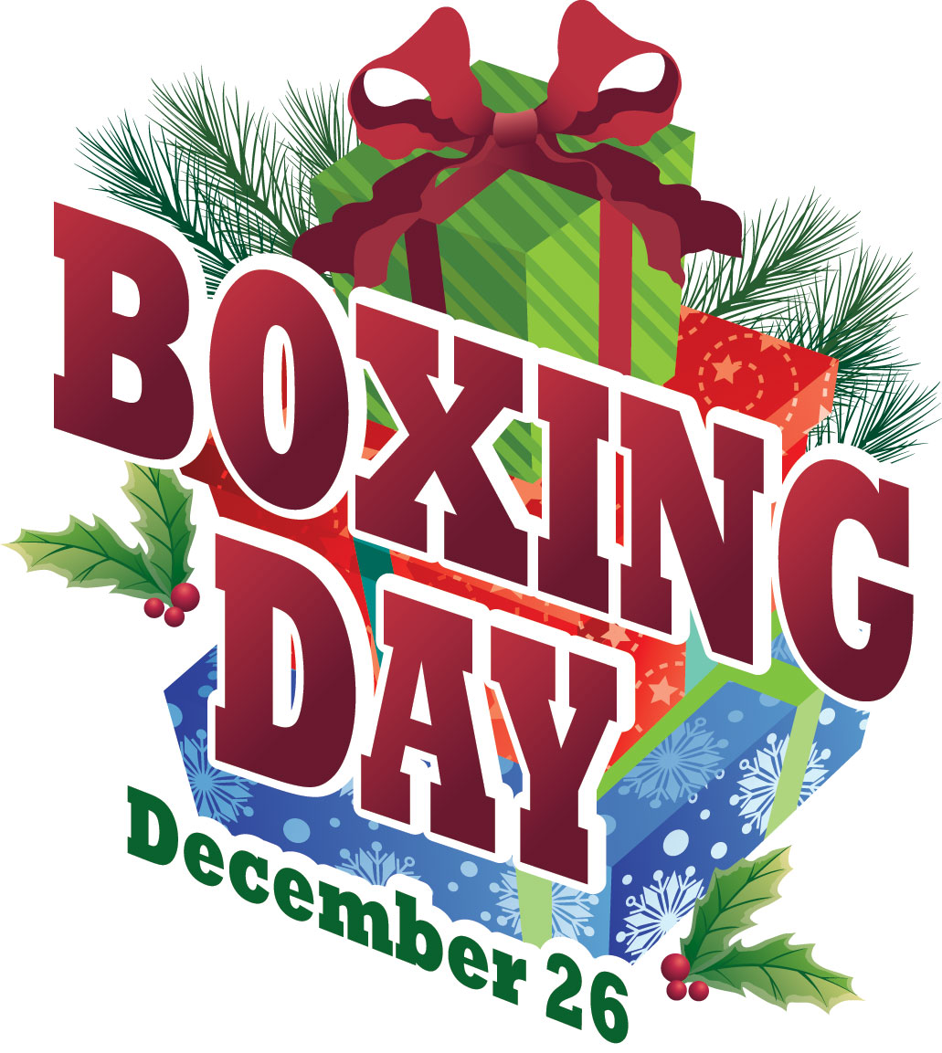
Christmas shopping
This is the busiest time of the year for retailers as shoppers buy gifts and all the other trappings of Christmas.

Slide 11
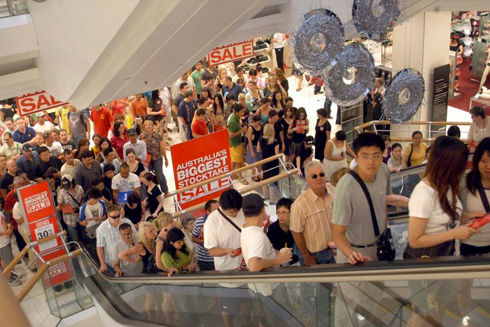
Boxing Day = Shopping Day
The day after Christmas is called 'Boxing Day.' And when you've recovered from all the food and presents, it's time to set your alarm early to join the stampede* of shoppers looking to grab a bargain at Boxing Day sales.
Crowds queue in a Brisbane department store moments after doors opened for the Boxing Day sales
*stampede – массовая давка

Slide 12
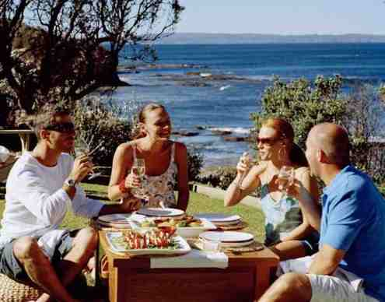
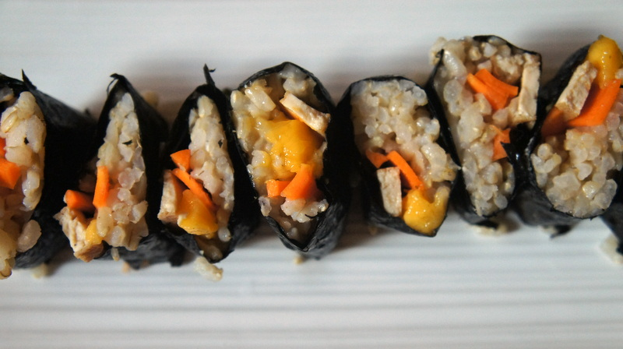
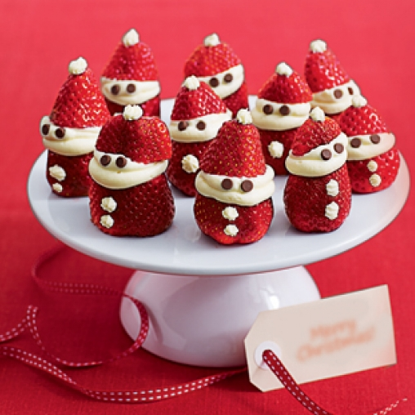
Christmas
food
On Christmas Day family and friends gather to exchange gifts and enjoy special Christmas food. A typical Christmas menu includes seafood, glazed ham, cold chicken, duck or turkey, cold deli meats, pasta, salads galore, desserts of all types, fruit salad, pavlovas and ice-creams.

Slide 13
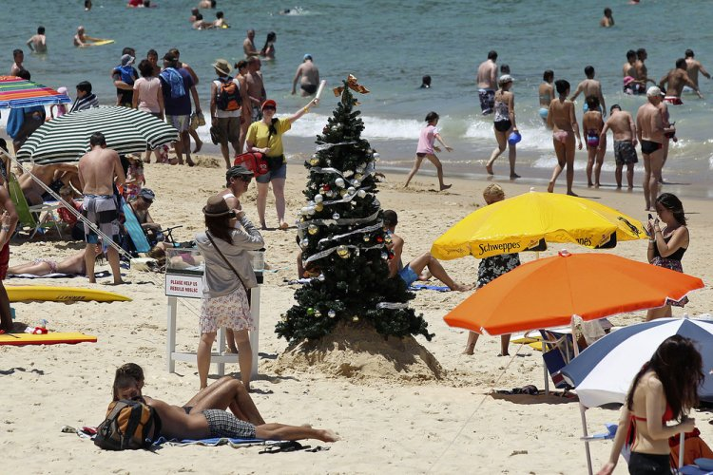
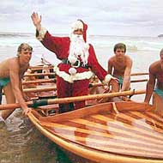
It's not only food and gifts that differ Australian Christmas from the European holiday. The weather impacts the hot atmosphere of Christmas. Most families prefer to stay outdoors in shorts and T-shirts and go to the beach.

Slide 14
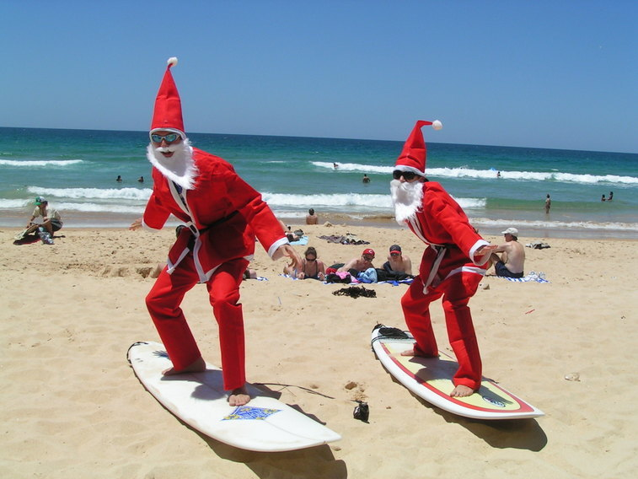
Most Australians have been dreaming of a white Christmas for centuries. But the traditional European Christmas is just a myth for Australians. Santas wearing thick wool clothes don't fit with Australia's thirty-degree heat.

Slide 15
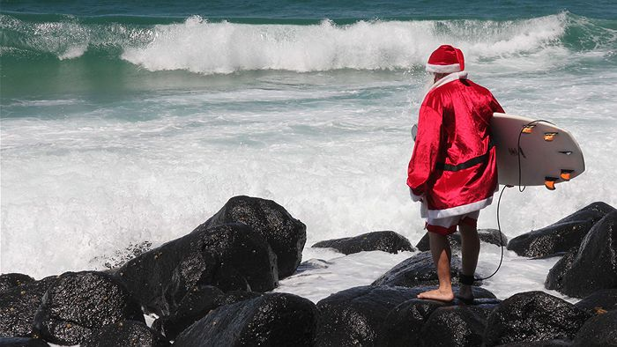
A summer Christmas means heading to the pool or the beach to keep cool - yes, even for Santa. Many Australians go to the coast for summer holidays.

Slide 16
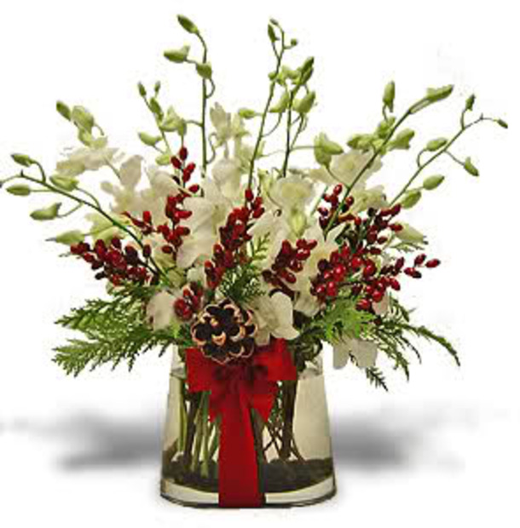
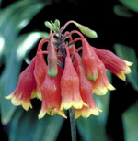
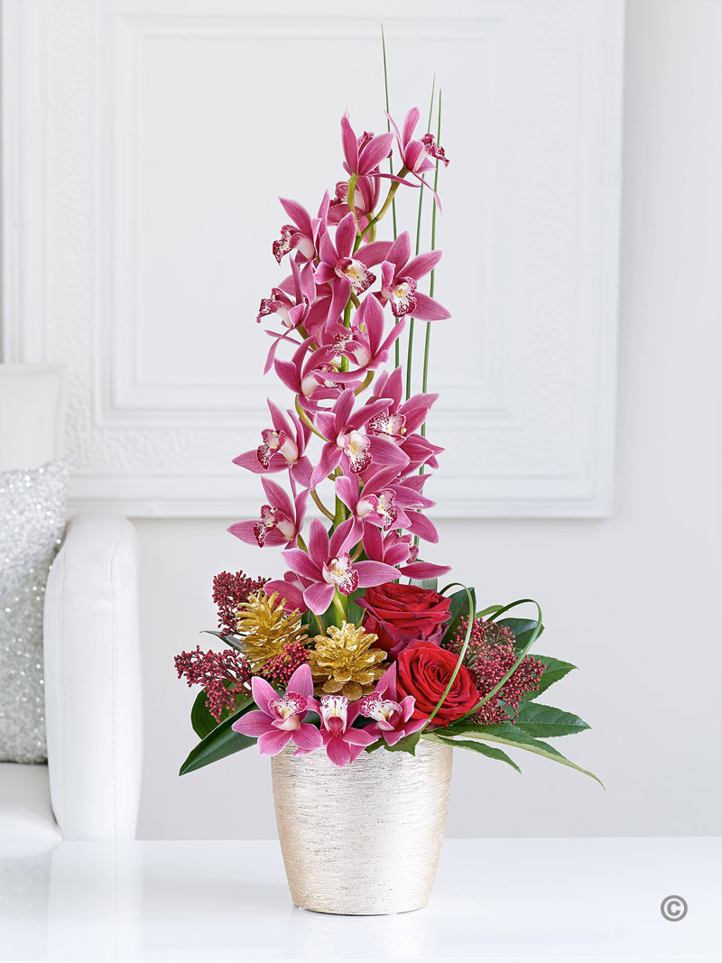
Christmas
plants
There are many native Australian plants in blossom over the Christmas season. A number of these have become known as 'Christmas plants' in various parts of the country, including Christmas bells, Christmas bush and the Christmas orchid.

Slide 17
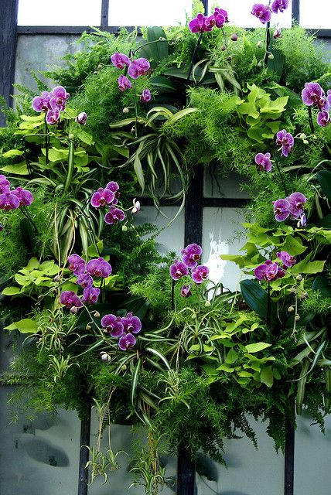
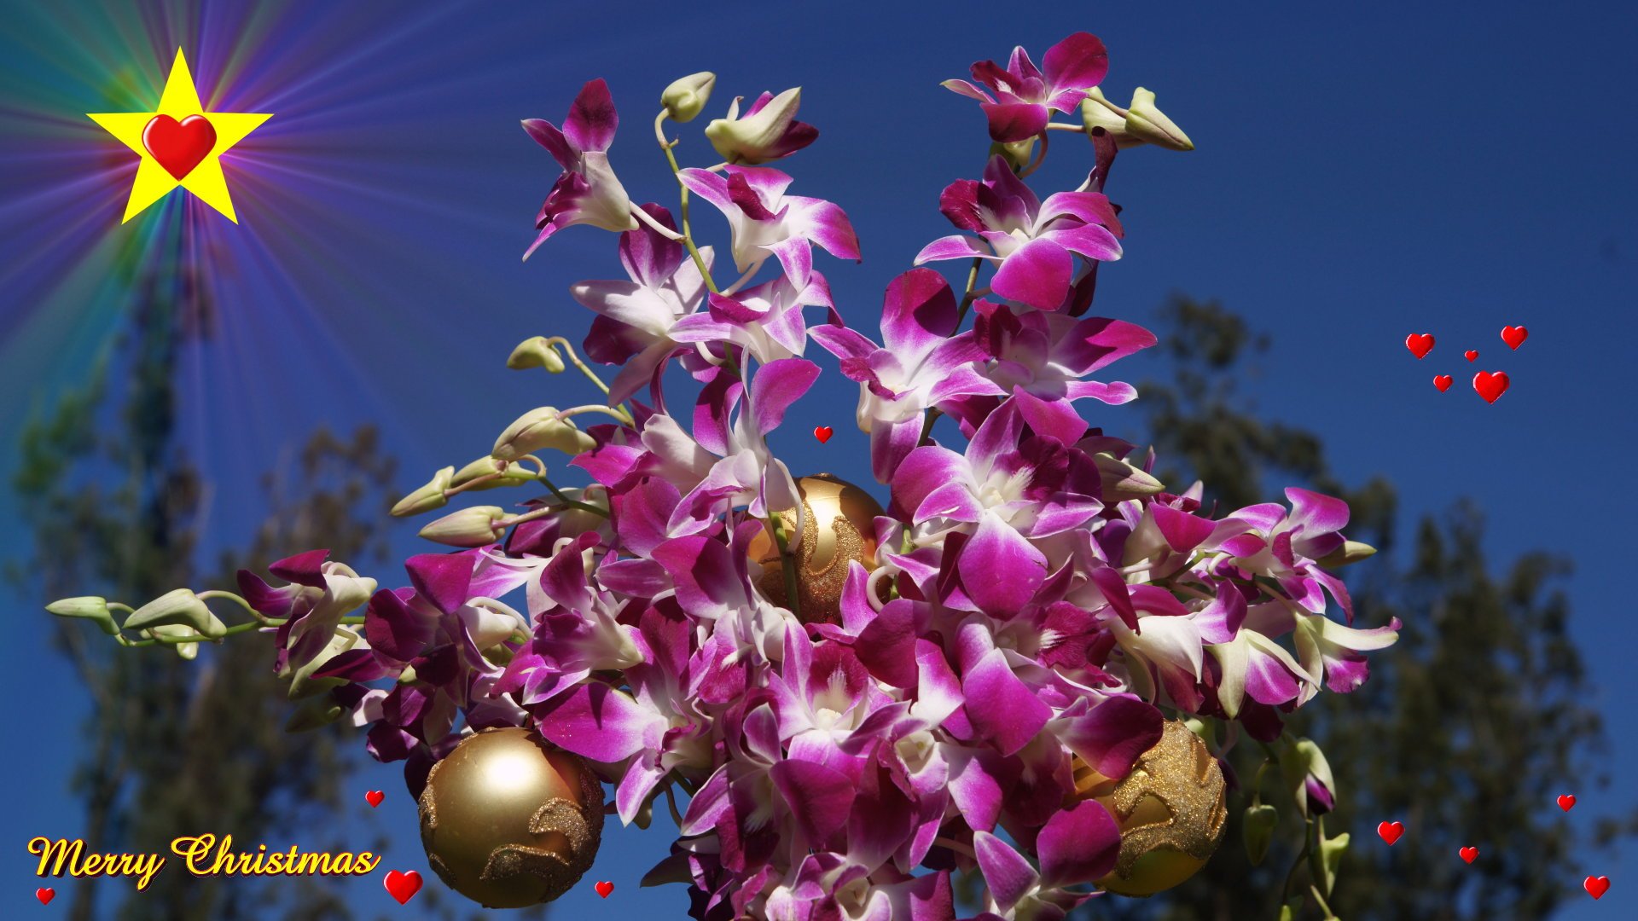
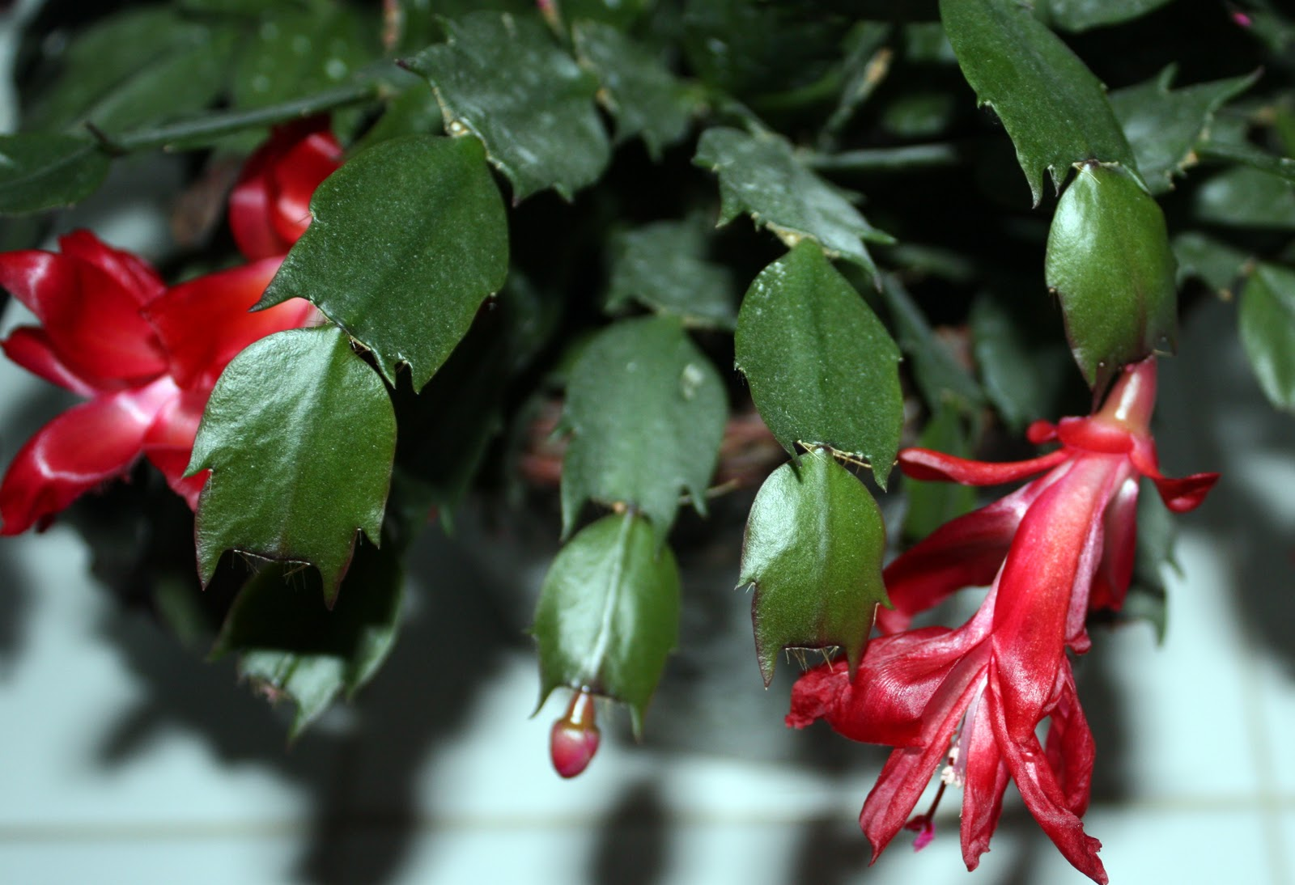
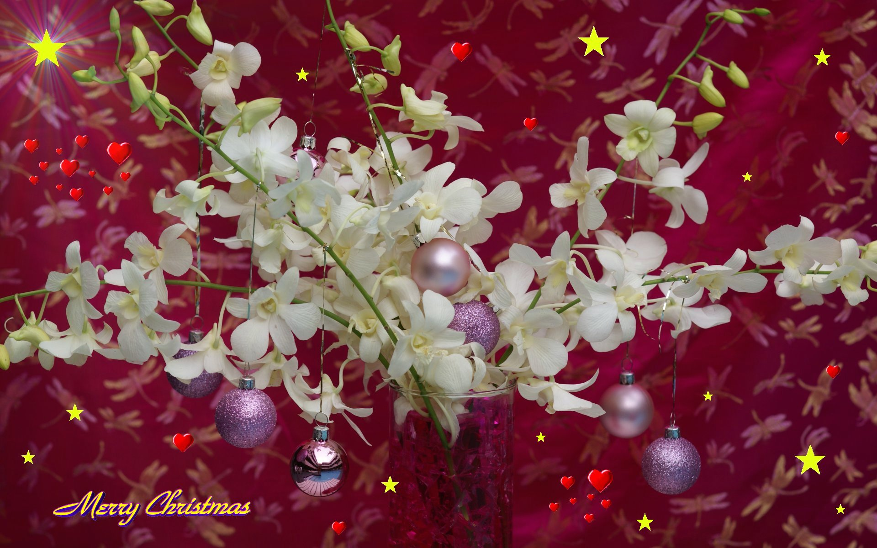
Orchid
Christmas
wreaths
and
decorations
Look! What is this?

Slide 18
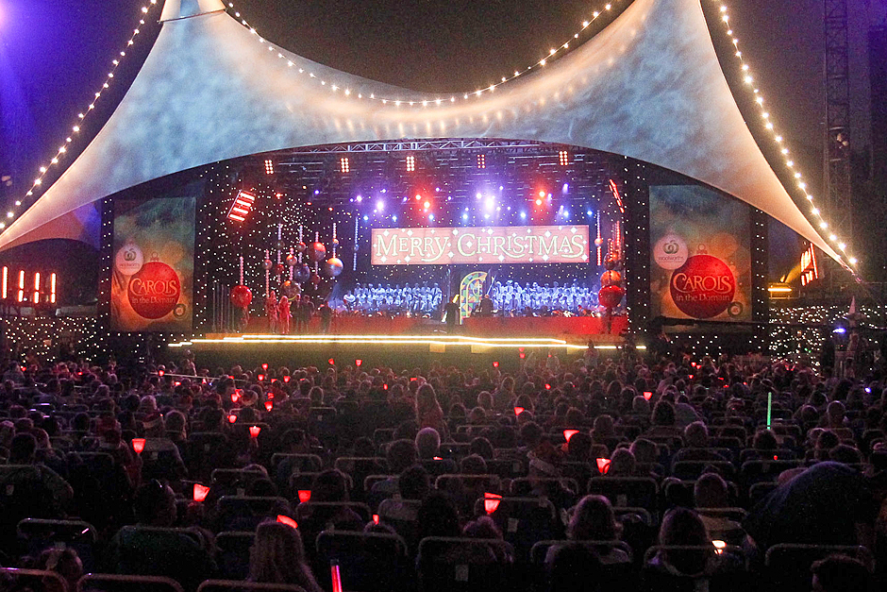
Carols by candlelight
There are some traditions in the Southern Hemisphere. Australia may have adopted winter Christmas customs of Santa and his reindeer, meals of roasted meat and vegetables, but there is one tradition that Australians claim as their own - carols by candlelight.
Every December carol singing by candlelight takes place in parks and gardens throughout Australia.

Slide 20
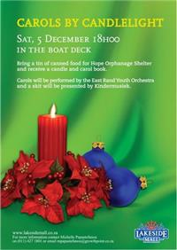
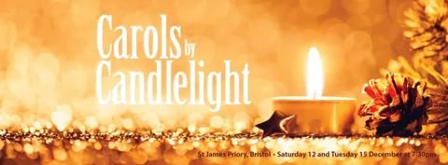
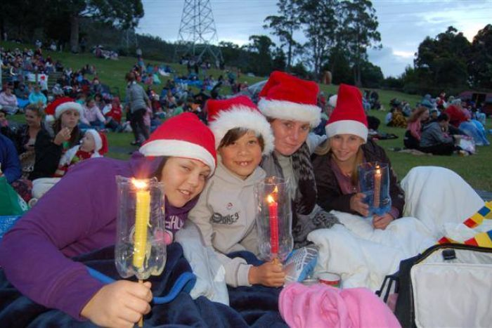
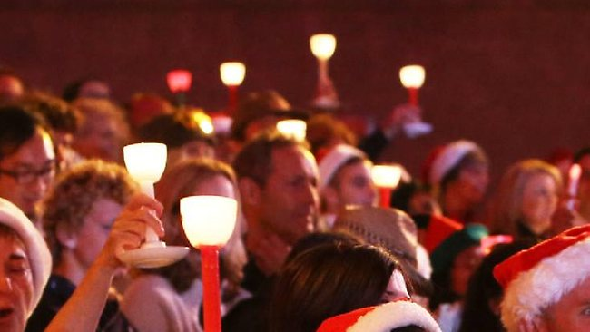
Carols by candlelight evenings are now held throughout urban and regional Australia with many councils, community and church groups involved and raising money for charity.
Youngsters at Carols by Candlelight in
Glenorchy, Tasmania

Slide 21
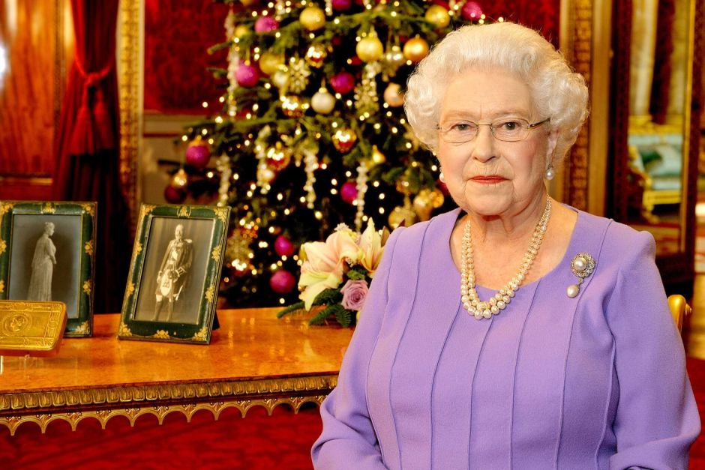
Annual Christmas Message
Australia remains part of the Commonwealth, meaning each Christmas night is punctuated by the broadcast of Queen Elizabeth's Christmas Day message. The Christmas speech is one of the rare occasions when Queen Elizabeth, whose role is mainly symbolic, is able to voice her own views without consulting government ministers.

Slide 22
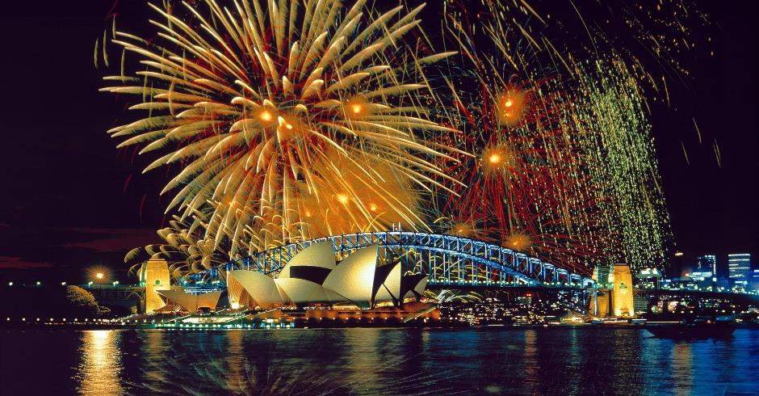
New Year in Australia
People in Australia don’t pay much attention to the celebration of a New Year. In Sydney, the start of the New Year is heralded by a huge fireworks display.
For many people, New Year's Day is a time to recover from New Year's Eve parties the evening before.
.

Slide 23
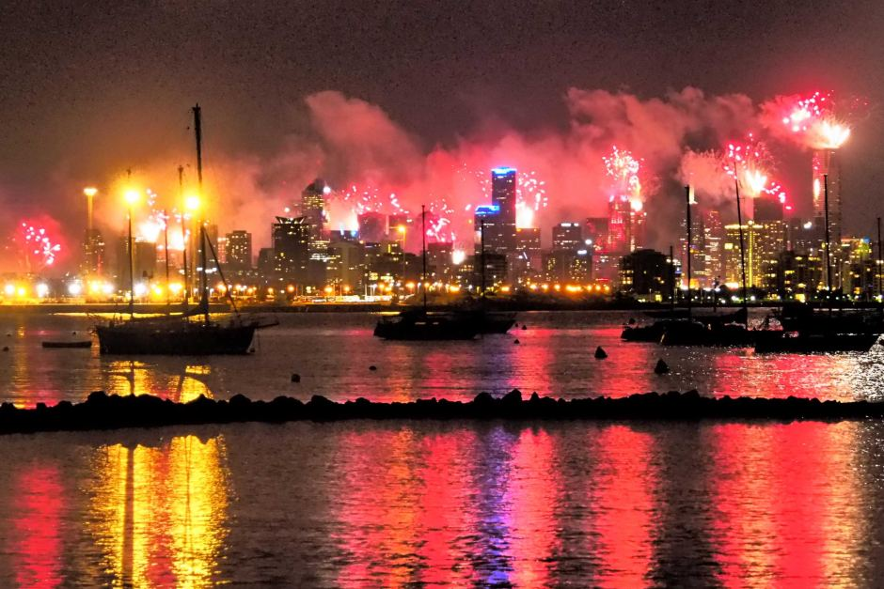
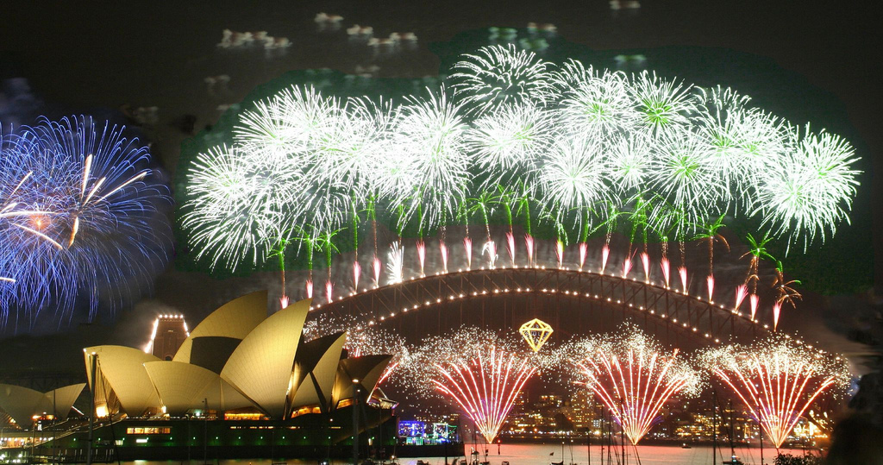
New Year is a public holiday and many people love to spend this day with their family and friends. Outdoor activities include picnics, camping, surfing, water sports etc.
Australia becomes the largest tourist hub at the time of New Year. The main attraction of Australian New Year is its magnificent fireworks.

