Slide 1
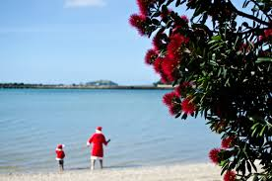
CHRISTMAS
season in
new zealand
By T.V. Kosormygina
“Sosny” school
December, 2016

Slide 2
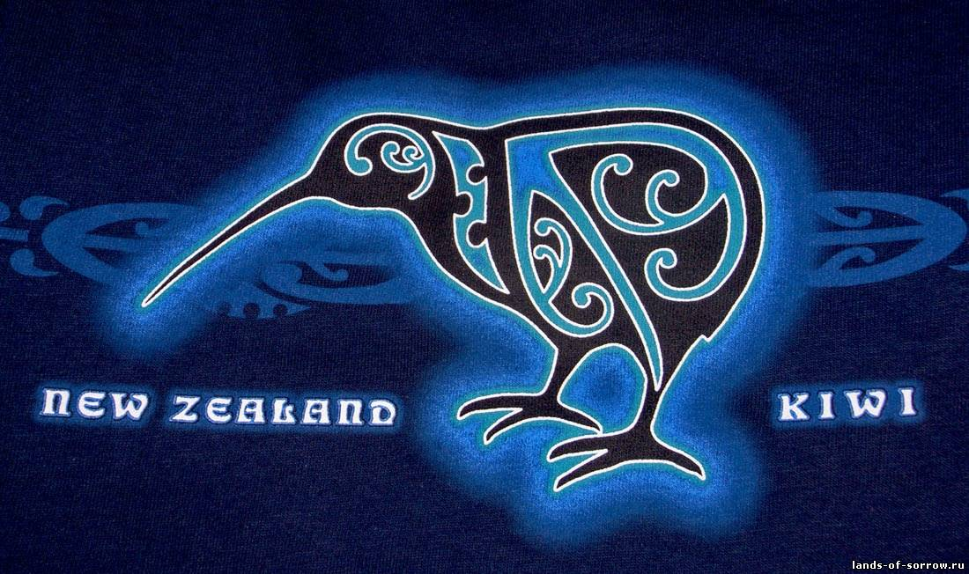
NEW ZEALAND
New Zealand is as large as Great Britain or Japan, but it is one of the least populated country. Its population is about 4 ml people.

Slide 3
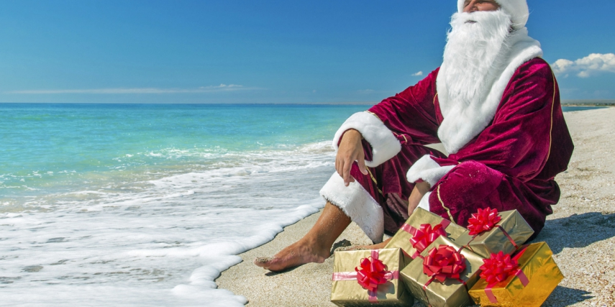
NEW ZEALAND
Christmas as well as New Year holidays are traditionally celebrated in winter. Christmas is a great time in New Zealand, though it is a quite different. Summer begins when it is winter in the Northern Hemisphere. In New Zealand it is often called Kiwi Christmas.

Slide 4
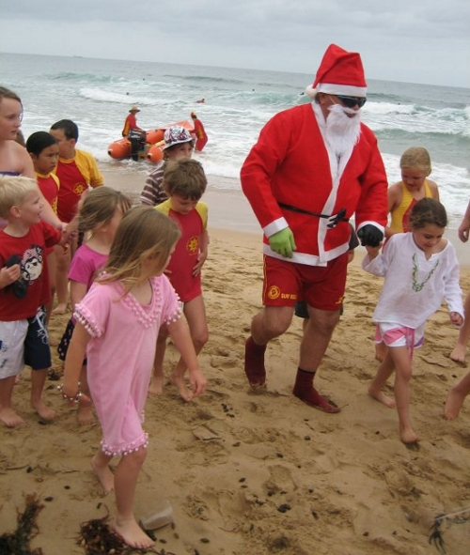
However, the Southern Hemisphere's summer season has resulted in the development of some
local traditions because of hot and humid weather.
With a different climate and time of the year altogether, the kiwi Christmas is something unique and it can be a lot of fun.

Slide 5
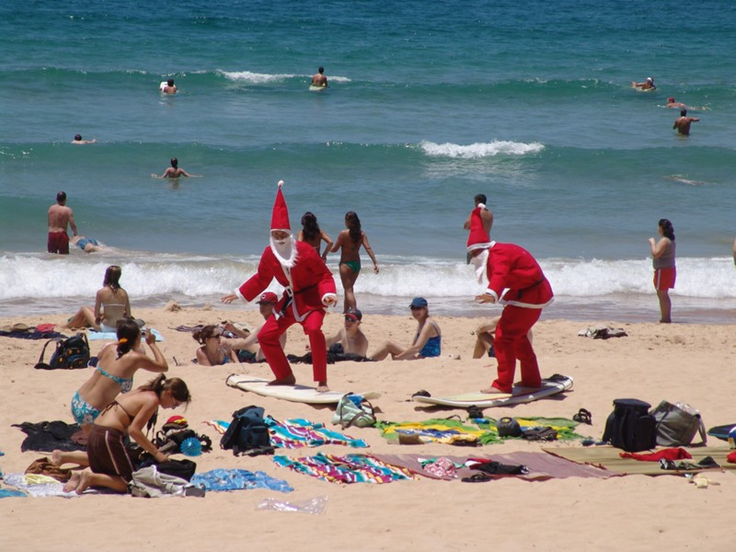
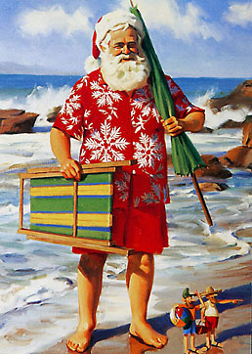
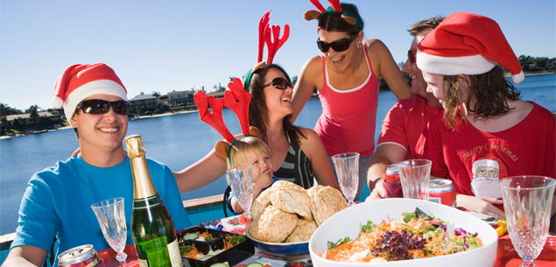
Sunny weather makes it possible to spend Christmas and New Year at the seaside. Christmas parties, picnics and barbeques often take place just on the beach in June and July.

Slide 6
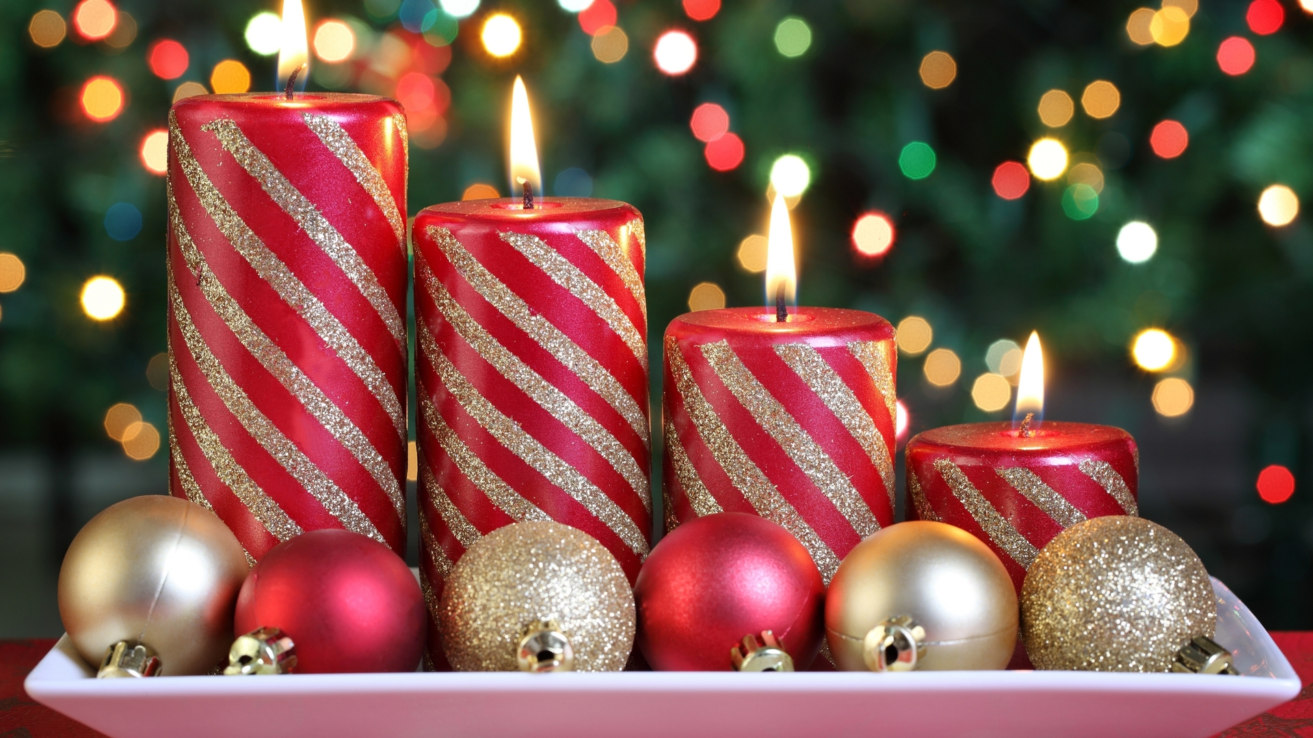
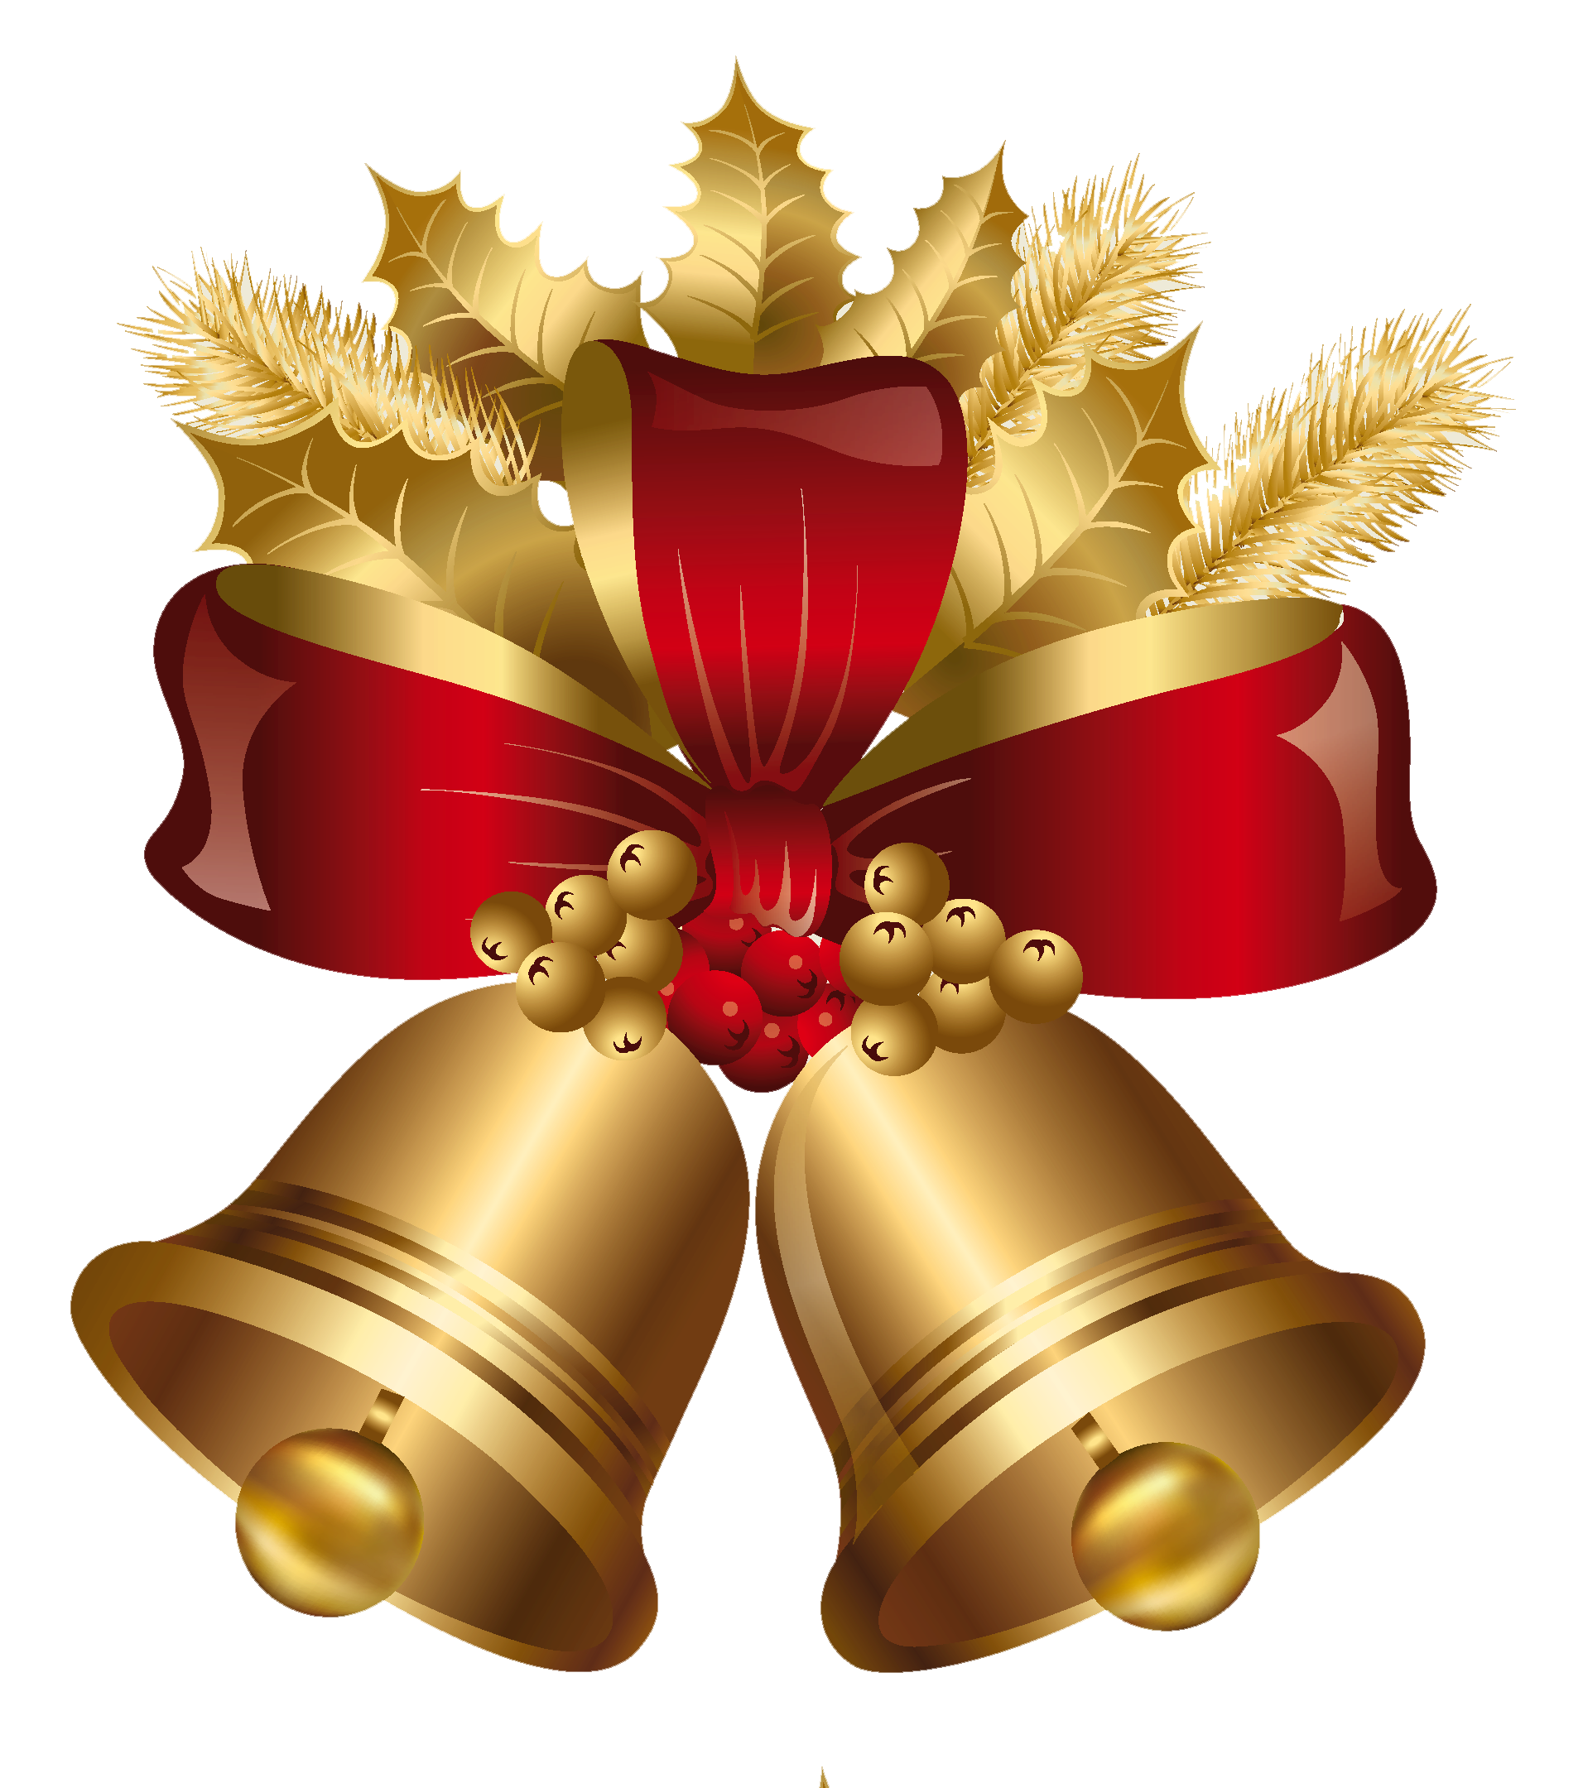
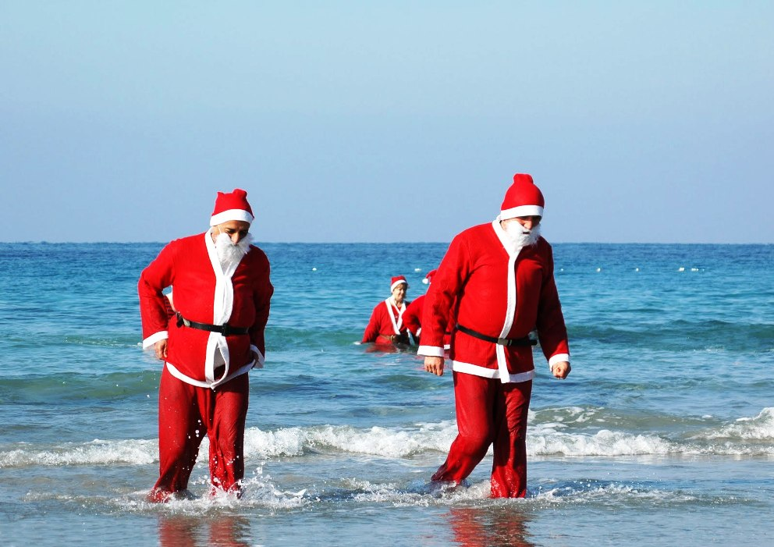
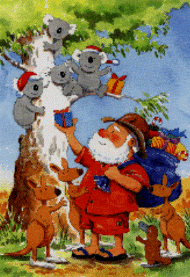
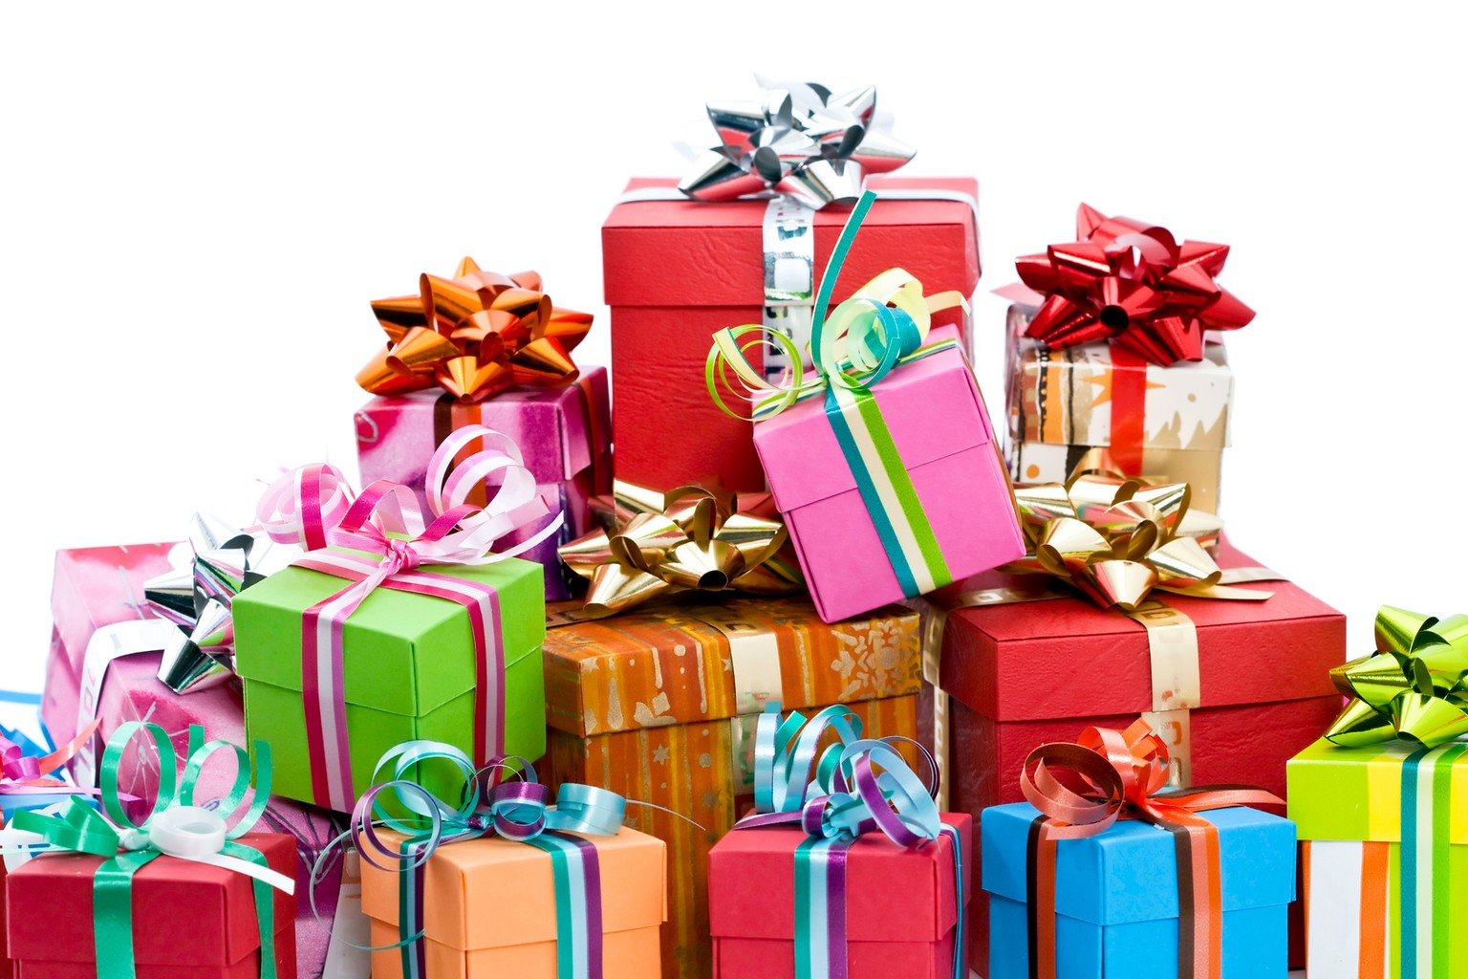
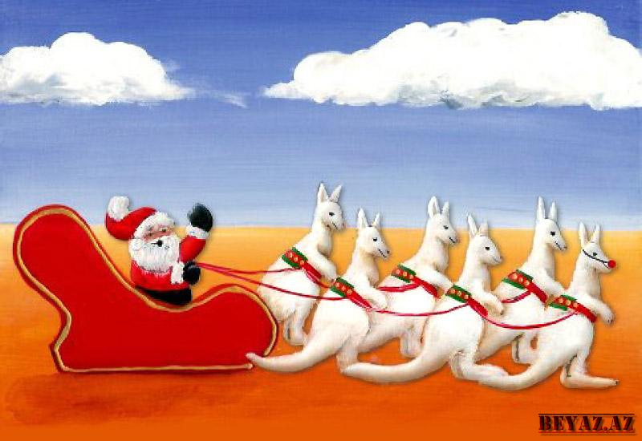
Christmas traditions in Australia and New Zealand have many similarities with British and the United States traditions, including traditional Christmas symbols: a red fur-coated Santa Claus, carols such as Kiwi Jingle Bells, Christmas cards and decorations.

Slide 7
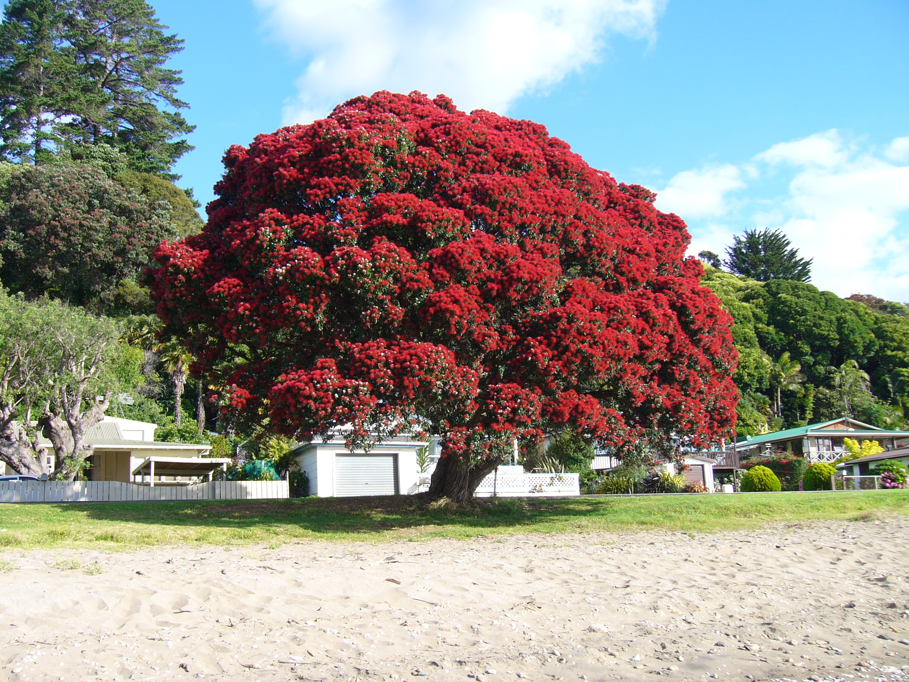
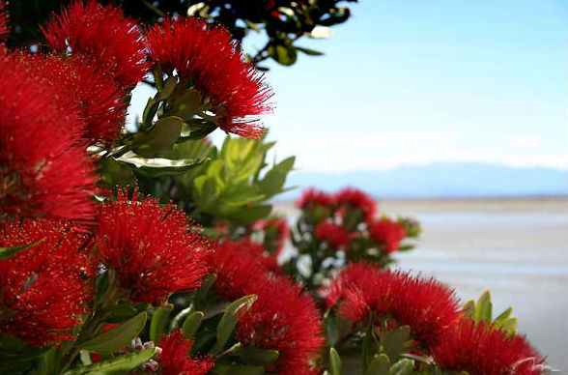
Christmas Plants
Pohutukawa is a Сhristmas tree in New Zealand. It is an evergreen plant with beautiful red blossoms. It bursts into bloom at X-mas holidays.

Slide 8
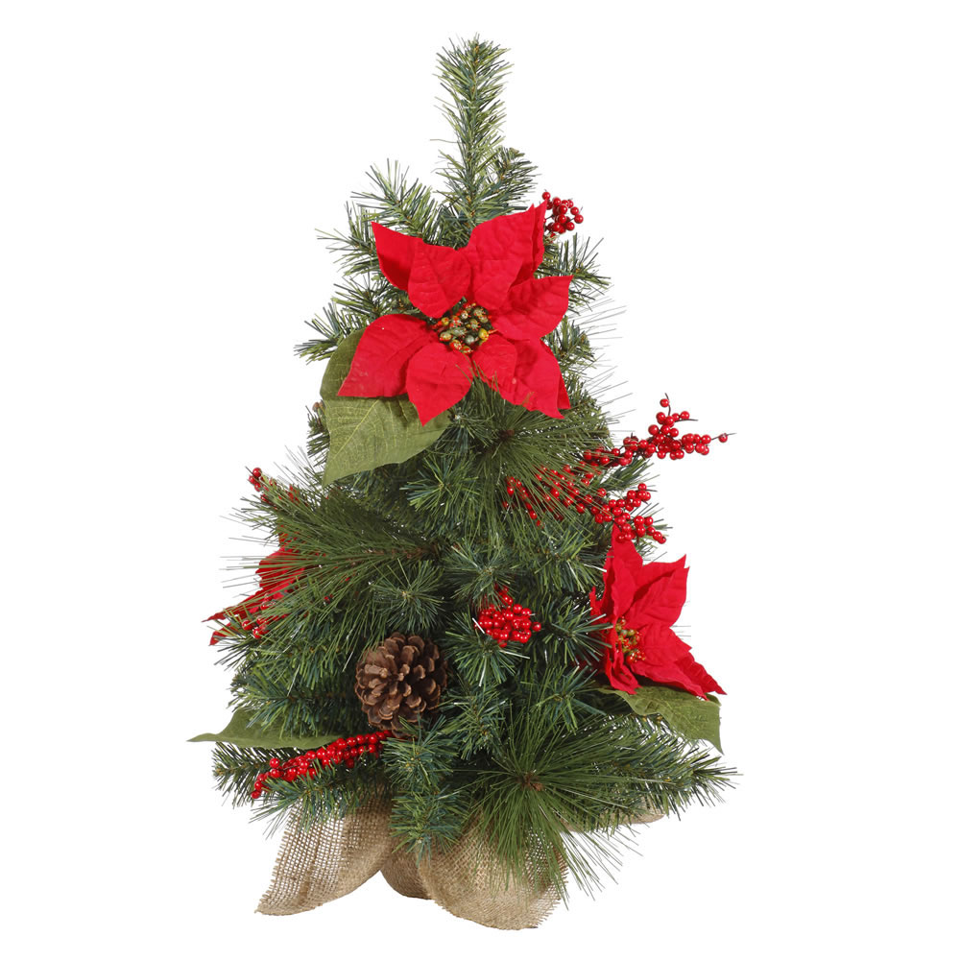
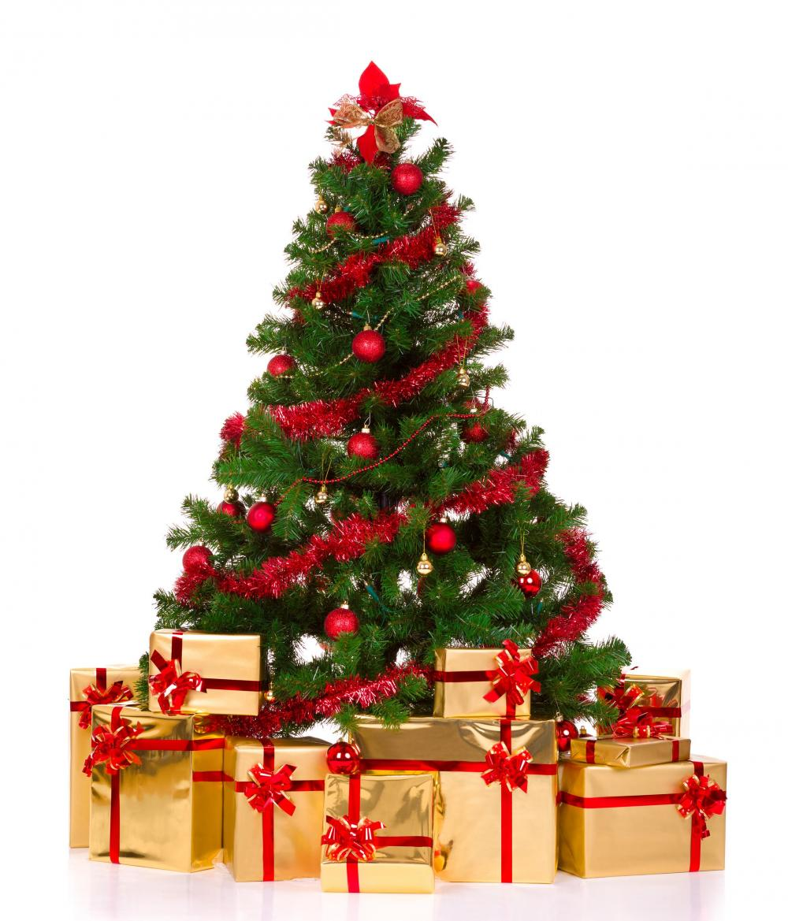
Many New Zealanders decorate a tree in their homes with tinsel and lights in the European tradition. The most
commonly used
tree is the pine tree,
which is found in a
great amount
throughout
New
Zealand.

Slide 9
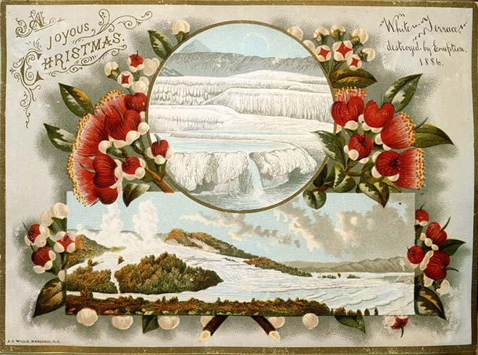
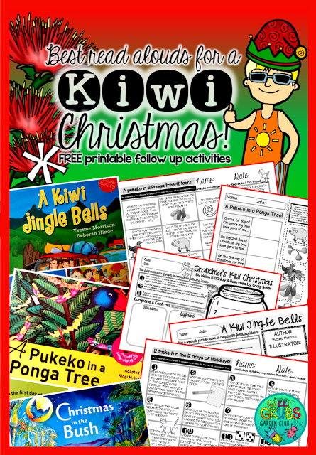
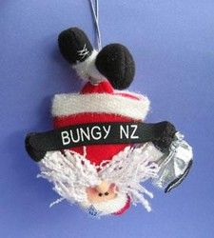
Kiwi Christmas Cards
Familiar New Zealand symbols add a distinctively local colour to traditional Christmas greetings and imagery. Locally, however, some particular New Zealand cards were produced.

Slide 10
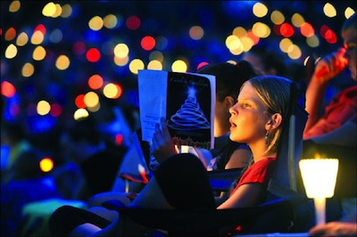
Christmas Carols
New Zealand has its own Christmas songs - some of which are set to traditional tunes and have a different dimension when sung in Maori like Marie te po or Silent Night.
It may seem a bit strange to hear "White Christmas" or "Deck the Halls" in the middle of summer! Nevertheless, carols are popular and you will hear them played or sung in shopping malls during the weeks up to Christmas.

Slide 11
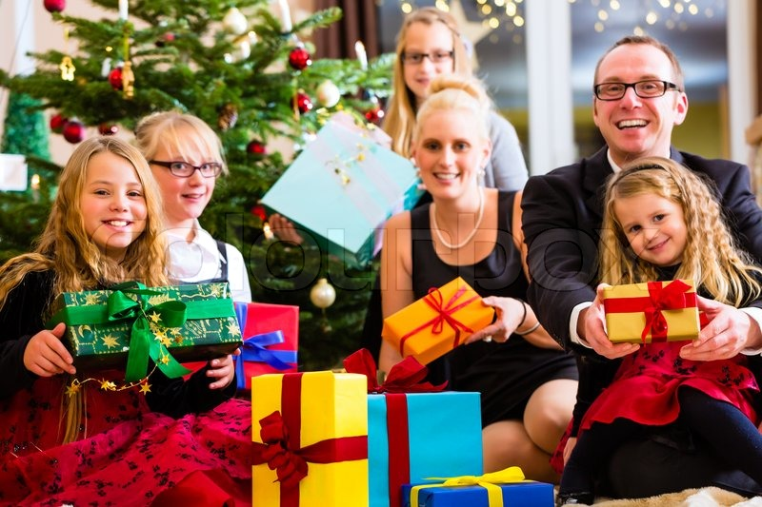
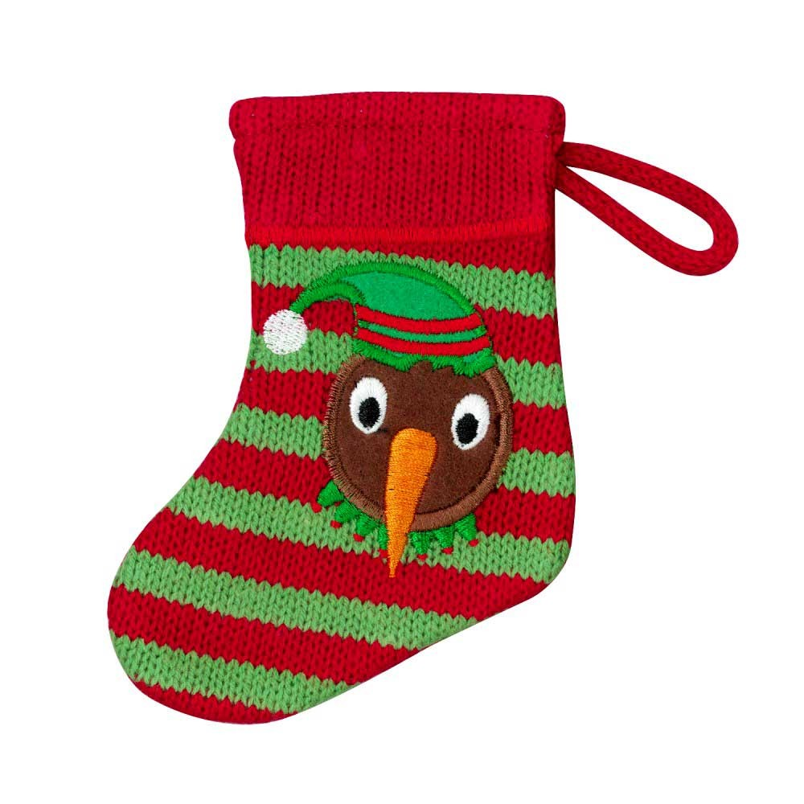
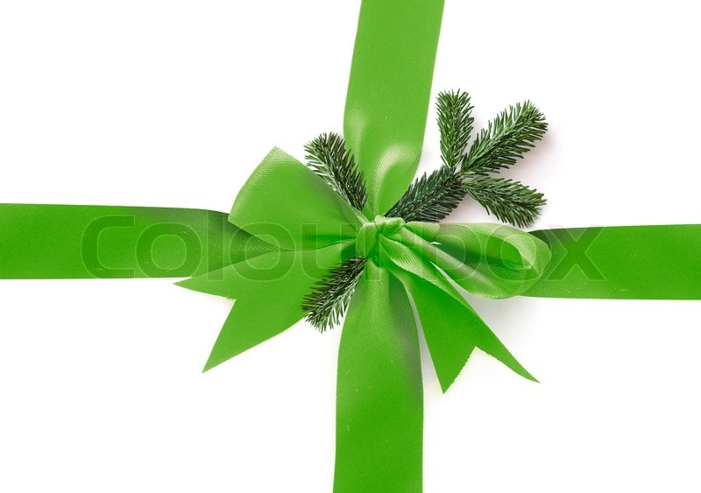
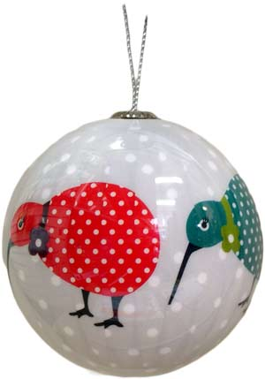
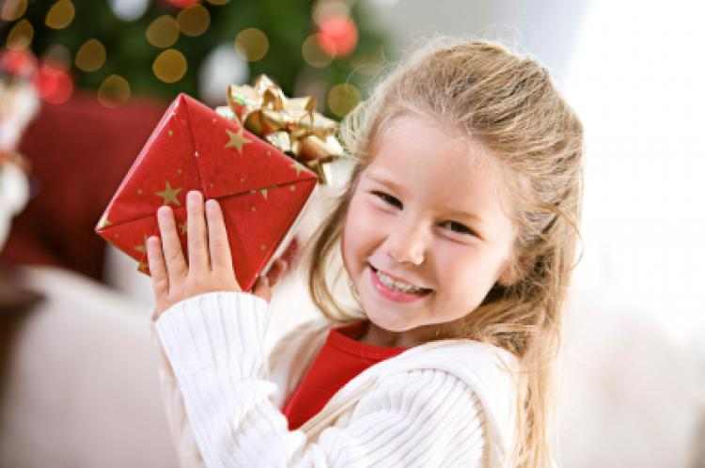
Opening presents is one of the
highlights of Christmas Day.
Christmas is a family holiday in New Zealand. Many people take their holidays between Christmas and New Year's Day.

Slide 12
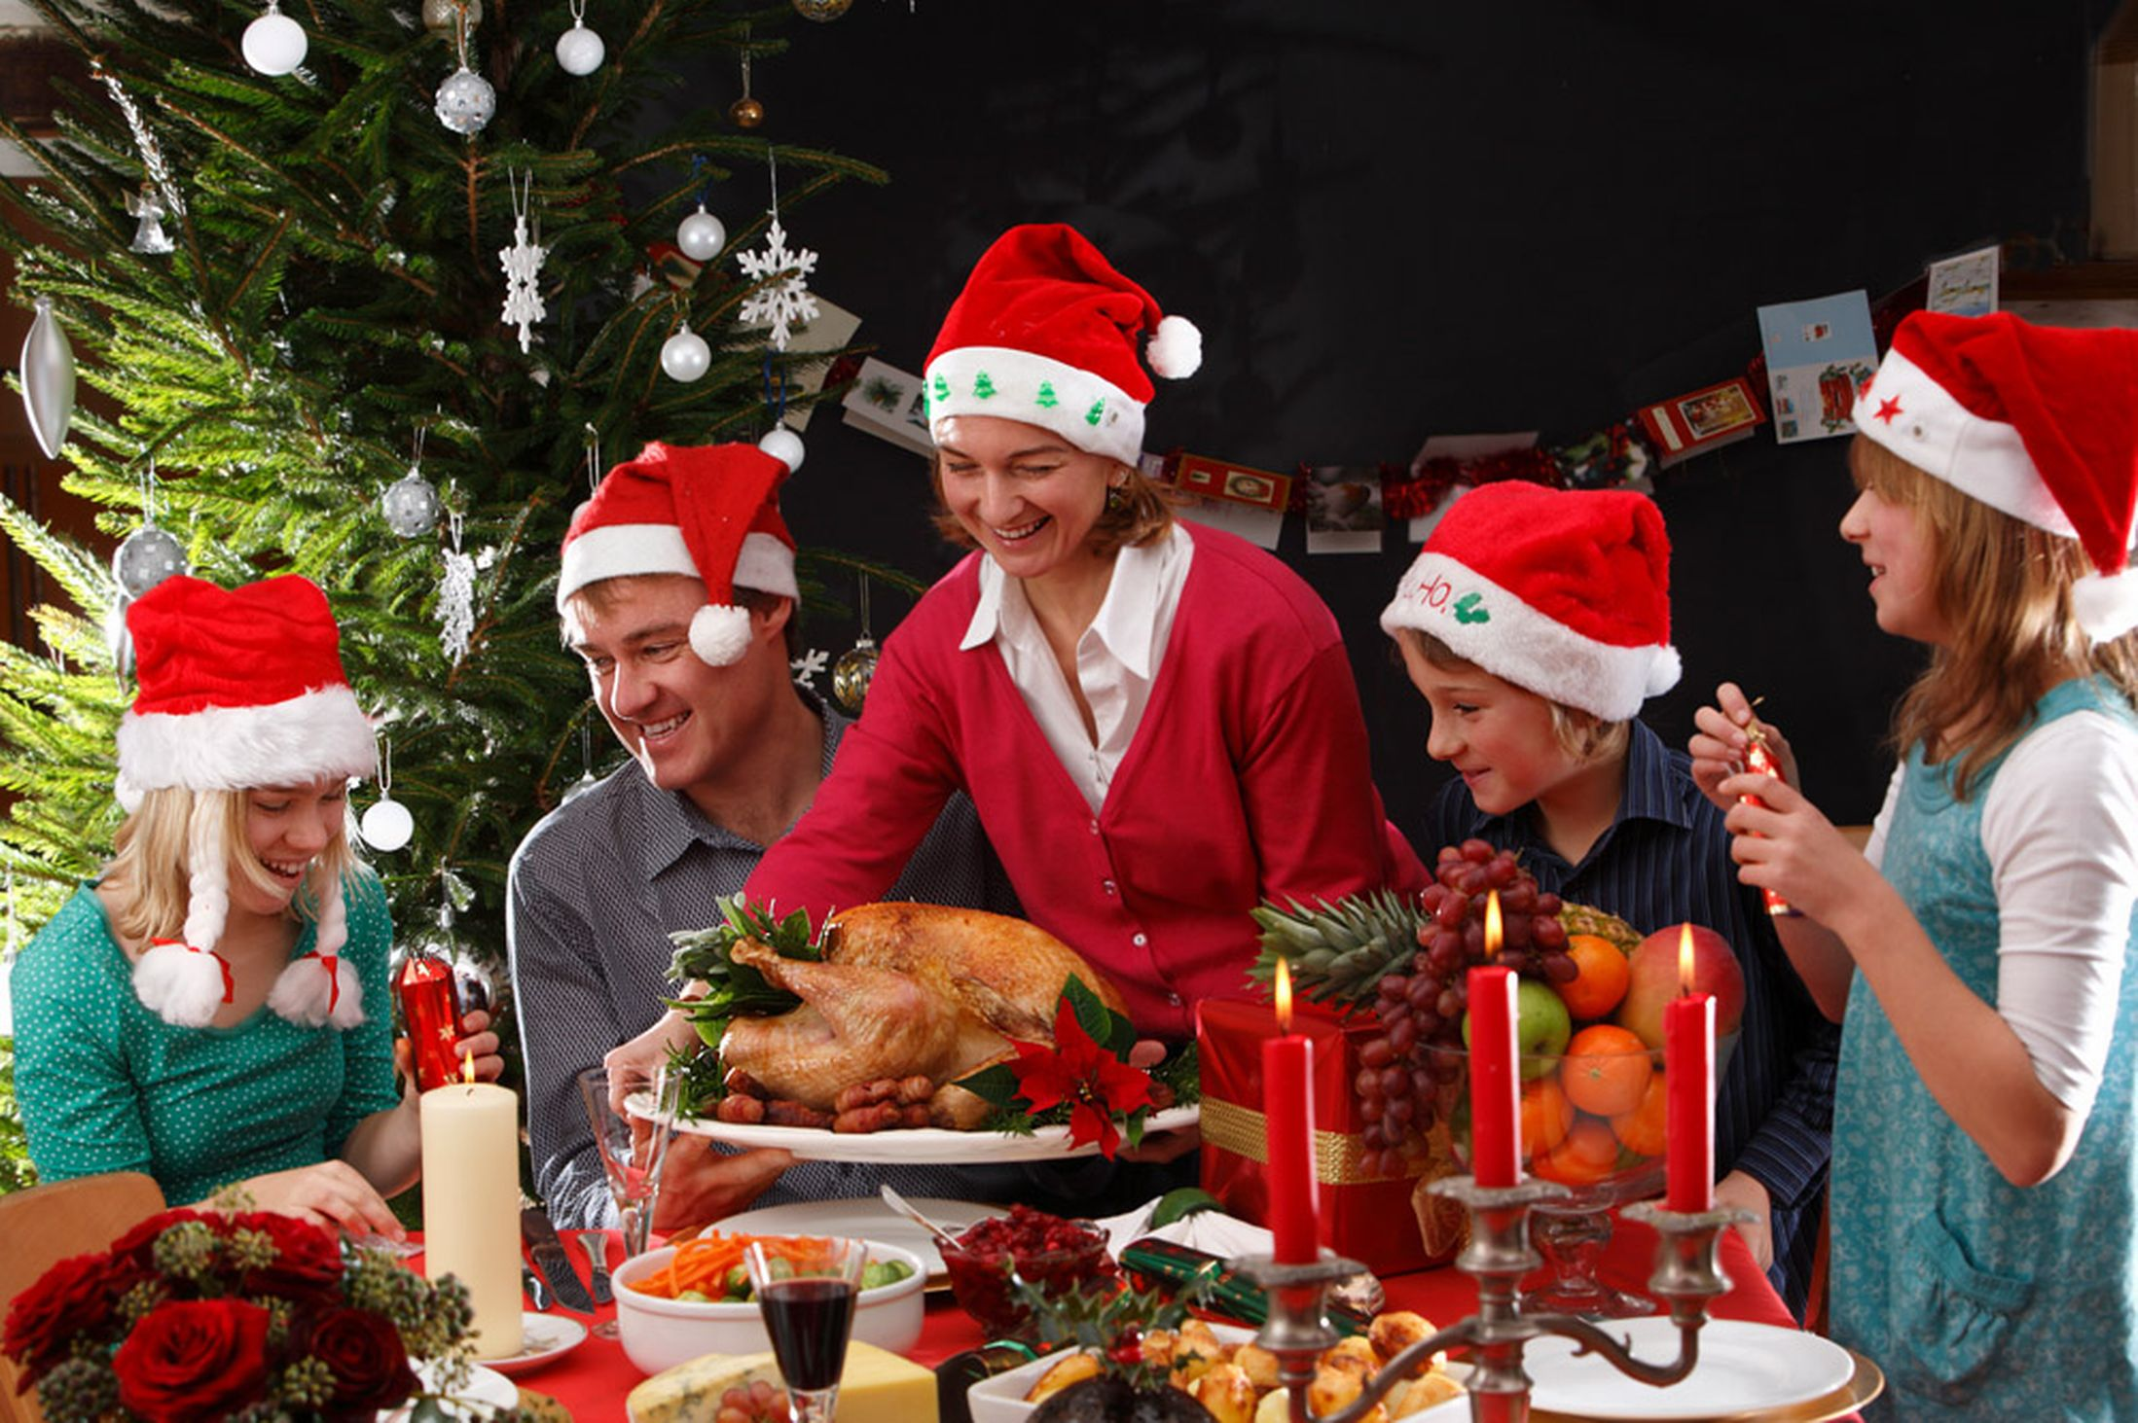
Christmas morning here usually starts with presents hidden under a fir tree. Then there’s a lunch with family. Turkey or chicken is usually served. Afterwards everyone has tea and invites friends for a barbecue. The family gets together with friends for a nice delicious meal with wine or beer!

Slide 13
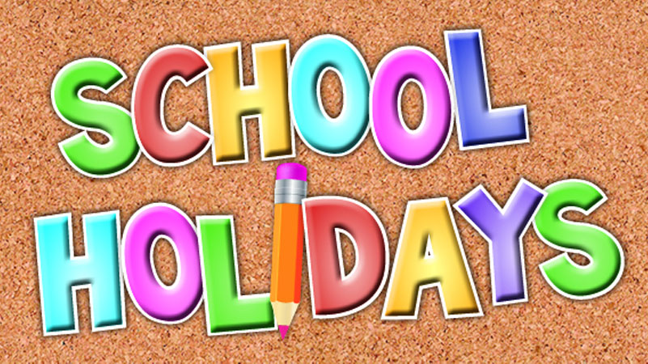
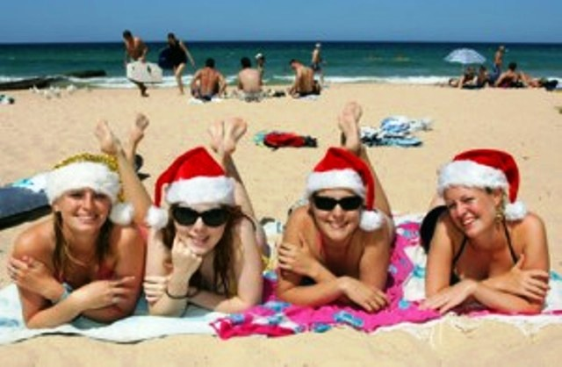
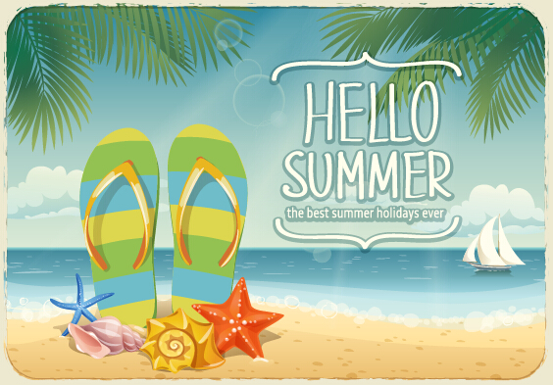
Summer holidays.
The holiday break begins at Christmas Eve and lasts until the end of
January. Schools are closed with the longest break being over the Christmas/summer period.

Slide 14
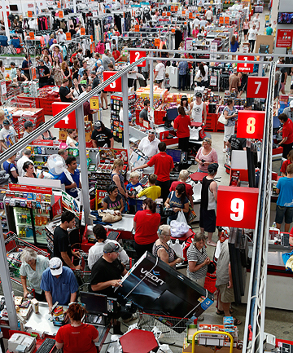
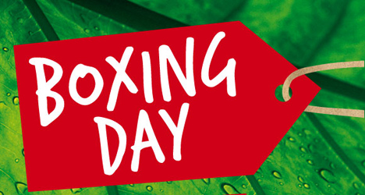
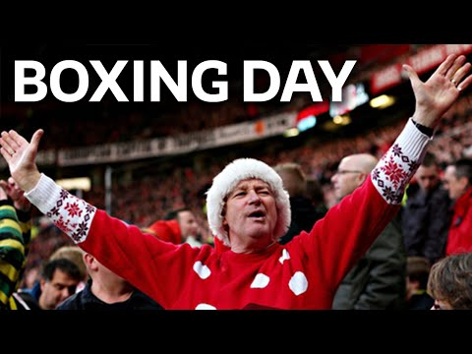
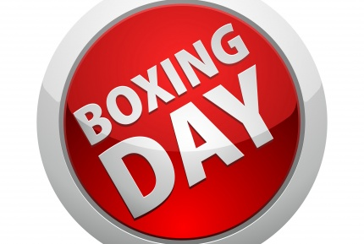
New Zealanders also celebrate Boxing Day, which is the day after Christmas (December 26th). People relax and spend time with family and friends. Some people take the time between Christmas and New Year as a vacation time off and a time to travel.

Slide 15
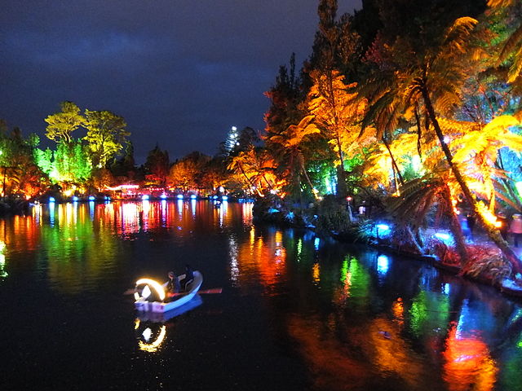
The Festival
of Lights
New Zealand has lots of festivals throughout the year. The Festival of Lights in December in New Plymouth sees the town light up with a fantastic display at Pukekura Park over Christmas.

Slide 16
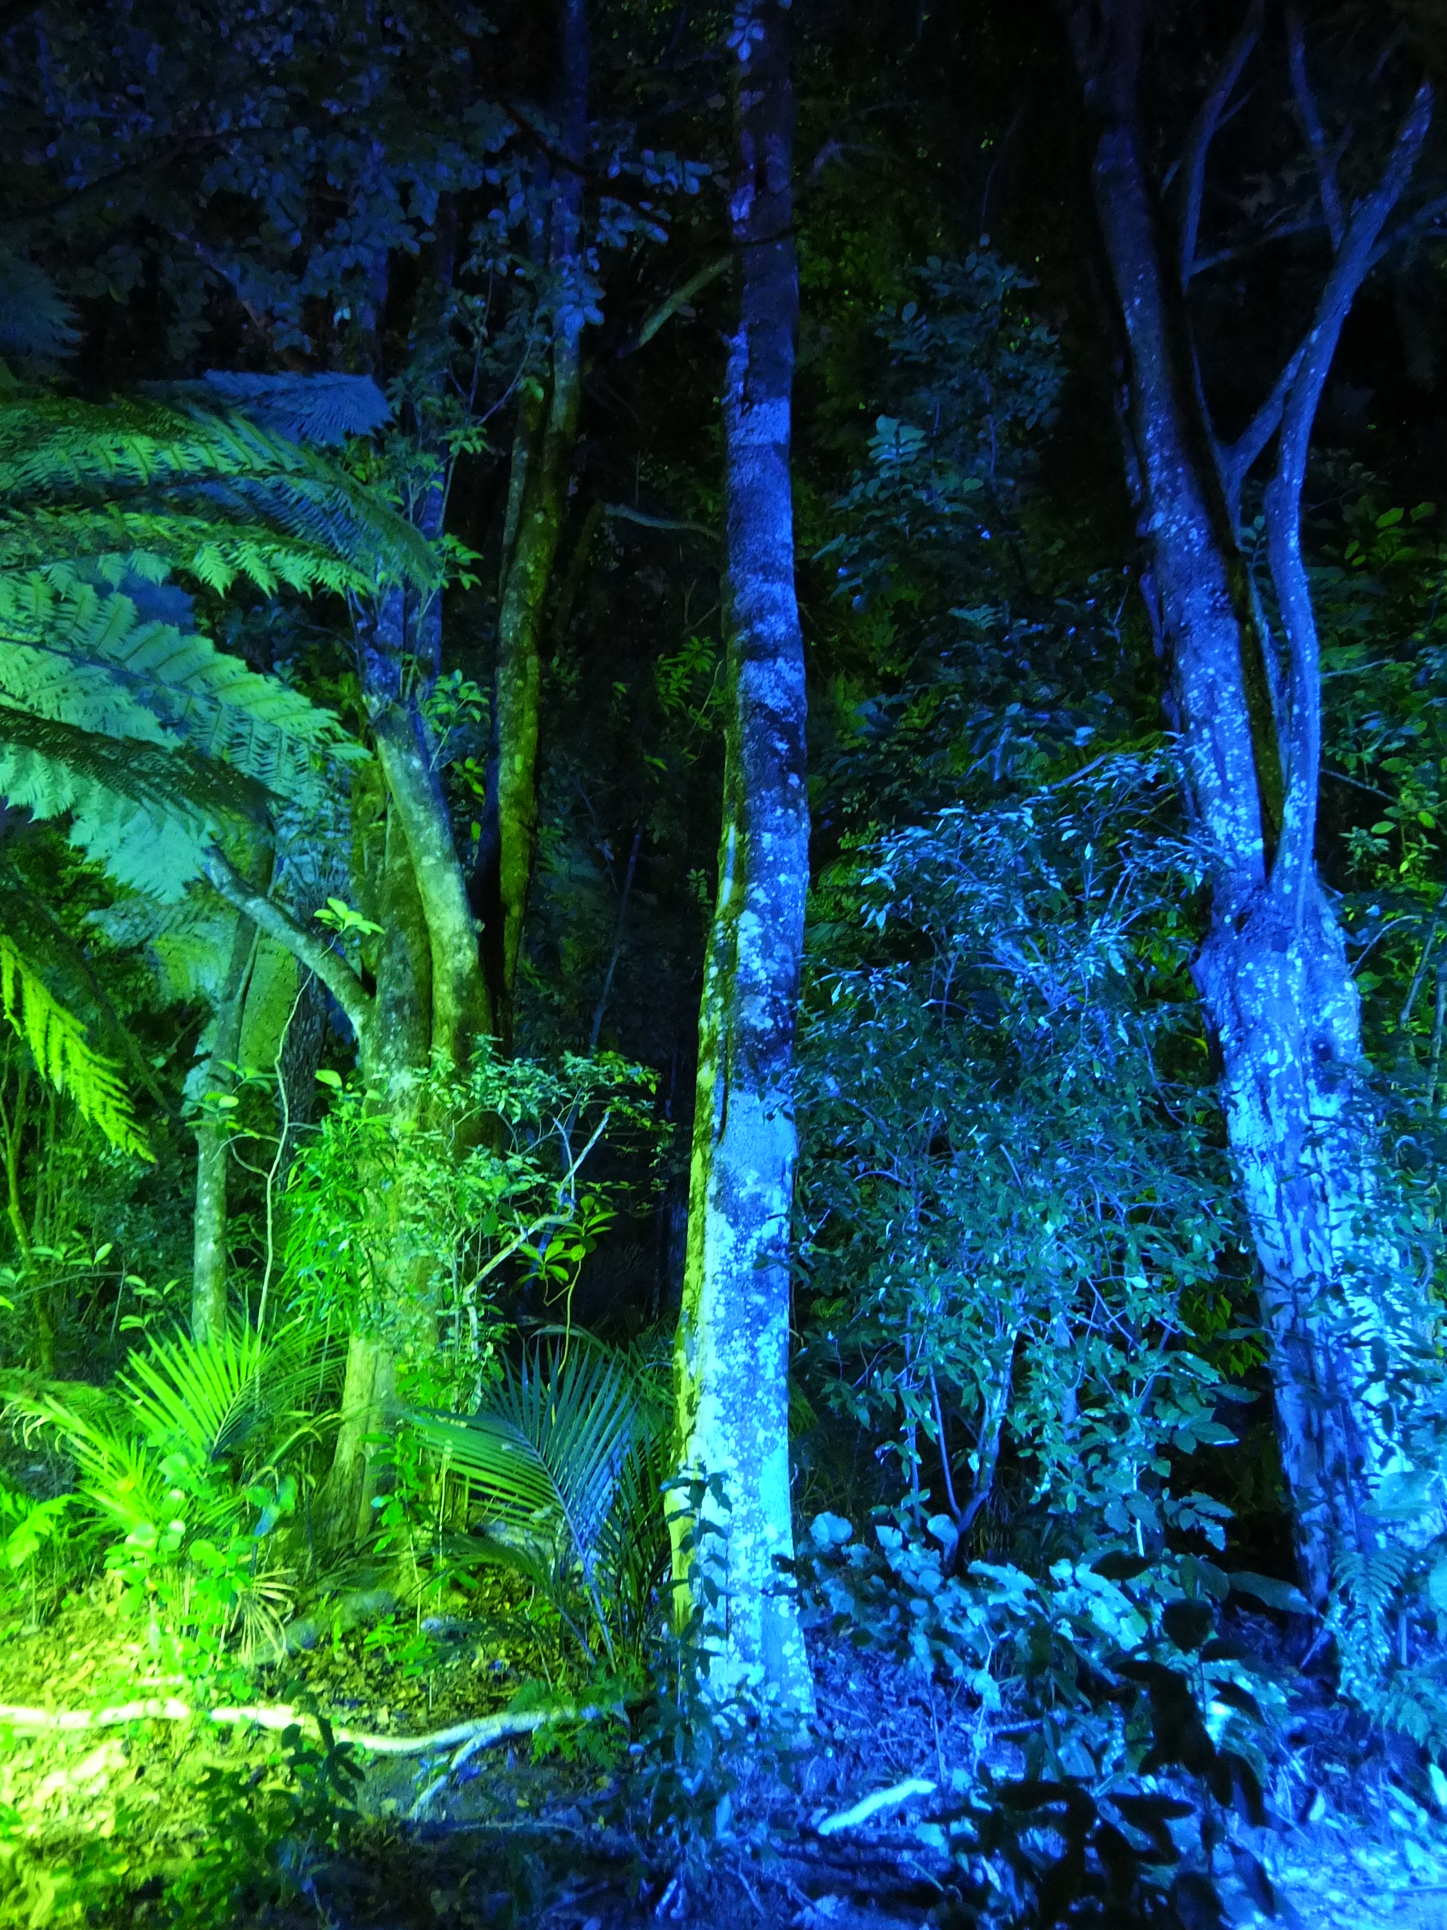
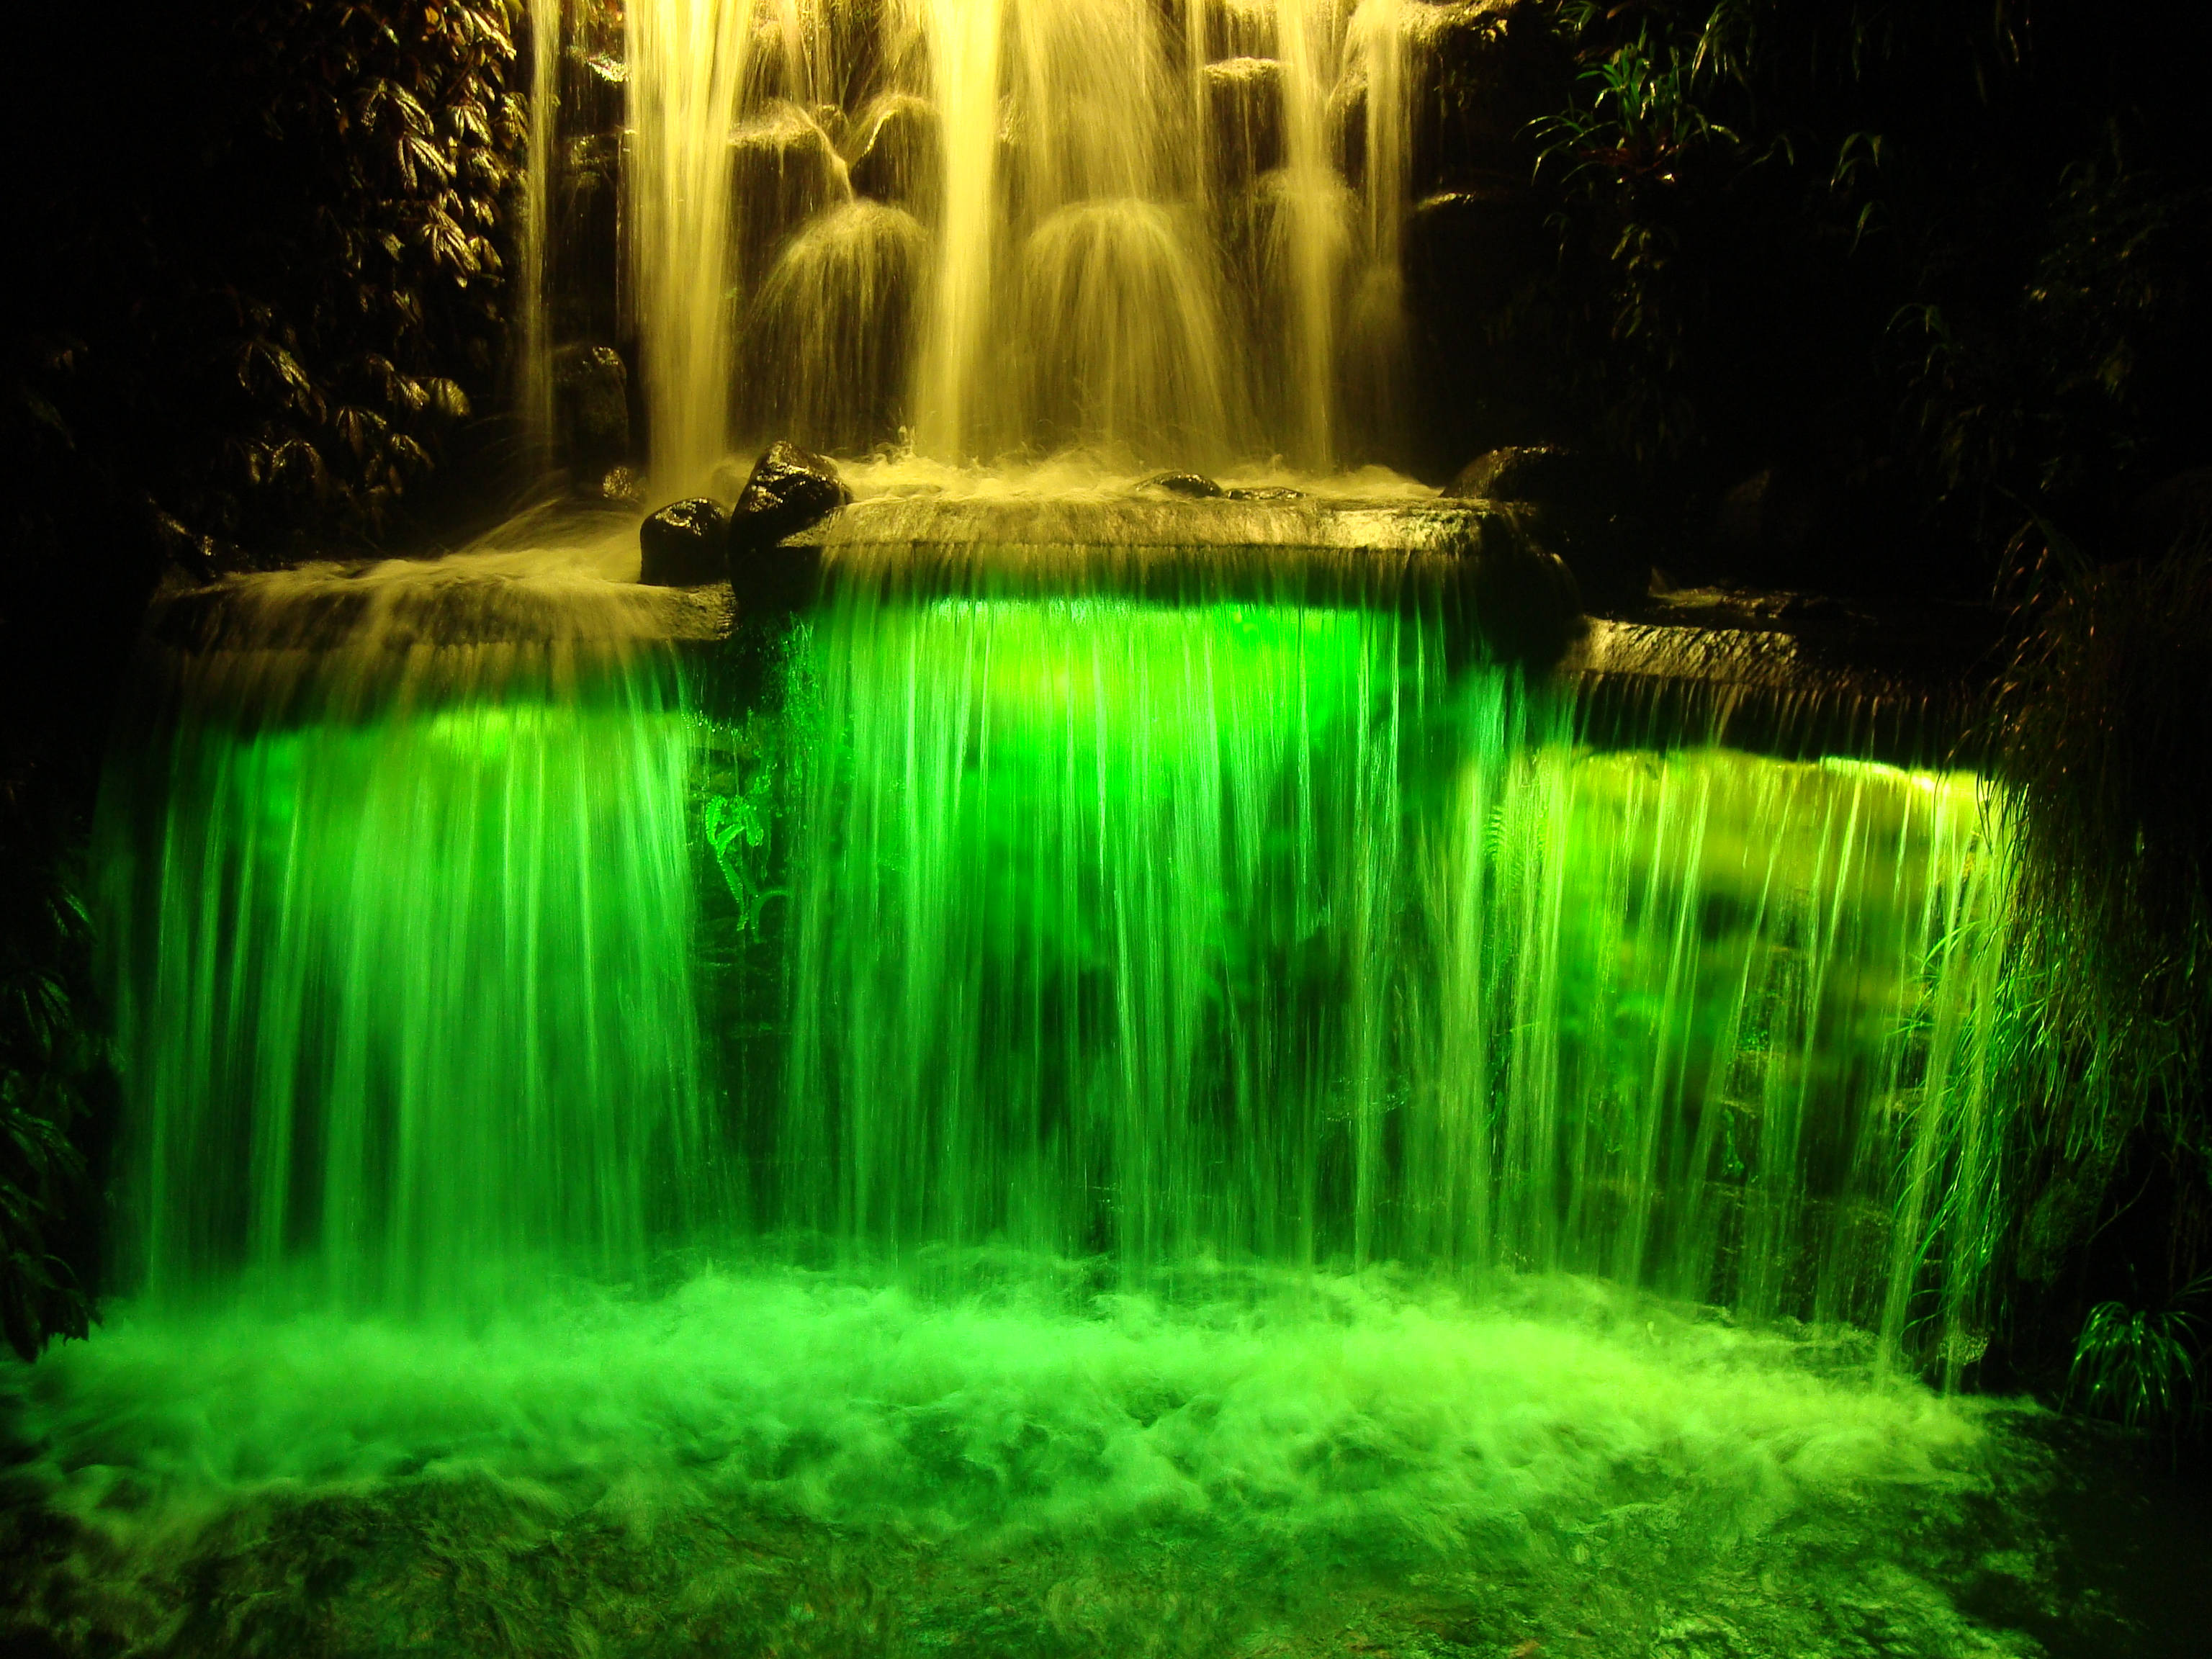
It has daytime and night time programmes of events for people of all ages. The festival itself transforms the park into an illuminated wonderland every evening.

Slide 17
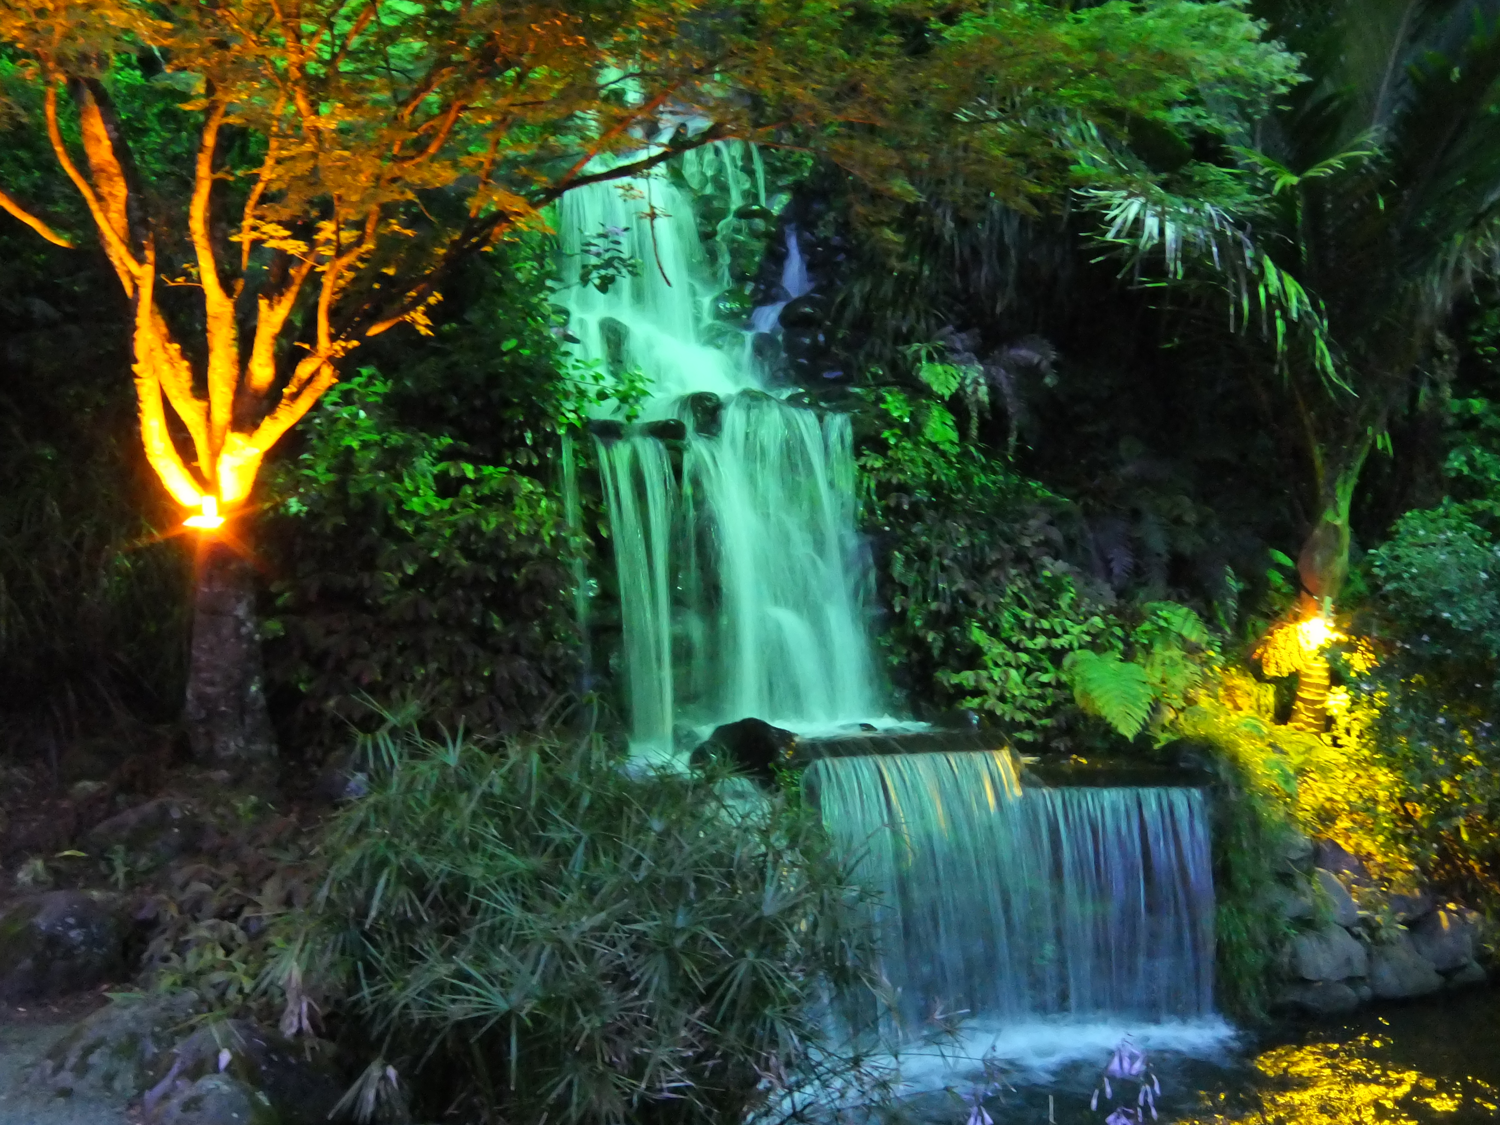
Everything is ready for Christmas. Pukekura Park, New Plymouth, New Zealand, is illuminated during the annual Festival of Lights. The festival has been a major summer attraction and cultural event for the city since 1993.

Slide 18
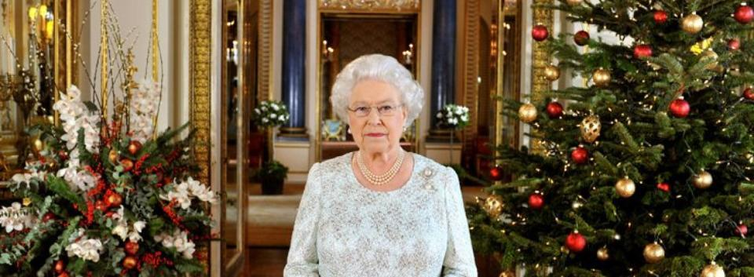
Annual Christmas Message
The Queen's Christmas Message is a broadcast made by the sovereign to the Commonwealth of Nations each Christmas. Since 1952, the message has been read by Elizabeth II; today it is broadcast on television, radio, and the Internet via various providers.

Slide 19
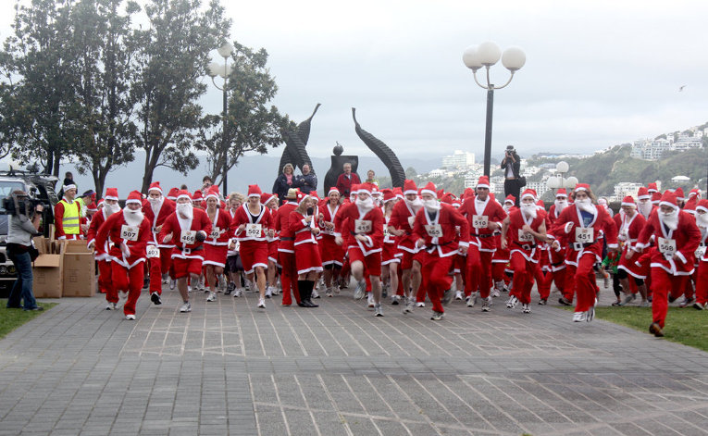
The parade of Santa Clauses
It is another important tradition at the beginning of the southern winter. Large commercial centres used to arrange them. It meant that Santa Claus’s souvenirs were delivered on the island.

Slide 20
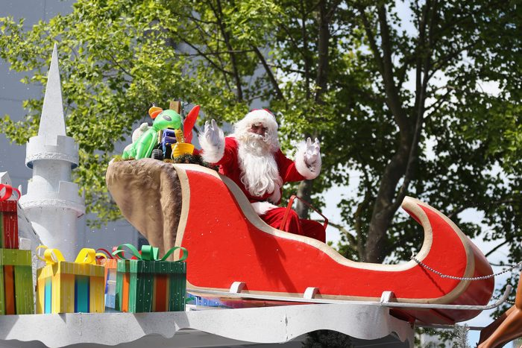
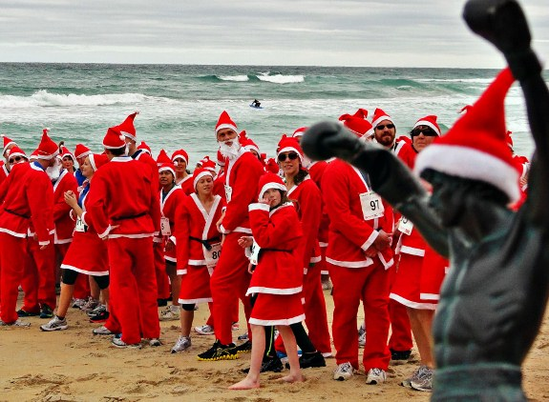
The aim of the parade was to attract the customers. However, the citizens enjoyed them so much that they soon became a permanent component of the holiday.
It is here where Santa Clauses compete in the creativity of their costumes and the variety of their extraordinary means of transport!

Slide 21
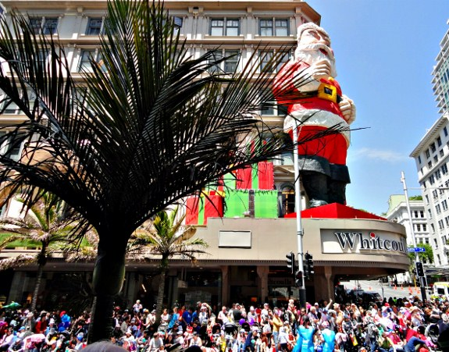
Santa Claus parades are usually known as Christmas pageants. Major pageants are held in Australian and in New Zealand cities. Santa Claus Congress and a Santa Claus Parade take place in July.

Slide 22
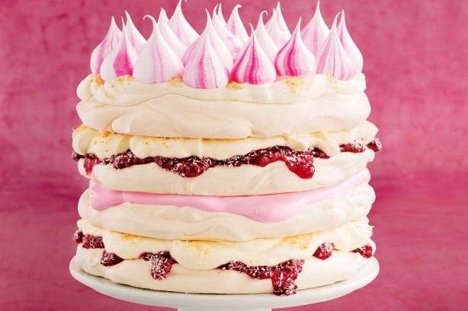
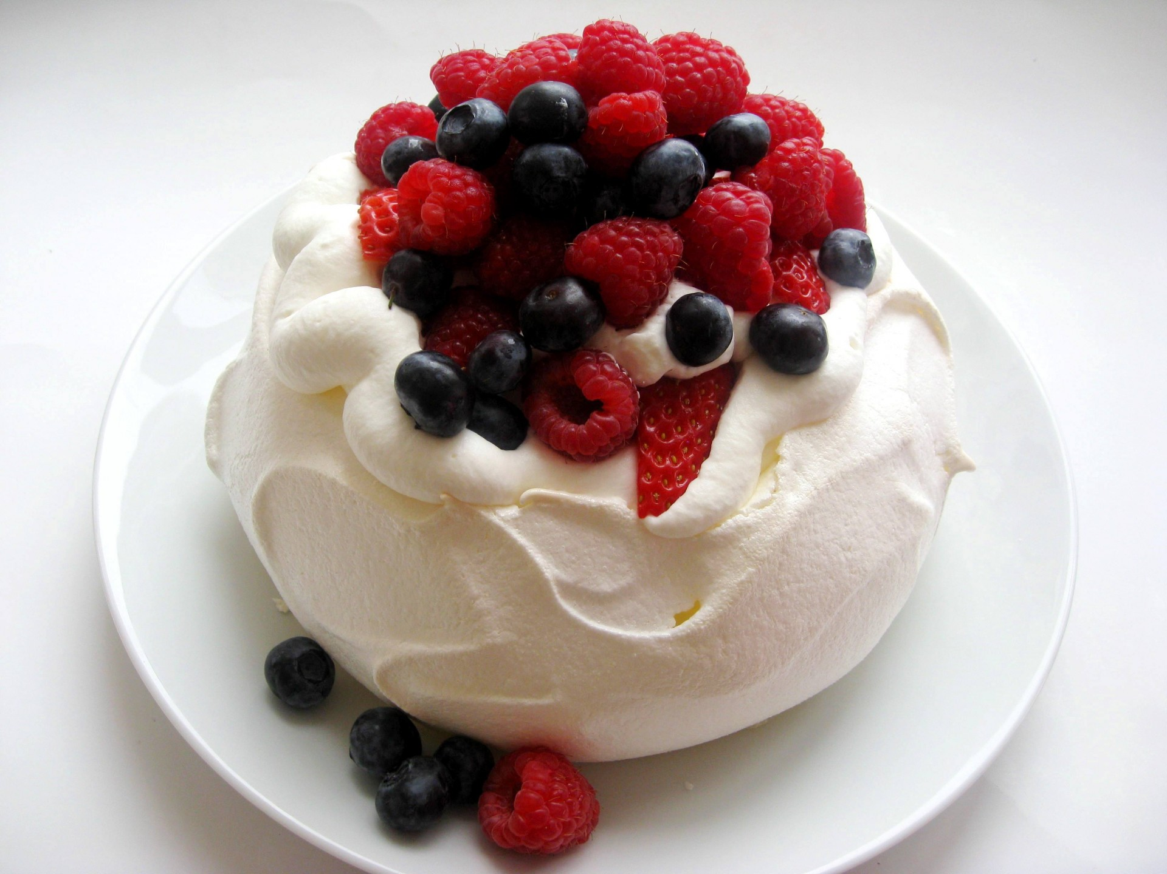
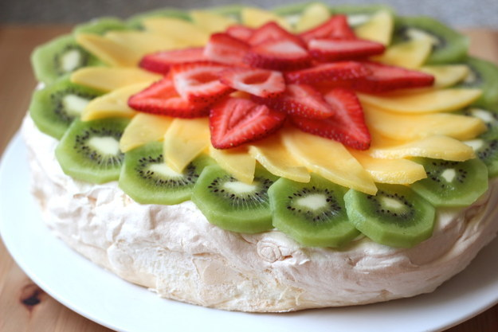
“Pavlova” desserts
One more tradition is pavlova dessert. The dessert is a popular dish and an important part
of the national cuisine of both Australia and New Zealand. One can’t imagine a holiday table
without pavlova.

Slide 23
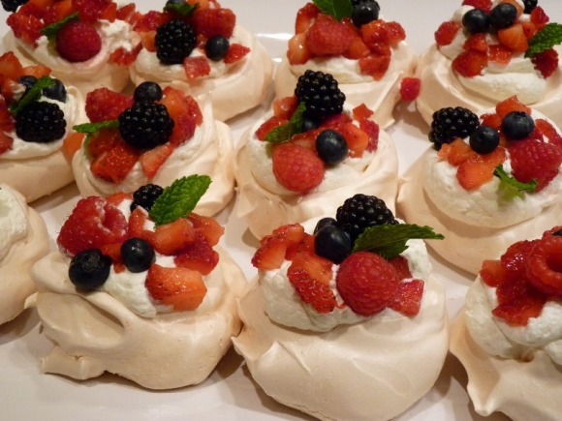
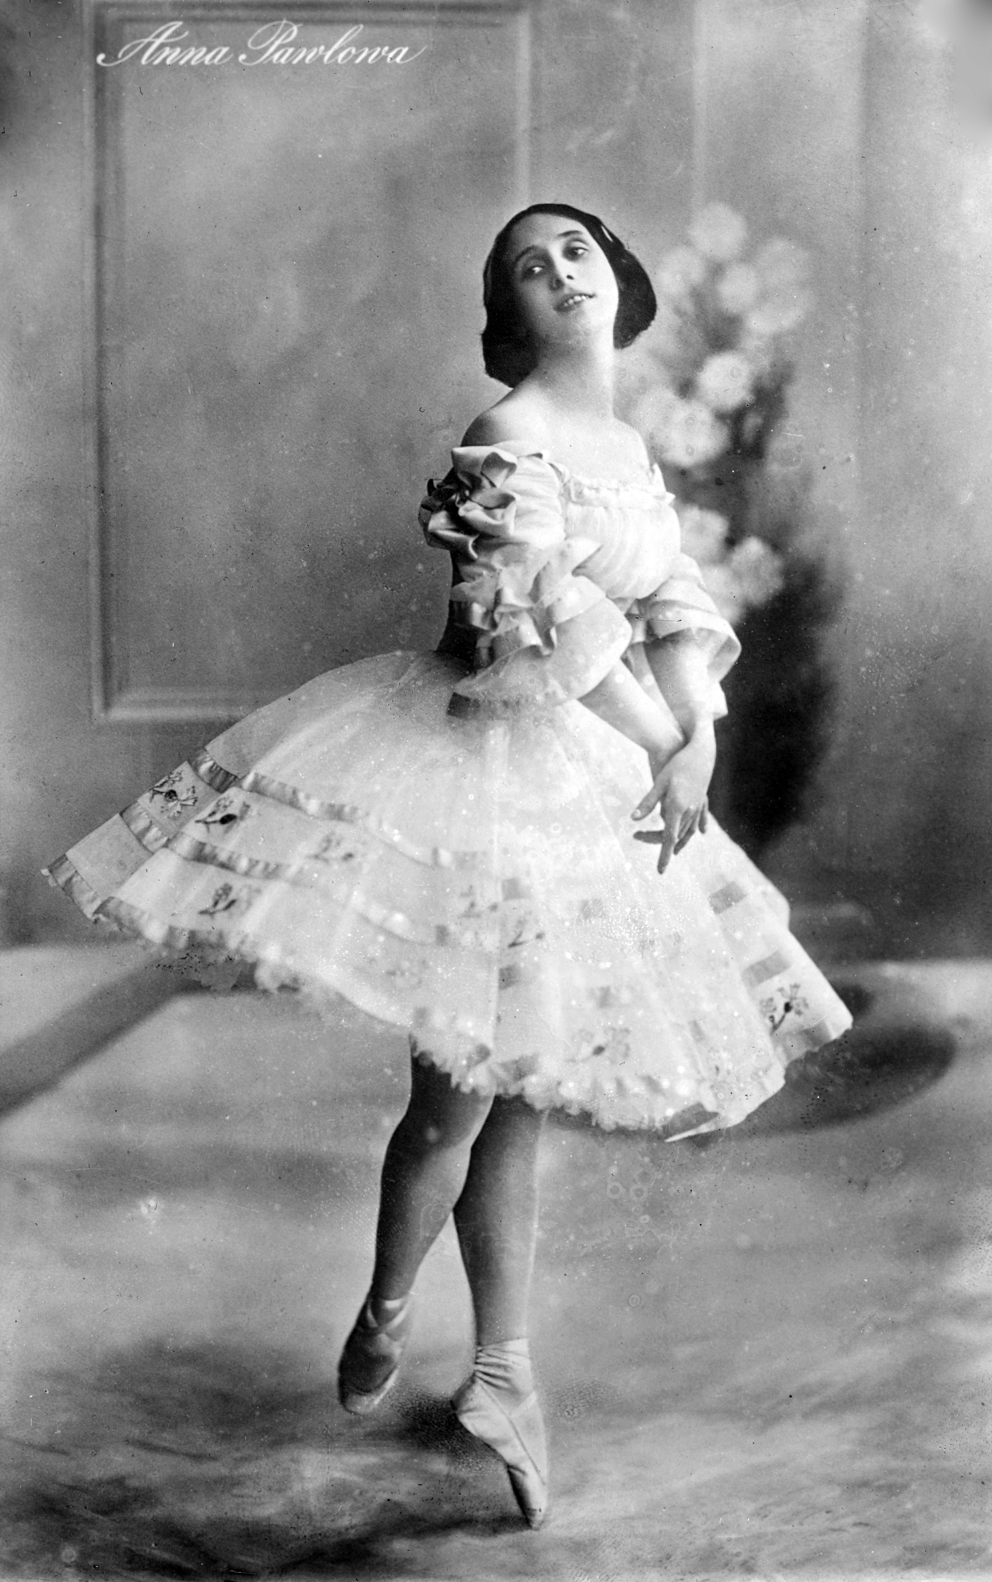
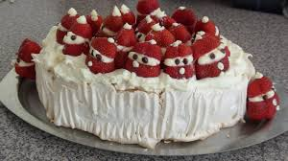
Pavlova is a meringue-based dessert named after the Russian ballerina Anna Pavlova. The dessert is believed to have been created in honour of the dancer either during or after one of her tours to Australia and New Zealand in the 1920s.

Slide 24
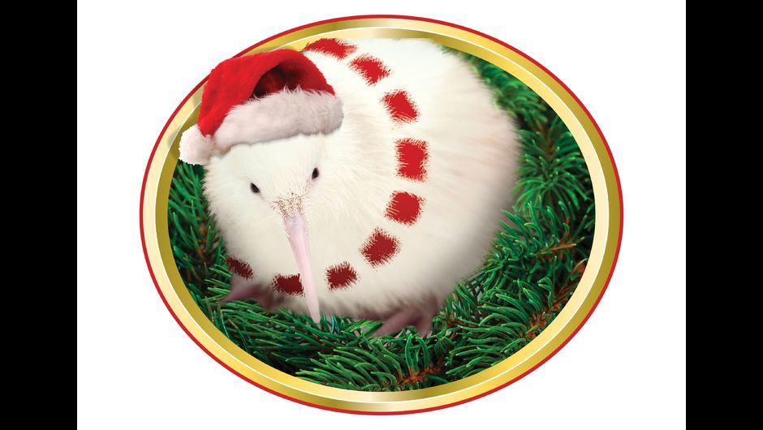
Manukura - a rare white kiwi - is getting into the Christmas spirit.

Slide 25
Everything provides the basis for a relaxed Kiwi-style Christmas where the emphasis is on outdoors activities - to eat, play and be merry - because the weather is warm, the country is on holiday and ‘tis the season to celebrate.

