Slide 1
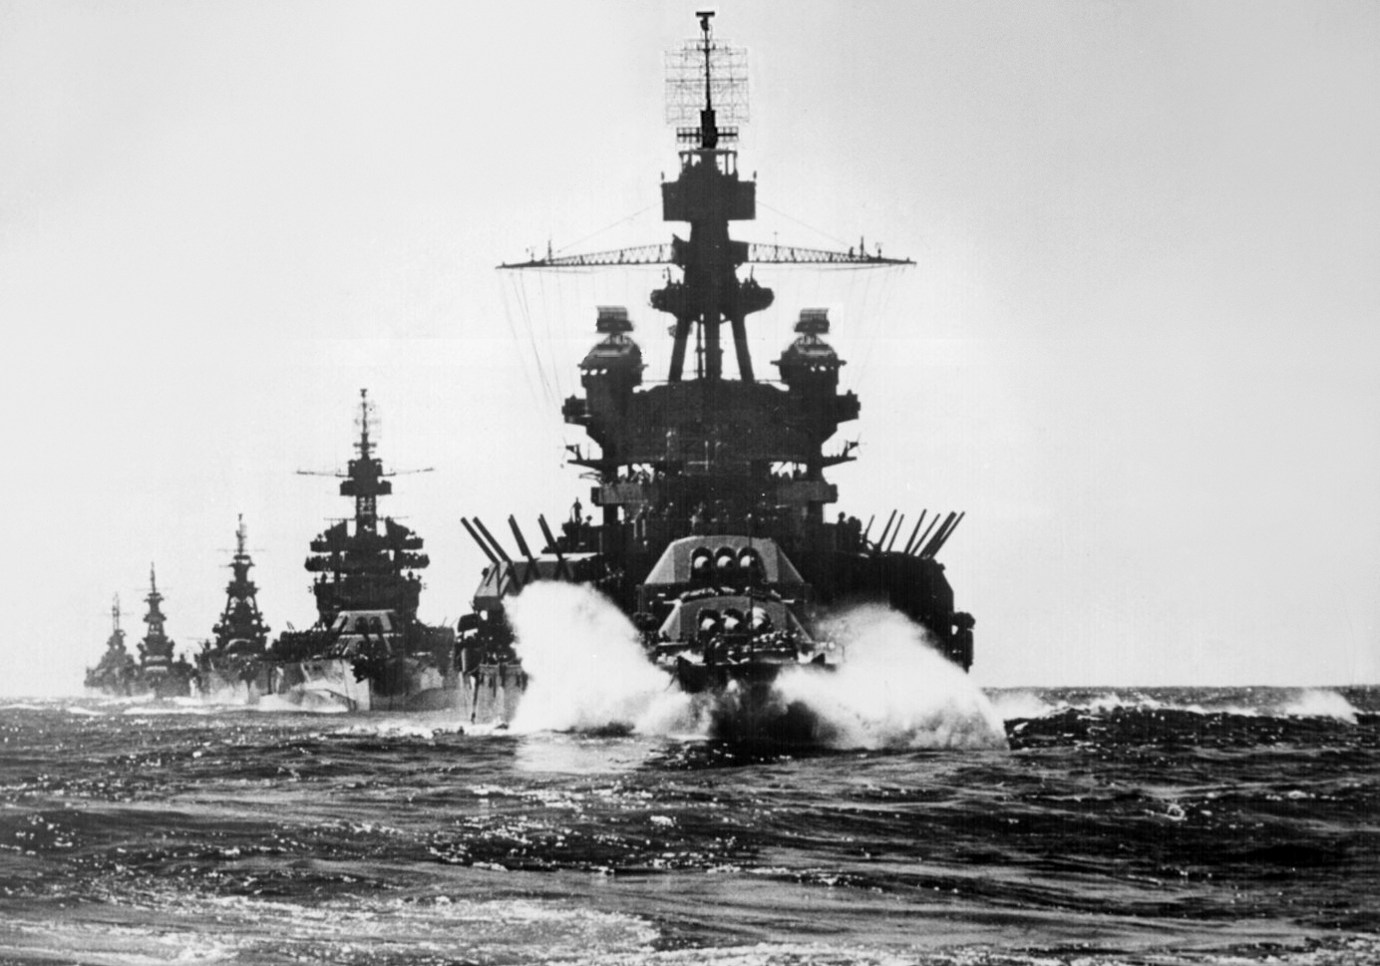
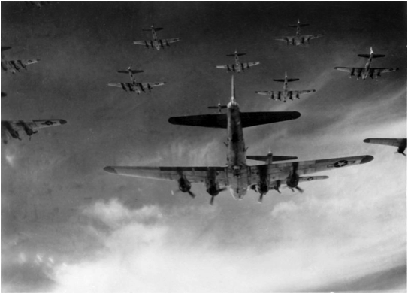
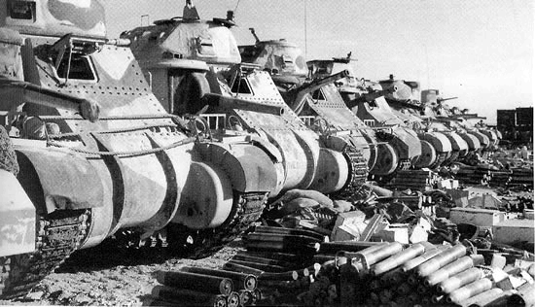
Great Britain in the second world war
Khanbalaev Sabir
Form 10 “Sosny” school
Teacher T.V. Kosormygina
March 2015

Slide 2
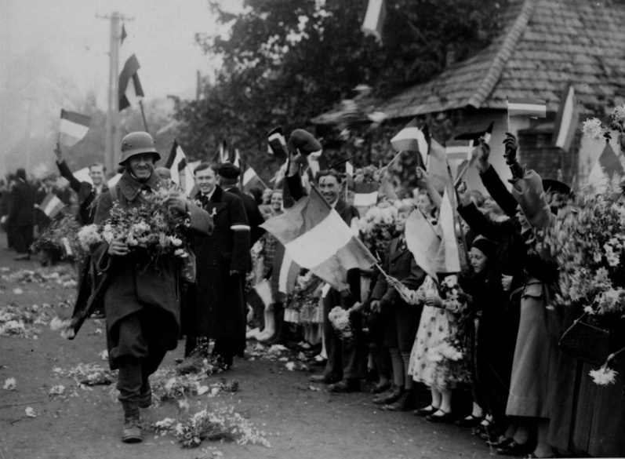
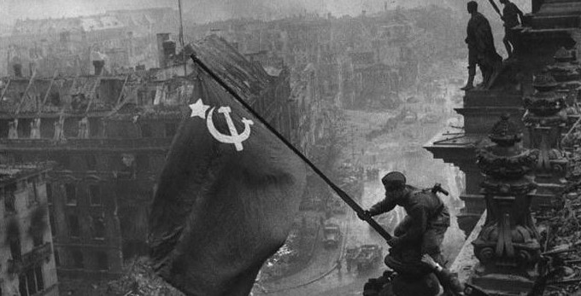
The second world war
The Second World War was a global war that lasted from 1939 to 1945. It was the most widespread war in history, and directly involved more than 100 million people from over 30 countries. On 3 September 1939 Britain and France declared war on Germany.

Slide 3
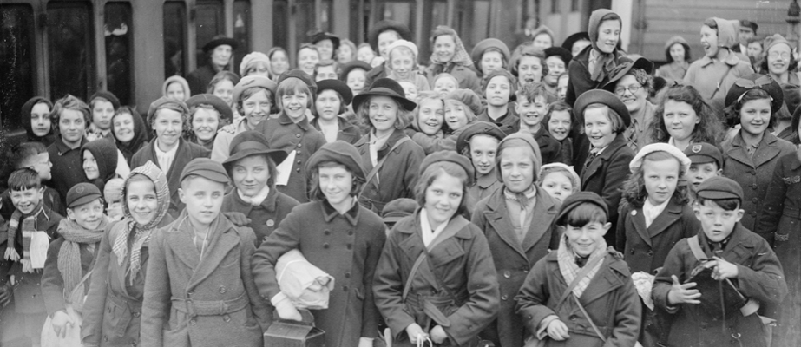
Beginning of the war
When the Second World War began, the British were feared that the Germans would bomb British cities causing great loss of life. So children from British cities were evacuated to the countryside. Altogether 827,000 schoolchildren with 103,000 teachers and helpers left the big cities.

Slide 4
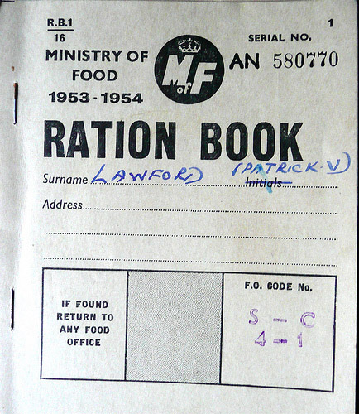
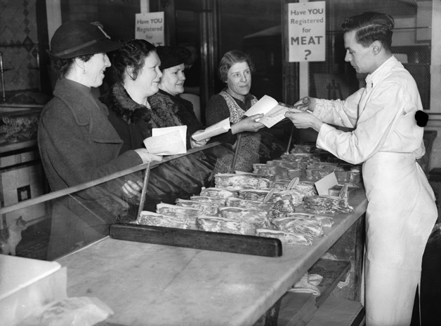
rationing
Rationing in Britain began in September 1939. Everything was rationed: food, clothes, petrol, even soap and washing powder. As the war continued, rationing became stricter and stricter. Many things were in short supply or unavailable. Rationing in Britain was over only in 1953 (in Russia – in 1947).

Slide 5
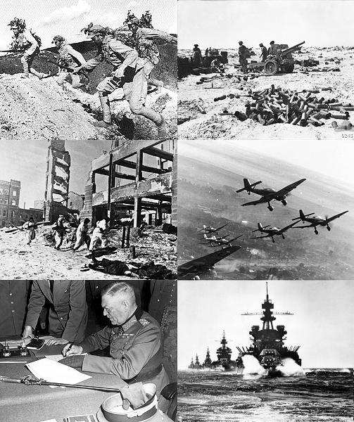
First battles
Britain stood alone against Hitler. Germany tried to conquer Britain by first gaining air supremacy. However, the Germans lost the Battle of Britain, the first battle to be fought solely in the air.

Slide 6
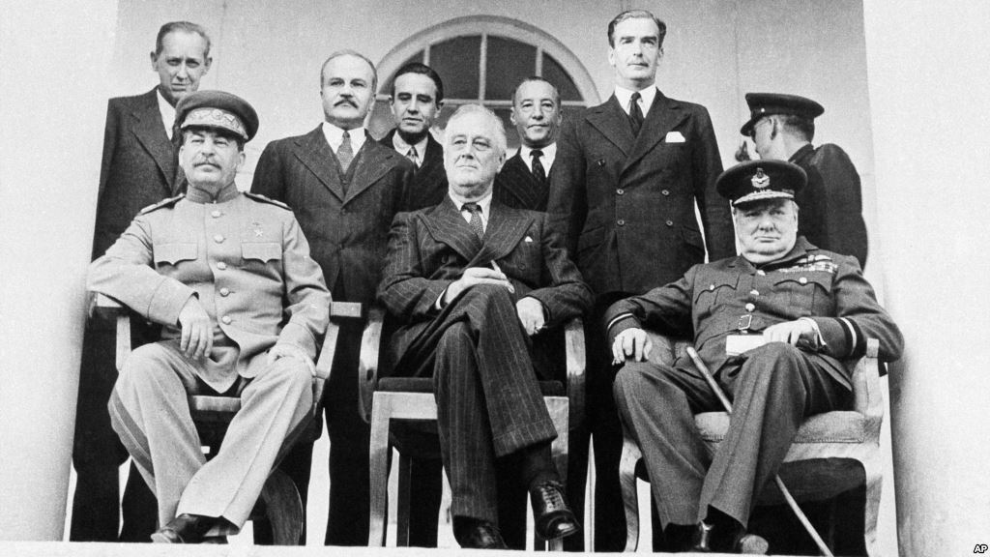
The creation of the second front
The problem of a second front existed from the time that fascist Germany attacked the USSR on June 22, 1941.
The decision to create a second front against Nazi Germany in Western Europe during the Second World War was made by representatives of the USSR, the US and the UK after talks in London and Washington in May - June 1942. At the Tehran Conference in 1943 the Western allies pledged to open a second front in May 1944.

Slide 7
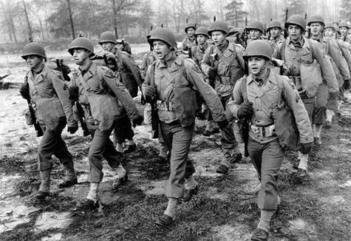
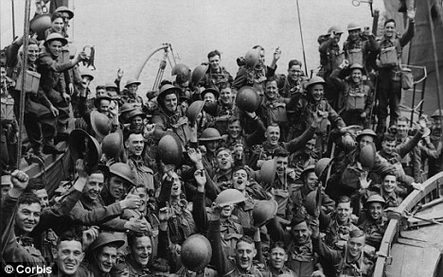
The British army
The British Army was not the most technically equipped army in the world, it did not have the largest number of soldiers, but for the expense of a well thought out tactics the British were able to turn around the tide of the war on the Western Front.

Slide 8
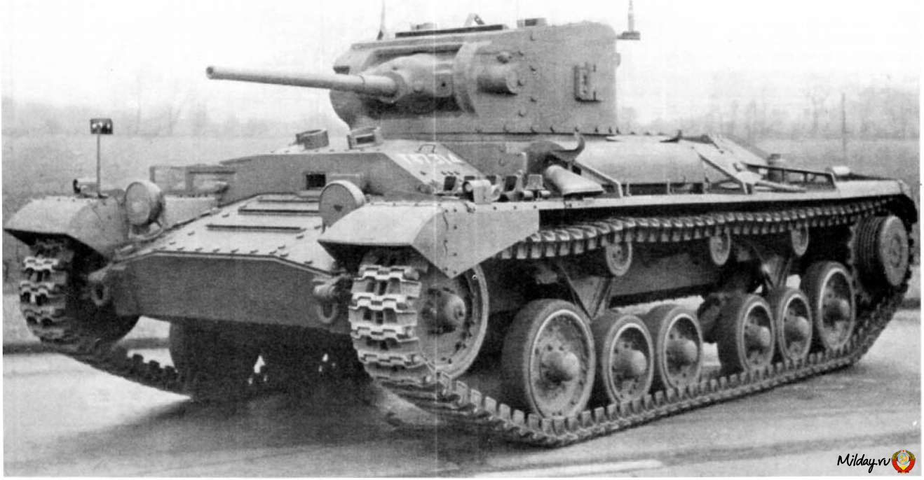
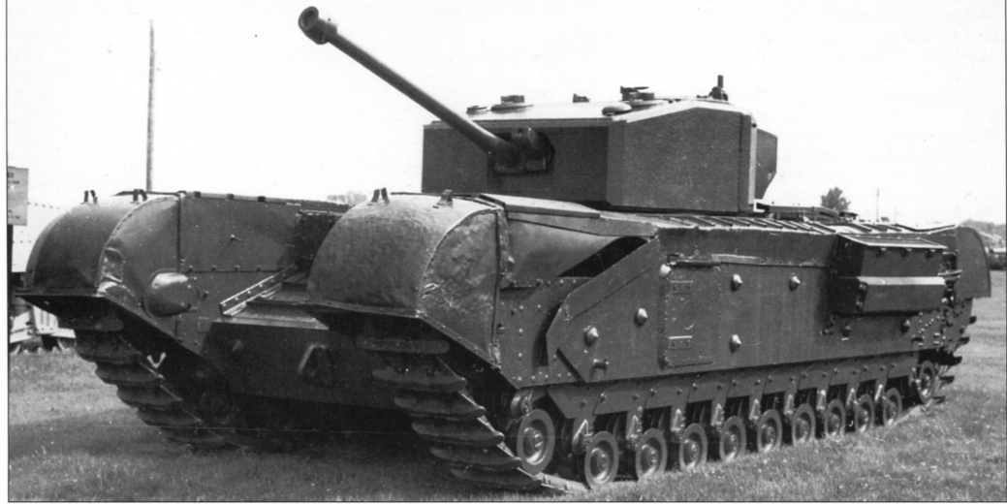
The main tanks of the UK
At the beginning of the Second World War in service of the British army there were such tanks as "Matilda", "valentine" and "Churchill". The tanks had a 40-mm cannon and 2-3 machine-guns. Tank "Churchill" had bulwarks, which often wedged caterpillars. All tanks are distinguished by low mobility.
Valentine Churchill

Slide 9
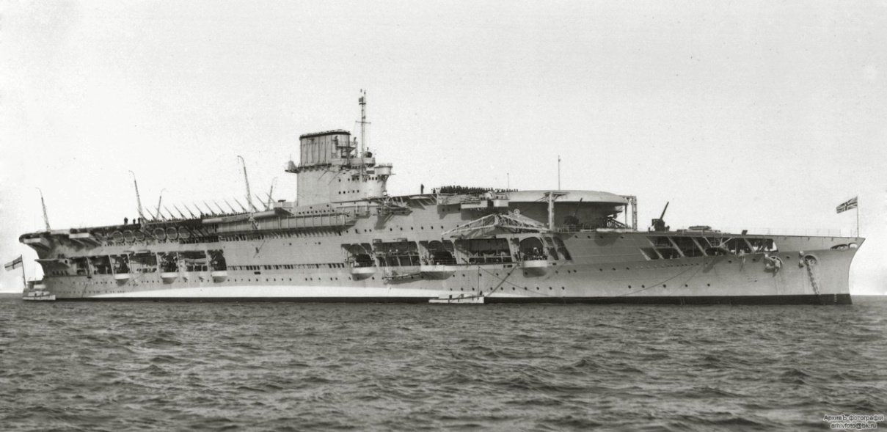
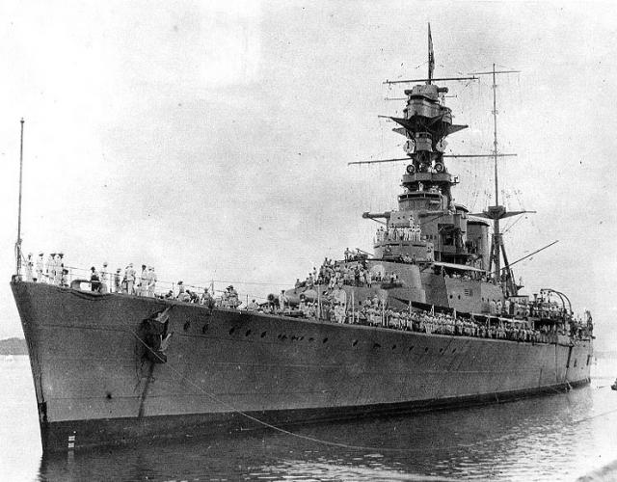
The ships
During the second World War Great Britain had many types of war ships like Carriers (Courageous, Argus, Hermes, Eagle, Ark Royal), battle cruisers (Renown, HMS Hood), heavy cruisers (Hawkins, County, York), destroyers and others. Mostly all of them had heavy armor and huge weapons.
Courageous HMS Hood

Slide 10
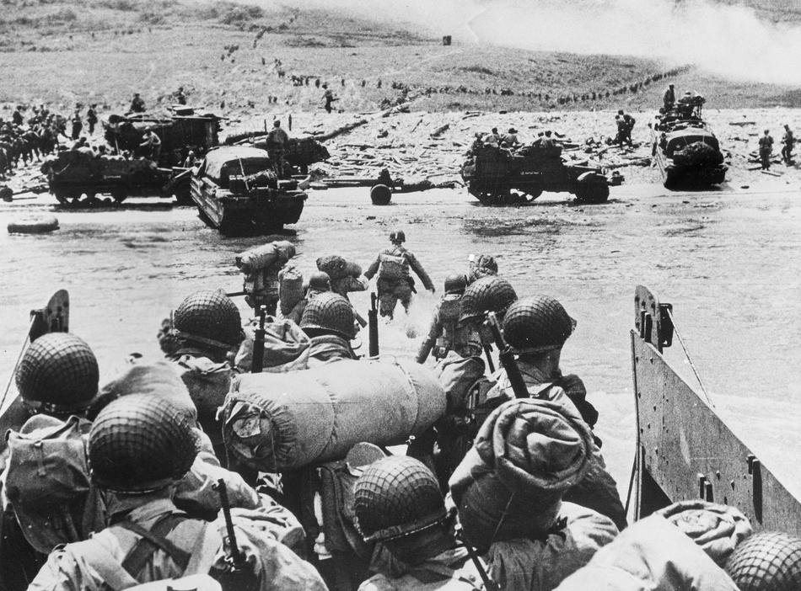
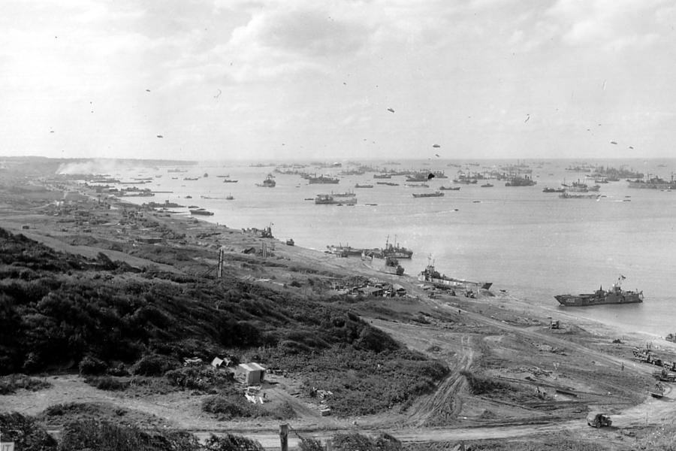
overlord
The second front was opened on the 6-th June, 1944 as a result of landing of English and American troops in Normandy. Normandy landing operation was named "Overlord". «Overlord» is the largest amphibious operation in history.
After the battle the Allies crossed the River Seine, released Paris and went on the offensive to the French-German border. More than 3 million soldiers took part in this operation.

Slide 11
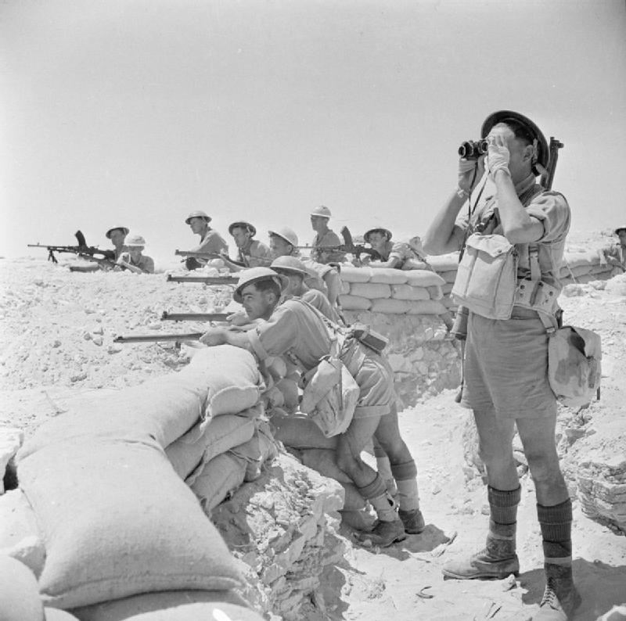
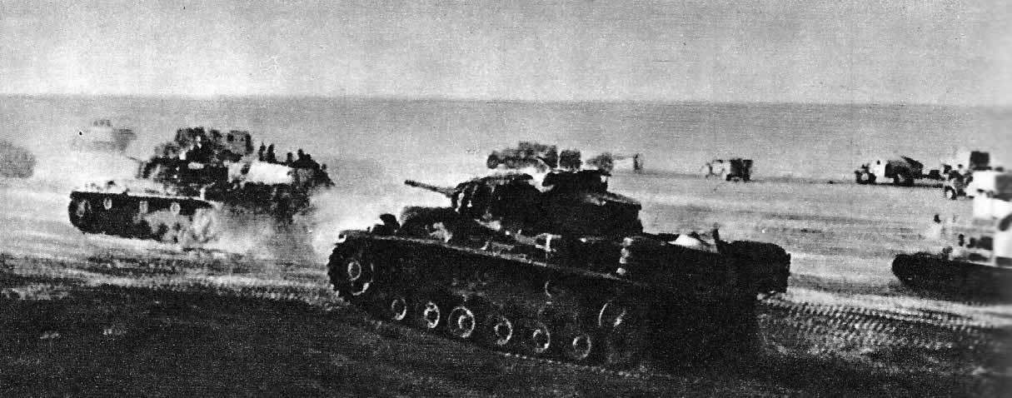
el Alamein
One of the turning points of the Second World War was the battle of El Alamein. Actually, there were two battles. The first one stopped the advance of Nazi troops under the command of General Rommel.

Slide 12
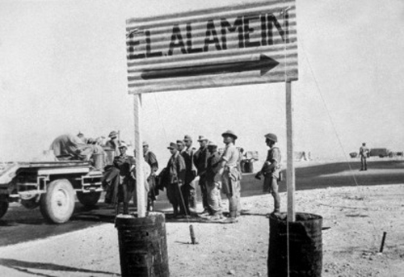
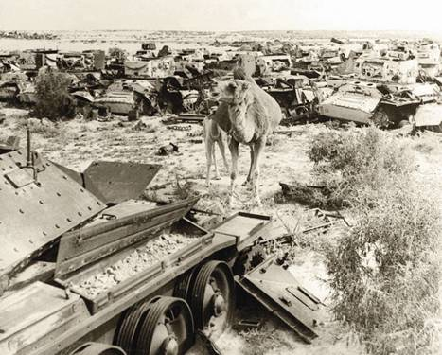
el Alamein. Second battle
The second one resulted in a series of runaway wins the British Army and the liberation of North Africa. The victory was achieved due to multiple superiority of the British army.

Slide 13
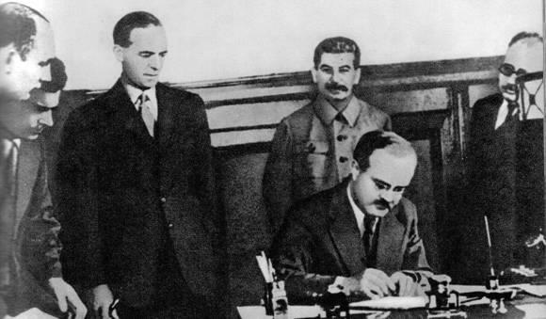
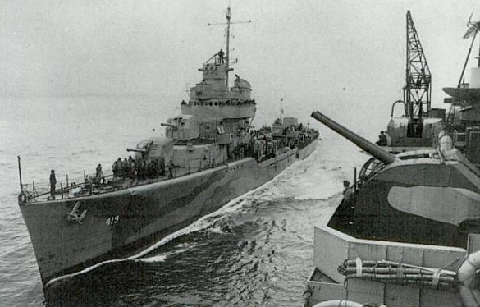
The help of the british for the Ussr
On the 12 of July 1941, Great Britain signed the Soviet-British agreement on joint actions against Germany in Moscow. On the 16 of August Great Britain granted the USSR a military credit. On the 31 of August the first British convoy arrived in Arkhangelsk, and in September the first British aircraft took part in the fighting on the Soviet-German front.

Slide 14
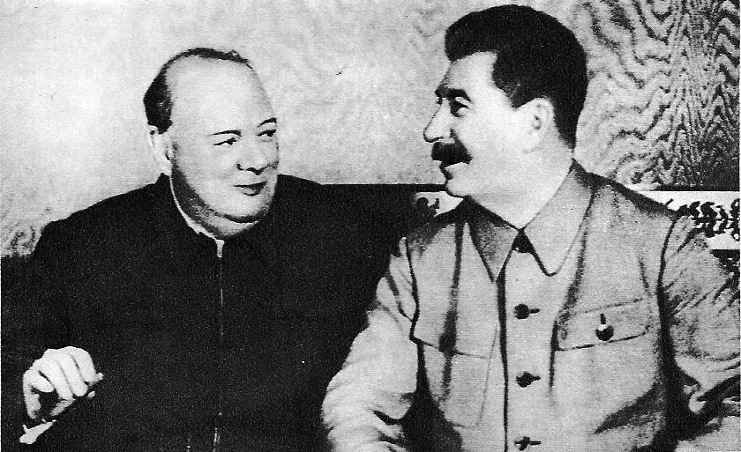
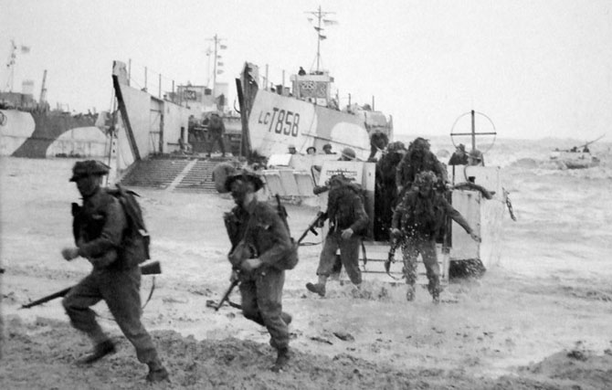
contribution of England
Great Britain helped allies a lot and made a great contribution to the victory. They sent convoys to the USSR, created the Western front, helped its allies, released North Africa and France. I can say, that the British were victorious by right.

