Slide 1
online shopping
Yuriy Stechishin
Form 8a
“Sosny” school
Teacher T.V. Kosormygina
December 2014

Slide 2
Internet retailing appeared at the end of 1990s. It was unlike home television shopping. Internet retailing quickly captured the attention of the public and the media, as companies started to develop websites that would sell directly to consumers.

Slide 3
Ancestor of the modern online store is videotext. Its author was a provider of communications networks, the Englishman Michael Aldrich. It was he, who in 1979 invented and launched the service, which is broadcast advertising products. Videotext gained popularity, and many people made purchases thanks to the inventive Michael Aldrich.
Michael Aldrich

Slide 4
Internet shopping has become possible of the evolution of e-commerce.
E-commerce or e-business consists of buying and selling of products or services over electronic systems such as the Internet and other computer networks.
Electronic commerce that is conducted between business is referred to as business-to-business or B2B .

Slide 5
However, after a few years the global network has spread, people stopped online trading because of distrusting it.
In 1994 started the American project Amazon, the largest company on the sale of goods and services, which is very popular so far. And the first restaurant that has attracted its visitors through the World Wide Web was a pizzeria.
Now we can acquire and buy any right thing, not even leaving home.

Slide 6
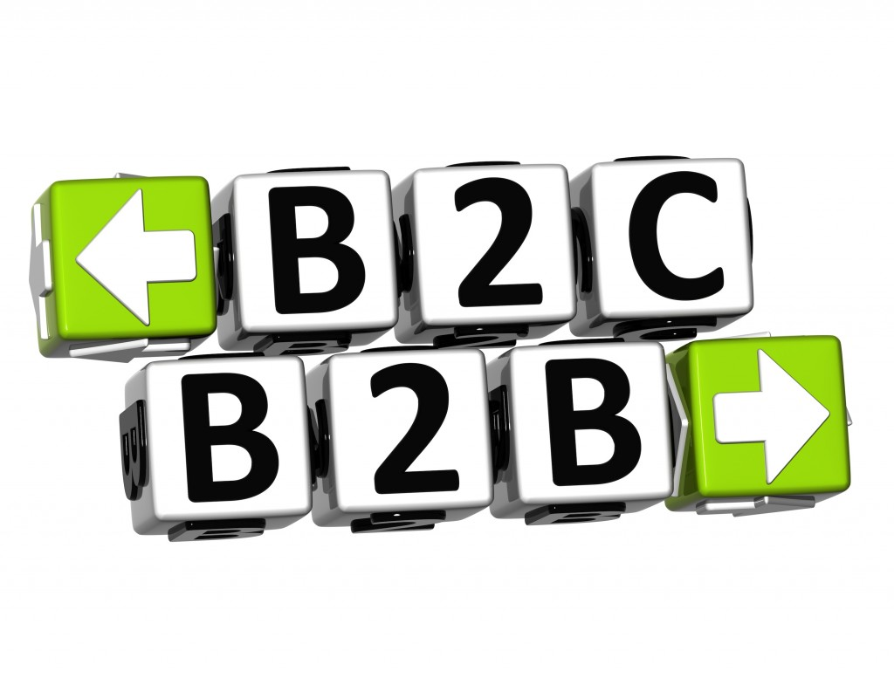
B2b & b2c
Electronic commerce that is conducted between business and commerce, on the other hand, is referred to as business-to-consumer or B2C.
This is the type of electronic commerce conducted by companies such as
Amazon.com.

Slide 7
Online shopping is a form of electronic commerce where the buyer is directly online to the seller’s computer usually via the internet. There is no intermediary service.

Slide 8
The sale and purchase transaction is completed electronically and interactively in real-time such as Amazon.com for new books.
If an intermediary is present, then then sale and the purchase transaction is called electronic commerce such as eBay.com.

Slide 9
aDvantages of online shopping
Online shopping has numerous advantages for the customers.
First, you can get the best bargain as the Internet gives you the opportunity to look at offers of many stores.

Slide 10
Second, you can save time. Online stores are usually available 24 hours a day, and many consumers have Internet access both at work and at home. Searching and browsing an online catalogue can be faster than browsing the aisles of a physical store.

Slide 11
Third, one can avoid crowded malls.

Slide 12
Disadvantages of online shopping
Nevertheless, there are some disadvantages, too.
To begin with, some customers find computers hard to use.
Second, not all online retailers have made their sites easy to use or reliable.
Third, we cannot inspect the quality of the product before buying it. So the risk of fraud is much higher in online shopping than in conventional shopping.

Slide 13
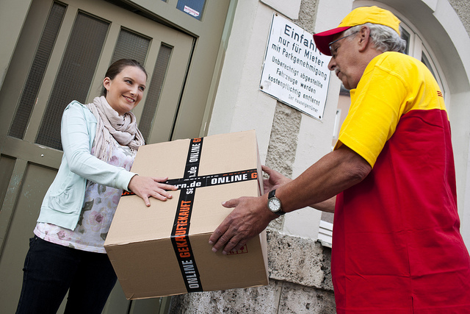
If there is a problem with a product and one wises to return it, the procedure can be quite complicated. Moreover, very often the delivery takes quite a lot time and may be delayed.

Slide 14
So we can say with confidence: online stores - is one of the greatest achievements of the 21st century and they are still developing.

Slide 15
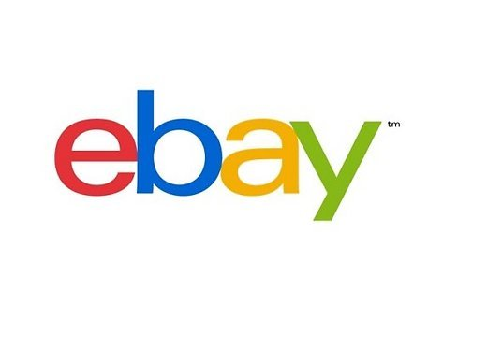
These are some well known online stores

Slide 16
The end

