Slide 1
selfridges
Andrey Mitko
Form 8 a
“Sosny” school
Teacher T.V. Kosormygina
29.12.14

Slide 2
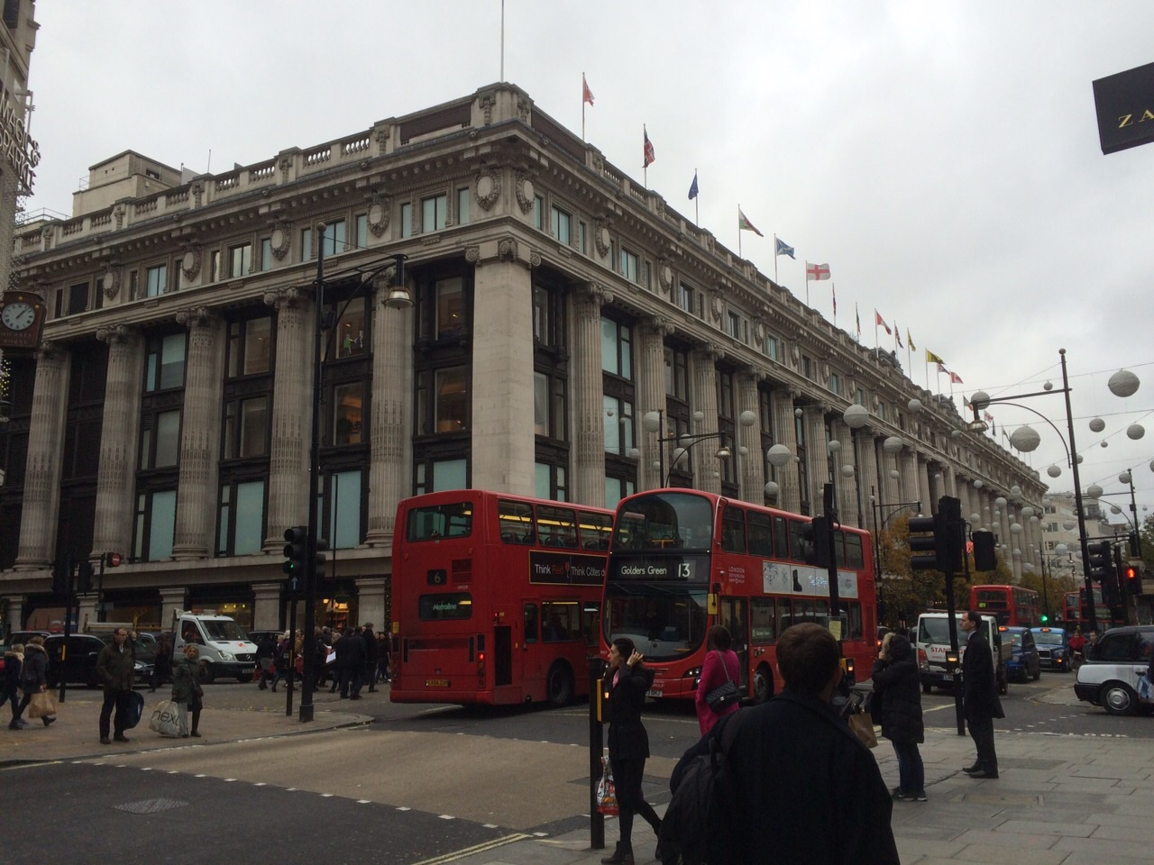
Selfridges
Location
Selfridges, Oxford Street is a Grade II listed retail
premises, located in
Oxford street London, England.

Slide 3
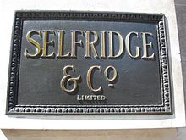
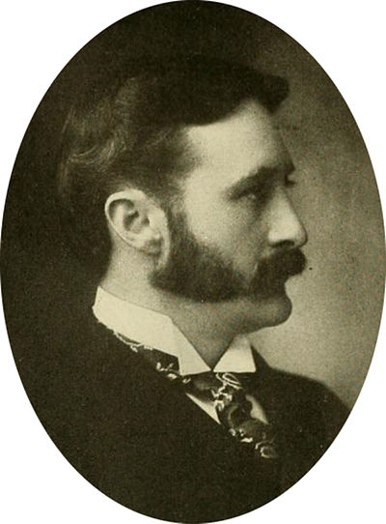
It was designed by Daniel Burnham
for Harry Gordon Selfridge, and opened in 1900. He tried to make shopping a fun adventure instead of a chore.

Slide 4
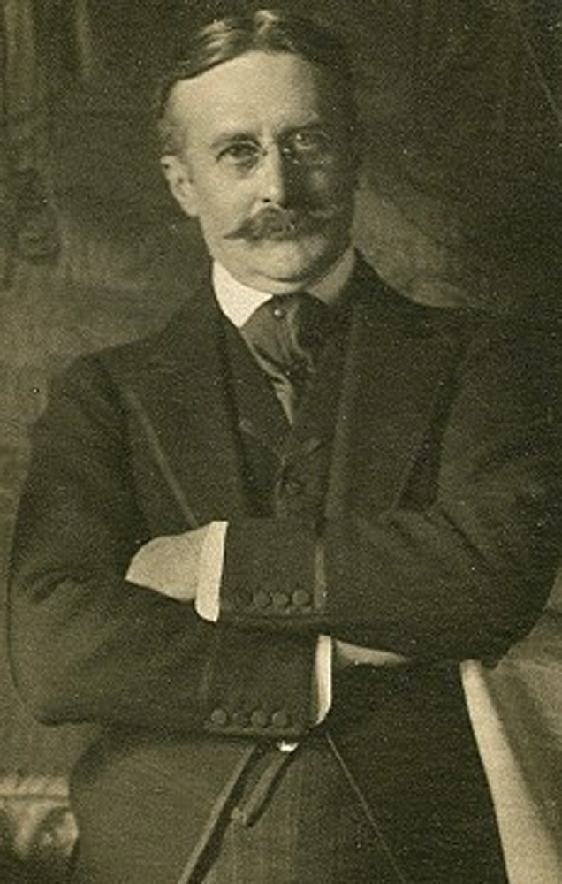
Harry Gordon Selfridge
Harry Gordon Selfridge, Sr. (11 January 1858 – 8 May 1947 ) was an American-born British retail magnate who founded the London-based department store Selfridges. His 30-year leadership of Selfridges led to his becoming one of the most respected and wealthy retail magnates in the United Kingdom. Selfridge remained chairman until he retired in 1941. In later life, Selfridge lost most of his fortune.

Slide 5
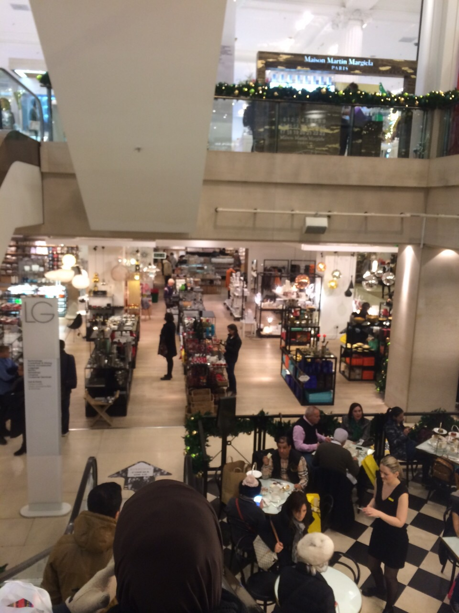
The store is the second largest retail premises in the UK, half as big as the biggest department store in Europe, Harrods. It was named the world's best department store in 2010, and again in 2012. Harry Gordon Selfridge will celebrate 150 years in 2015!
Selfridges

Slide 6
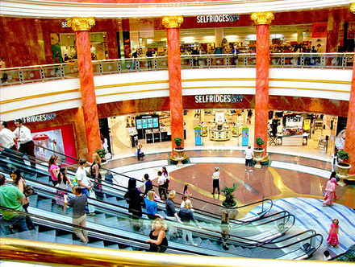
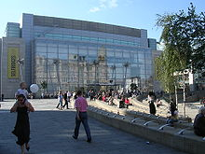
Selfridge attracted shoppers with educational and scientific exhibits and was himself interested in education and science, and believed that the displays would introduce potential new customers to Selfridges, generating both immediate and long-term sales.

Slide 7
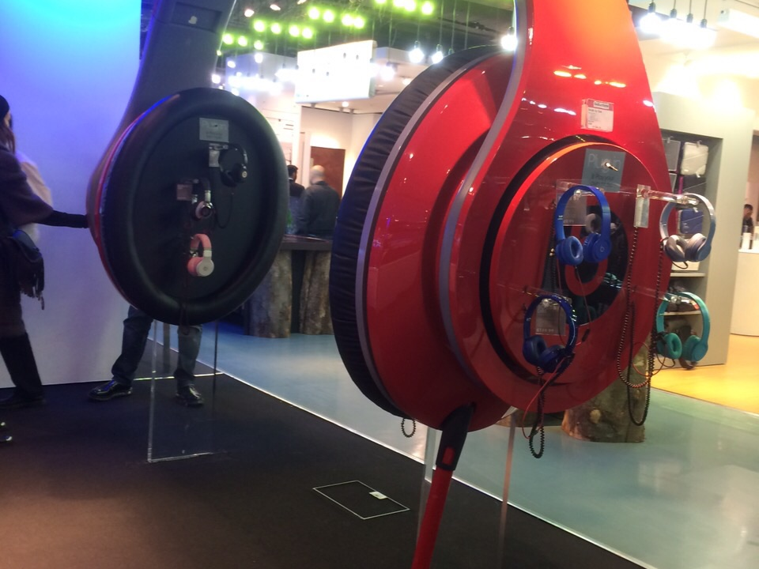
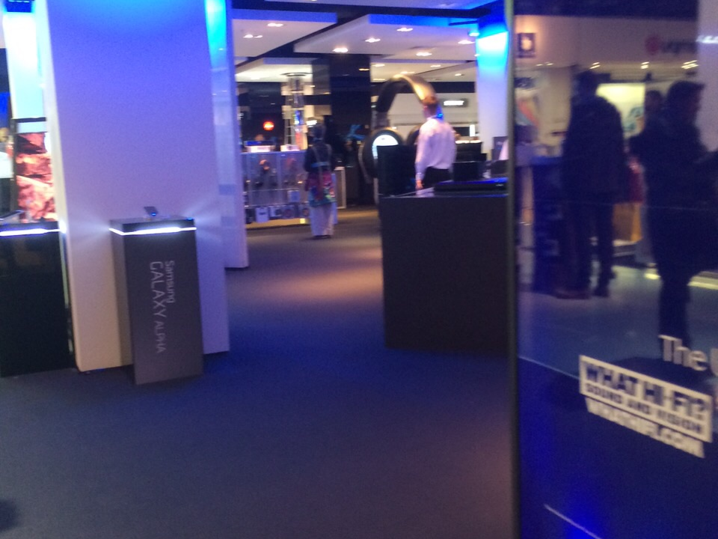
Selfridges, also known
as Selfridge & Co., is a
chain of high end
department stores in
the United Kingdom.
It was founded by
Harry Gordon Selfridge.
The shop's history
was dramatised in 2013, in
the British television series
Mr Selfridge.
Other Selfridges stores opened in
the Trafford
Centre (1998); Exchange Square
(2002) in Manchester; and in the
Bullring, Birmingham (2003).

Slide 8
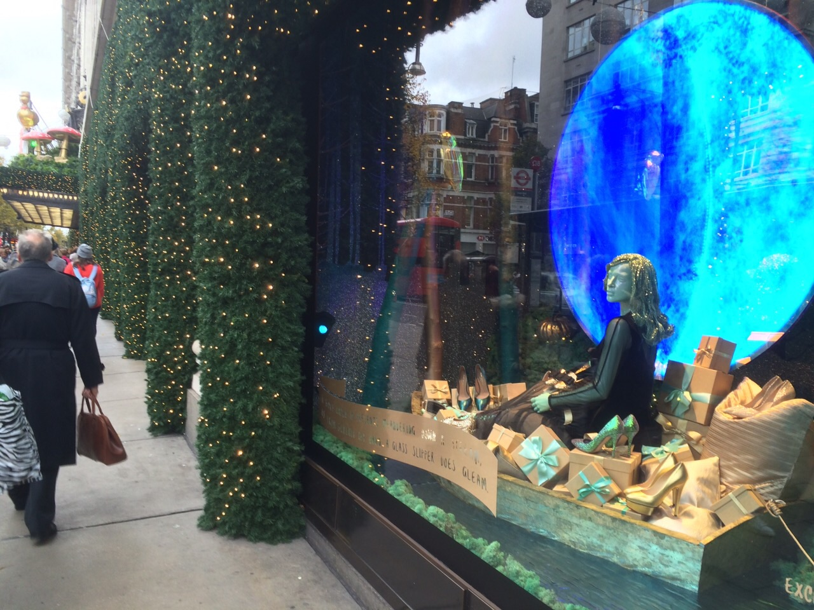
Windows
Selfridges windows have become synonymous also with the brand, and to a certain degree have become as famous as the company and Oxford Street location itself. Selfridges has a history of bold art initiatives when it comes to the window designs.

Slide 9
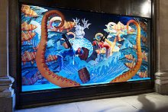
The windows consistently attract tourists, designers and fashionists alike to marvel at the current designs and styling and fashion trends.

Slide 10
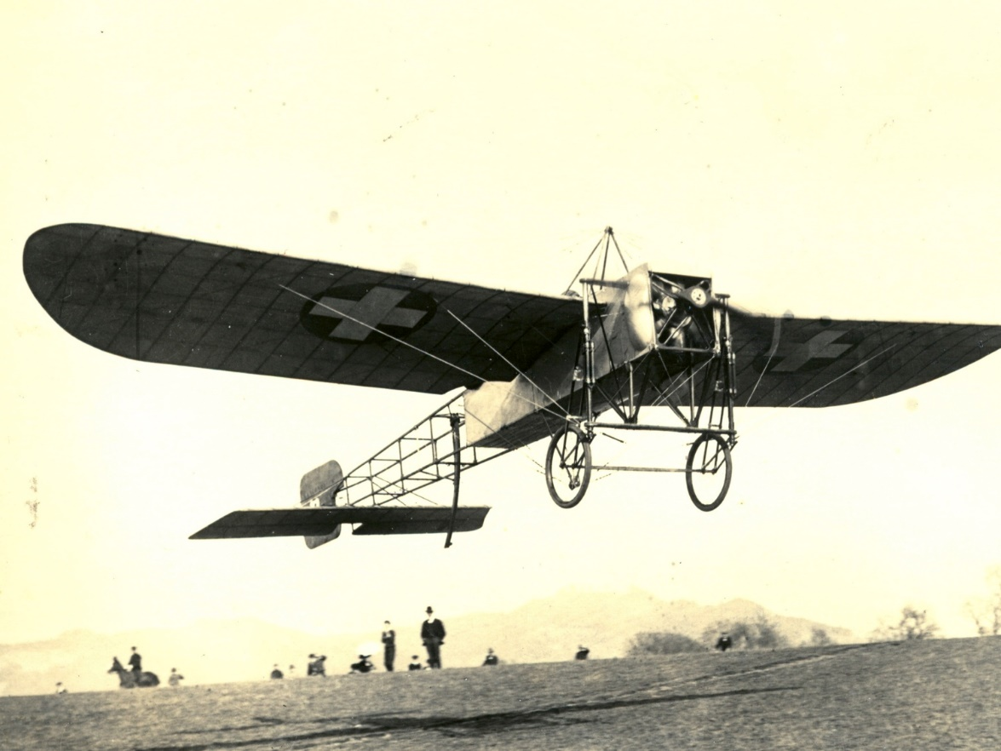
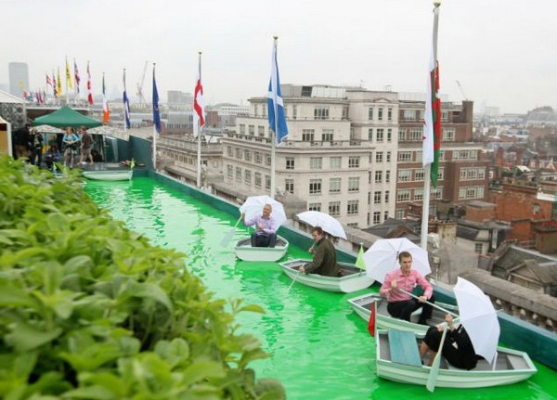
In 1909, after the first cross-Channel flight, Louis Blériot's monoplane was exhibited at Selfridges, where it was seen by 12,000 people.
The first public demonstration of television was by John Logie Baird from the first floor of Selfridges from 1 to 27 April 1925.
In the 1920s and 1930s, the roof of the store hosted terraced gardens, cafes, mini golf.

Slide 11
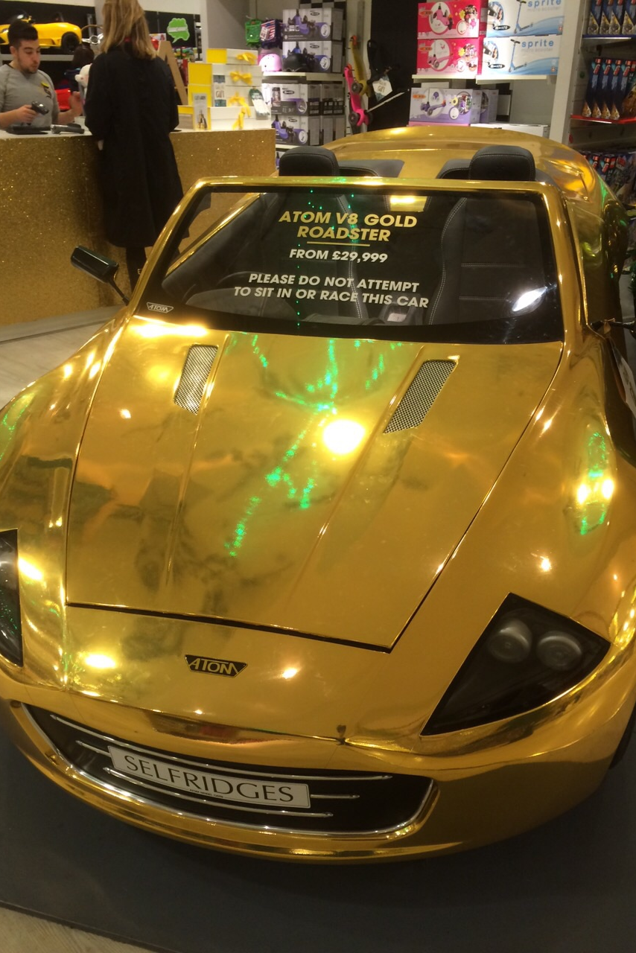
SPECIAL!
If you want,
you can buy little roadster !

Slide 12
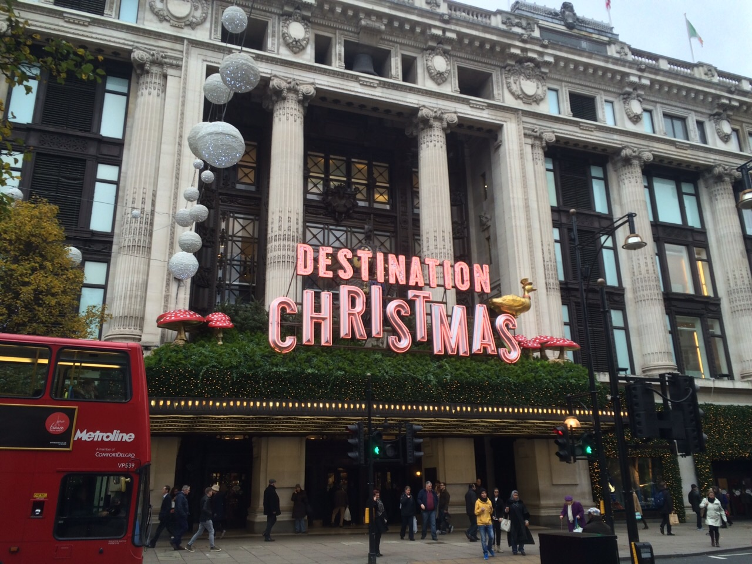
Every year Selfridges organizes an event sale! On 29.12.14 it was “Destination Christmas”! Harry Gordon Selfridge first organized the sale “ … days before Christmas”.
Event’s sale

Slide 13
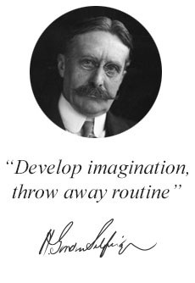
Slogan
The customer is always right!

Slide 14
Brands
There are approximately 363 brands!
Some of which you may know
LOUIS VUITTON
G-STAR
ARMANI

Slide 15
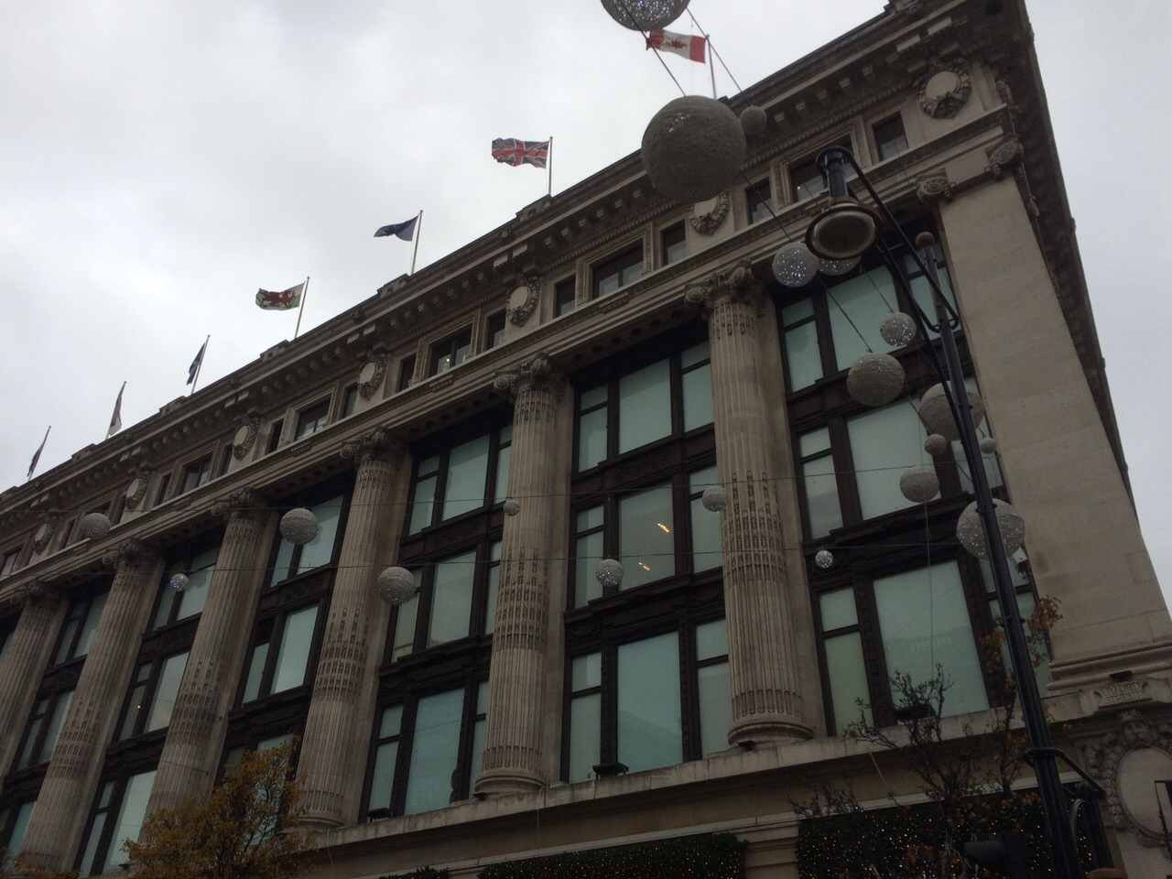
Selfridges proves its superiority!

