Slide 1
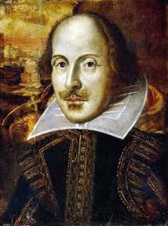
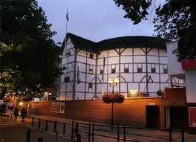
GLOBE THEATRE
By T.V. Kosormygina
April 2016

Slide 2
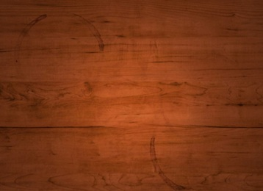
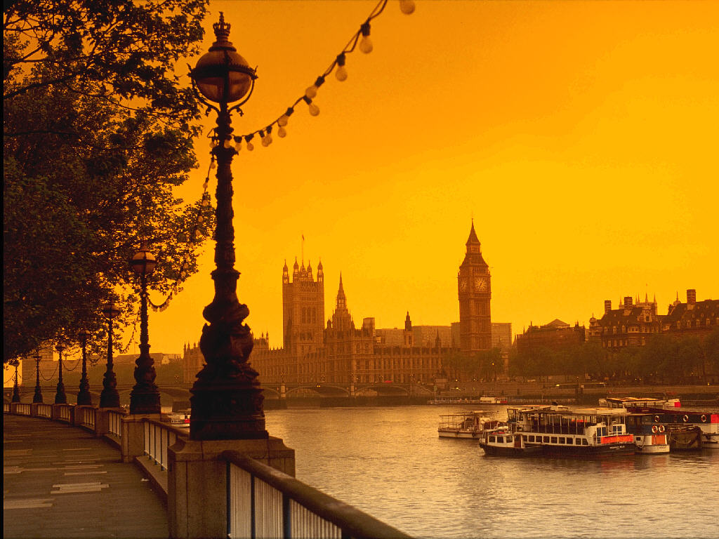
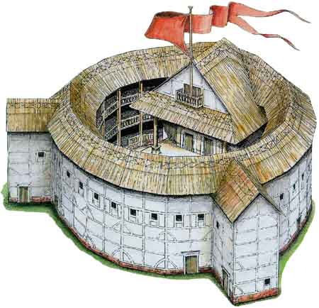
The Globe Theatre was a theatre in London associated with William Shakespeare. It was built in 1599 by Shakespeare's playing company.

Slide 3
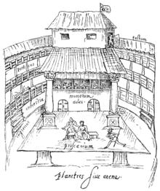
On 29 June 1613 the Globe Theatre went up in flames during a performance of Henry VIII. A theatrical cannon misfired and a fire started. No one was severely injured in the event. It was rebuilt in the following year.

Slide 4
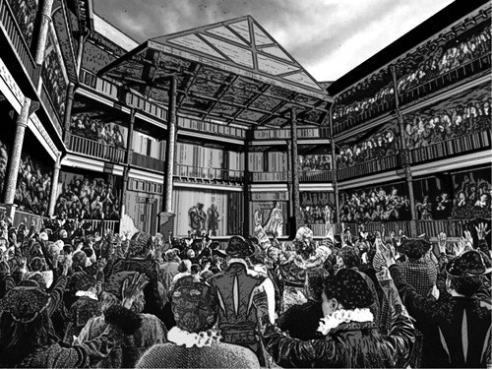
http://www.nathalie-maury.com/s/cc_images/cache_8508475.jpg?t=1389732805
Vertically around the yard were three levels of seats, which were more expensive than standing room.
The back wall of the stage had two or three doors on the main level, with a curtained inner stage in the centre and a balcony above it. The balcony housed the musicians.
Large columns on either side of the stage supported a roof over the stage. The ceiling under this roof was called the "heavens."

Slide 5
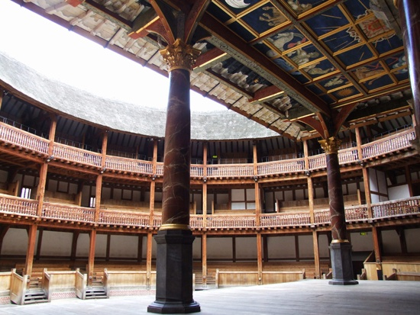
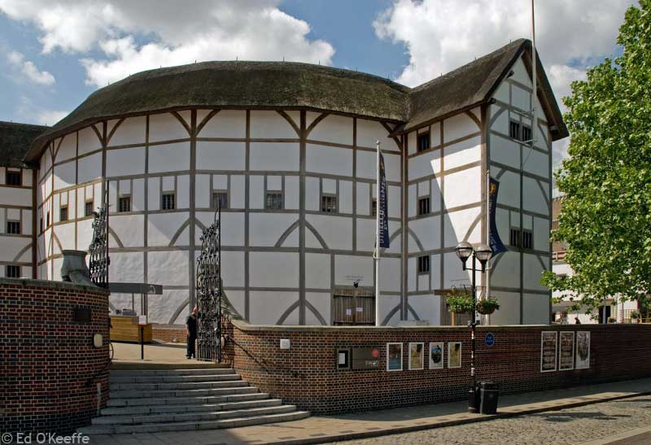
The second Globe Theatre was built on the same site in June 1614 and closed by the puritans in 1642 .
A modern reconstruction of the Globe, named "Shakespeare's Globe", opened in 1997 approximately 230 m from the site of the original theatre. From 1909, the current Gielgud Theatre was called "Globe Theatre", until it was renamed in 1994.

Slide 6
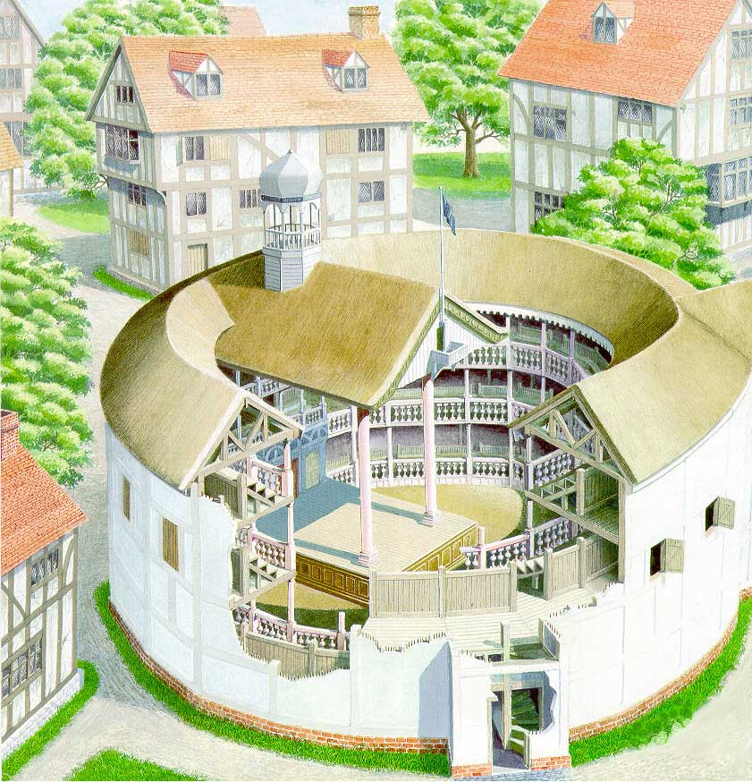
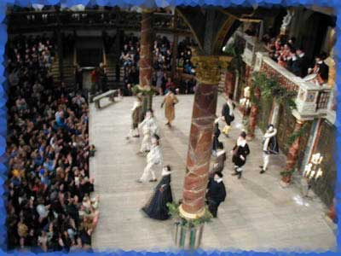
The original size of the Globe is unknown. The evidence suggests that it was a three-storey, the open-air amphitheatre that could house up to 3,000 spectators. The uncovered small part of the Globe's foundation suggested that it was a polygon of 20 sides.

Slide 7
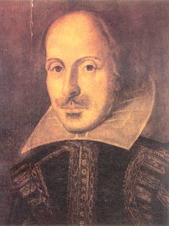
There wasn’t any scenery in the Shakespeare’s theatre. There were only notices with the signs, where and when the action took place. They helped the audience to understand the scene.

Slide 8
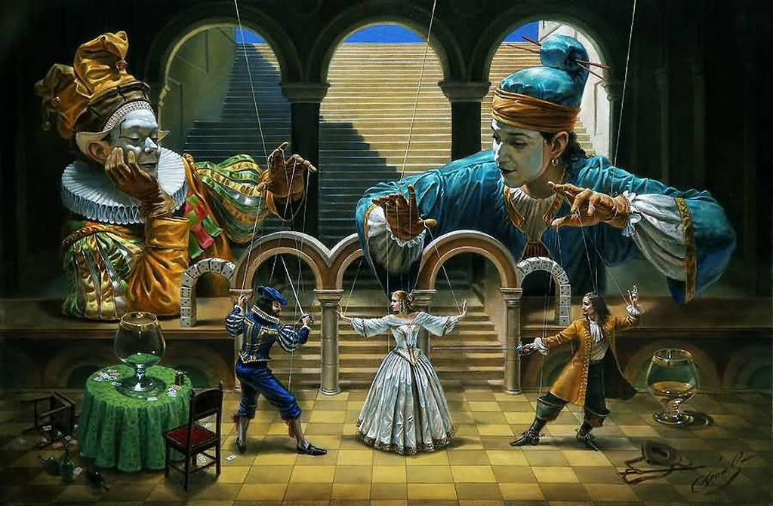
“… the world <is> a stage, where every man must play a part” (from “The Merchant of Venice”). Only men or teenagers were allowed to perform at the theatre in the 16th century. There were no women in a theatre company.

Slide 9
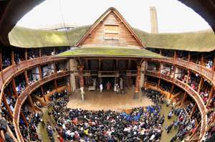
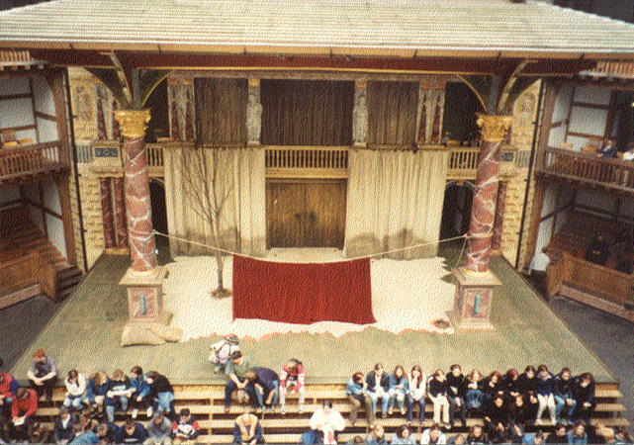
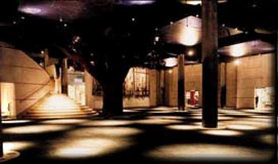
Shakespeare’s plays demanded to activate the audience’s rich imagination in order to understand the plot.

Slide 10
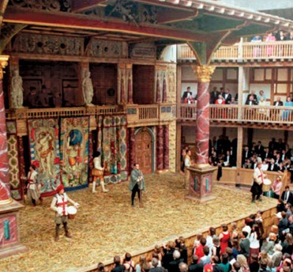
Today, the theatre has a stage that stands out in a huge round courtyard surrounded by seats on three balconies. Тhere is also some standing room, where people can’t sit during a performance.

Slide 11
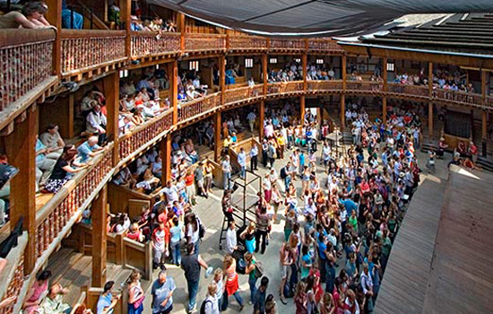
Seven hundred standing room tickets (stand optional, sit not allowed) in the courtyard are available for each view for 5 pounds each.

Slide 12
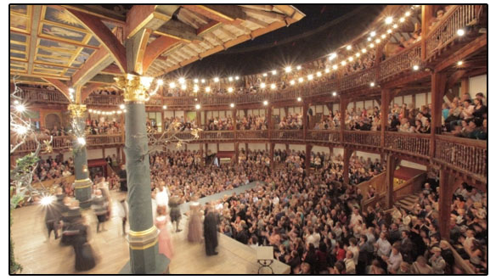
The only part of the amphitheatre closed by the roof is a stage and more expensive seats. In winter, when the theatre season is closed, the theater is used for educational aims.

Slide 13
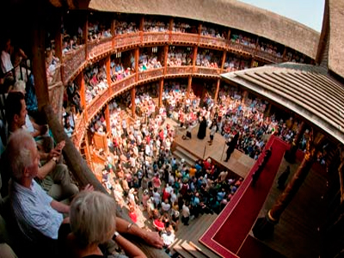
Nowadays showing performances goes every summer (May to October). Guided tours are available all the year round.

Slide 14
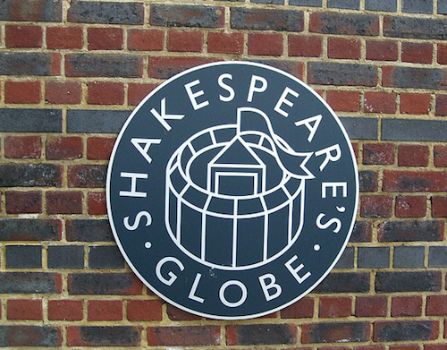
All the world is a playground

