Slide 1
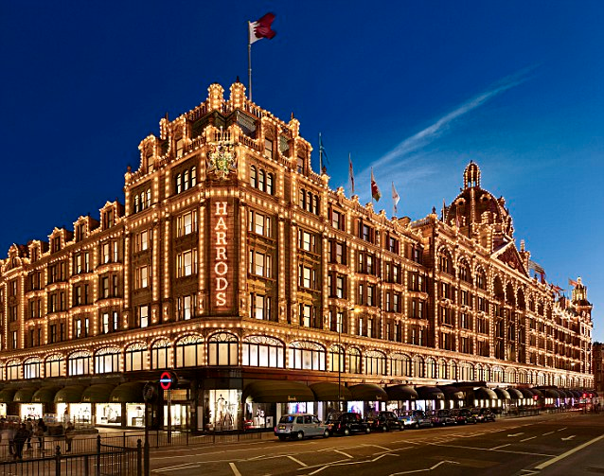
SHOPPING IN GREAT BRITAIN : the most popular shops and shopping centers
The presentation of Anastasia Kashkan,
Form 8 “A”,
“Sosny “ school
Teacher T.V. Kosormygina
December 2014

Slide 2
Great Britain is the ideal country for shopping and different purchases. Shopping in Britain attracts many tourists: in this country you may buy really fashionable and stylish clothes rather cheaper than in Russia, though you have to pay not little money for that.

Slide 3
Today ordinary people all over the world obtain goods from a very wide variety of global sources. People shop from the Internet, from mail order, from TV channels, from High Street (this is how the main shopping street in many British towns is called) or nearby mall a few miles away. But it has not always been this way.

Slide 4
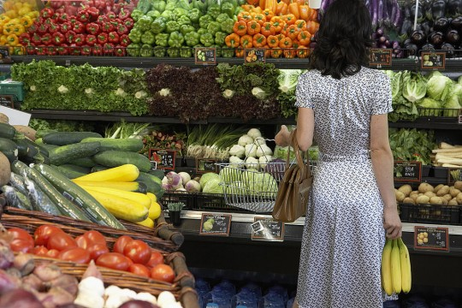
In ancient times people bartered goods that they had produced themselves. In the 19th and 20th century Europe most of the shopping was done in traditional shops including the local Butcher’s, Baker’s, Grocer’s, Newsagent’s.

Slide 5
Over the years as supermarkets appeared some of those traditional shops closed down and small corner shops selling many of the same things started to appear, often staying open much later than new supermarkets.

Slide 6
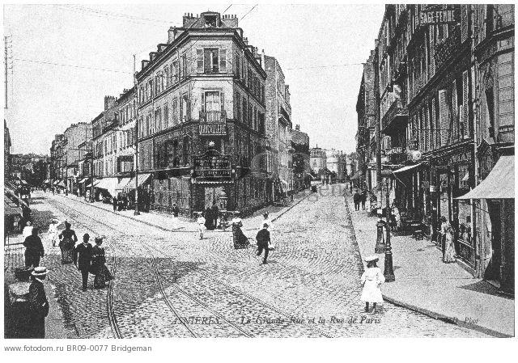
Shopping centers have existed in some form for more than 1000 years in ancient market squares, bazaars and seaport commercial districts. Later shopping high streets appeared in the center of the European town. The modern shopping center, which includes everything from small suburban centers to the million-square-foot superregional malls, emerged in the 1920s.

Slide 7
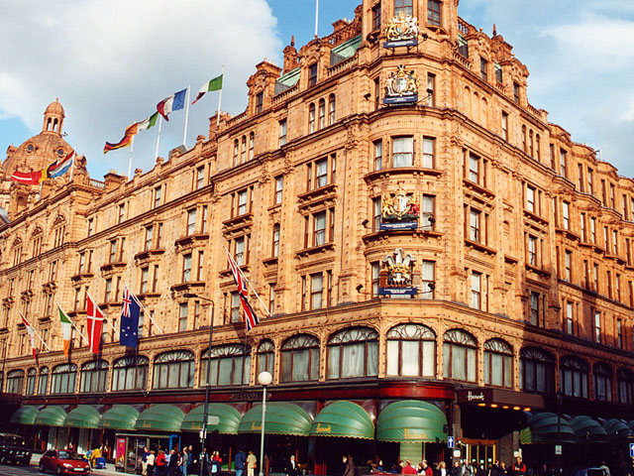
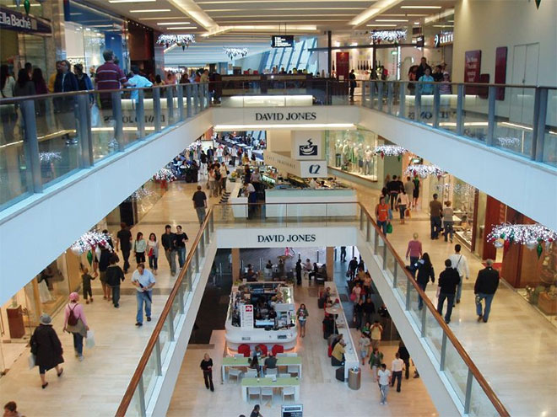
Nowadays there are several types of shopping centers. Department stores sell a wide range of products including clothing, furniture, appliances, toiletries, cosmetics, jewelry, toys, and sporting goods. Originally most of the department stores were independent and were located in the center of the city. Now a single company may own 20 brands trading in City centers and out of town malls.

Slide 8
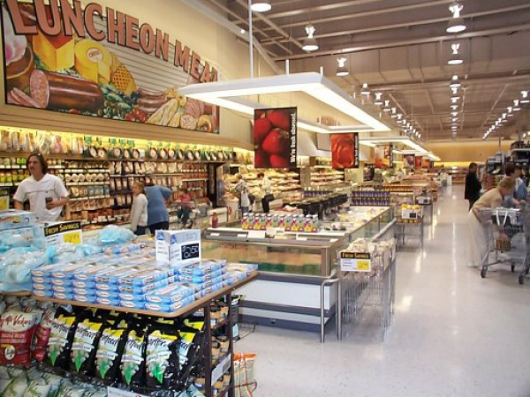
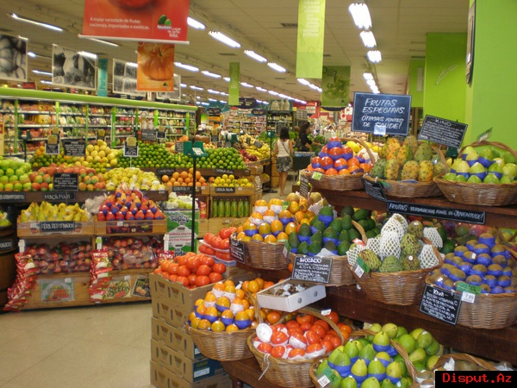
Another modern type of shopping is a supermarket. When supermarkets first appeared, some of them specialized in food and others had no food products as the core of the business. Now they sell anything from paint to toys to a mouse for your computer or fresh bananas. They build bigger and bigger out-of-town stores and they have grown for a great amount. A few powerful forces in supermarket retailing dominate the market in each country. The stores are often part of a corporate supermarket chain.

Slide 9
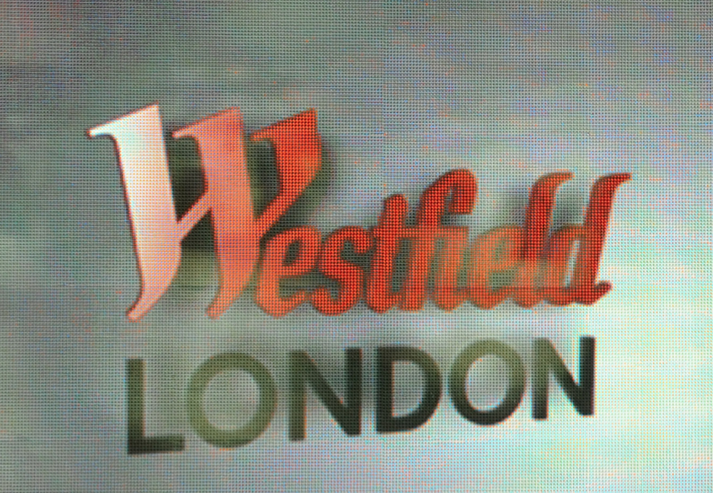
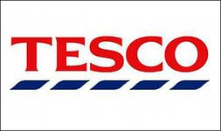
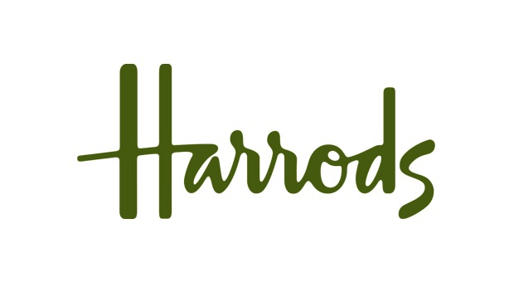
Westfield, Sainsbury’s, Harrods and Tesco are among the most popular shopping centres in London.

Slide 10
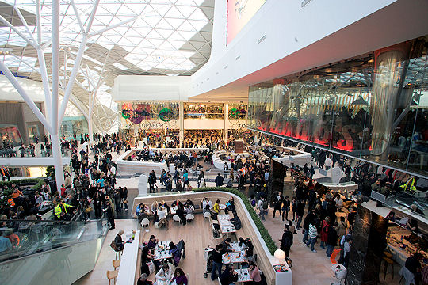
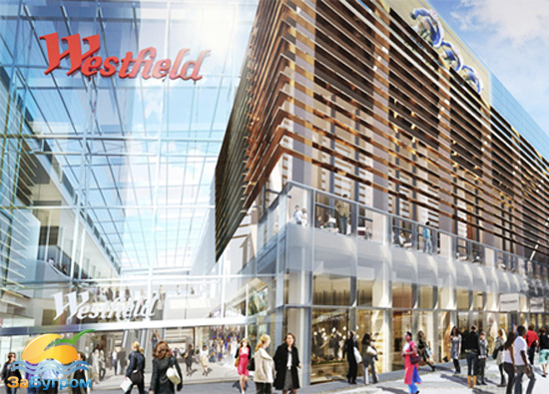
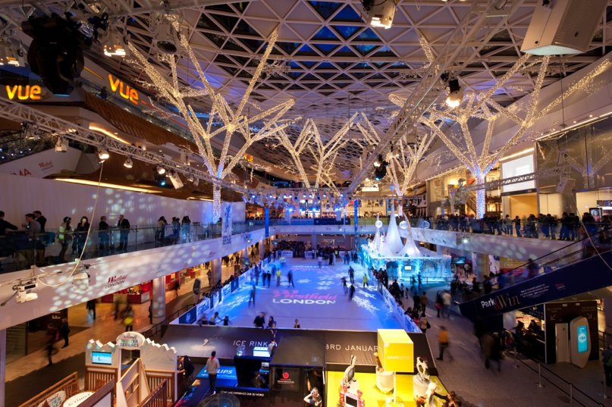
Westfield is the biggest shopping center in Europe.

Slide 11
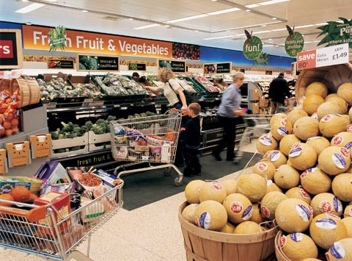
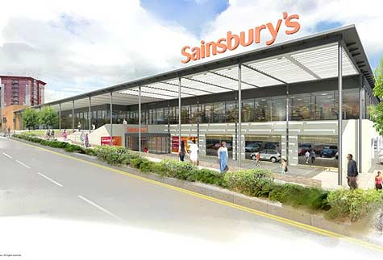
Sainsbury's is the third largest chain of supermarkets in the United Kingdom. Founded in 1869 by John James Sainsbury with a shop in Drury Lane, London, the company became the largest grocery.

Slide 12
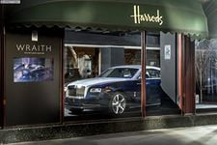
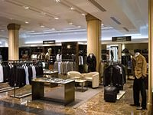
Harrods is the most popular and one of the most expensive shopping centres of London.

Slide 13
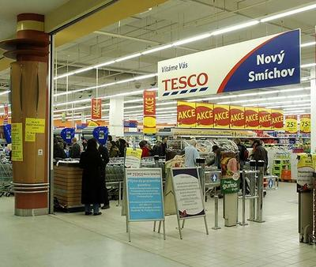
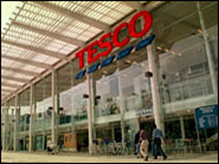
Tesco is the dominant player in the UK with large superstores in and out of town shopping areas with easy and free parking.

Slide 14
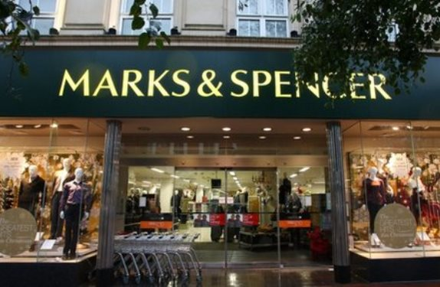
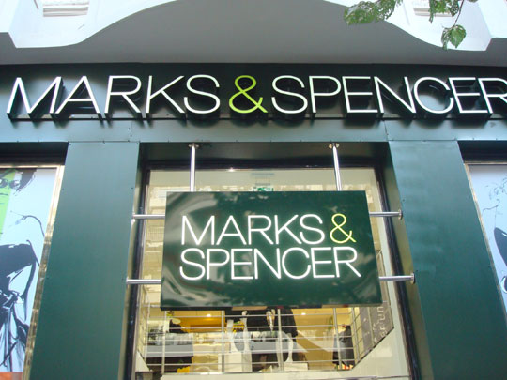
Marks & Spencer is a world famous department store selling everything from clothes and home furnishings to food.

Slide 15
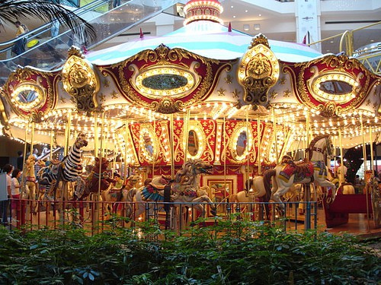
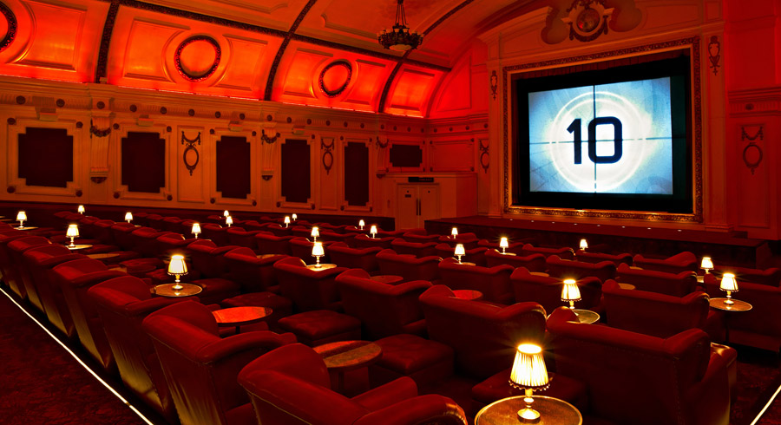
Entertainments in shopping centers.
Entertainment quickly became popular in the early 1990s, and shopping centers started to use it. Under one roof in shopping malls and megamalls consumers enjoy children’s playscapes, virtual reality games, live shows, cinemas, a variety of food in the food court, carousel rides and another activities. Among the many services found in today’s malls are postal branches, travel agencies, beauty parlours and hairdresser’s , libraries, and museums.

Slide 16
Nowadays famous supermarkets are so attractive and amusing that more and more citizans prefer them to museums or cinemas.

