Slide 1
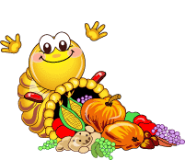
THE HISTORY OF THANKSGIVING DAY
by FEODOR KORNEEV
Form 4 B
“Sosny” school
Teacher T.V. Kosormygina
November, 2016

Slide 2
The last Thursday in November is a holiday in America. People call this holyday Thanksgiving Day.

Slide 3
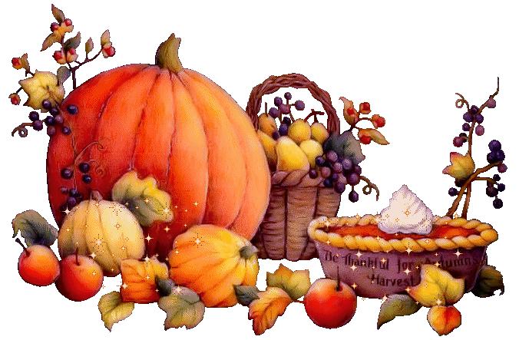
They decorate their houses with the fruit and flowers of autumn and have traditional American food: roast turkey, potatoes and pumpkin.

Slide 4
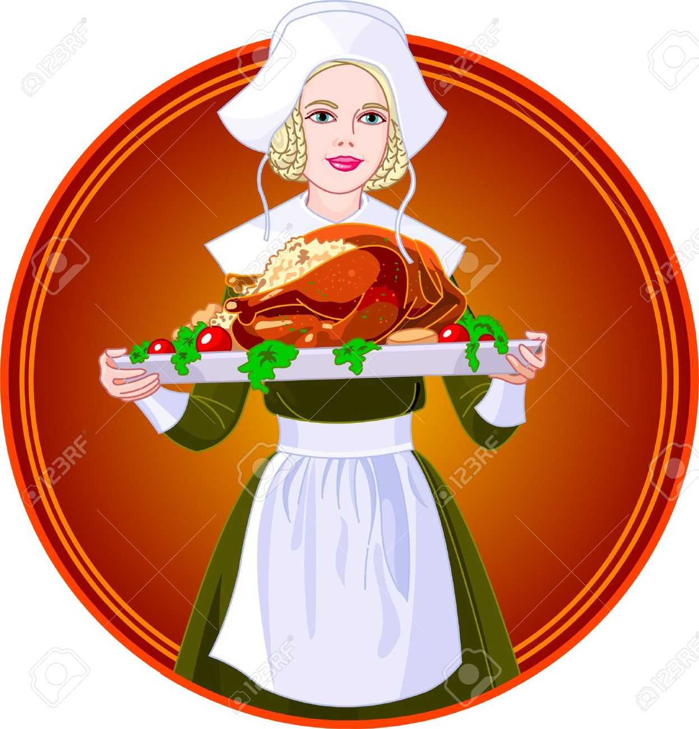
What are people celebrating?
What are people giving thanks for?

Slide 5
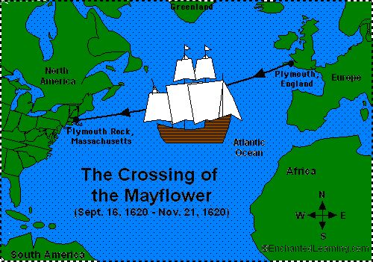
The first colonists came to America in the autumn of 1620. Their ship “The Mayflower” was about to break in storms.

Slide 6
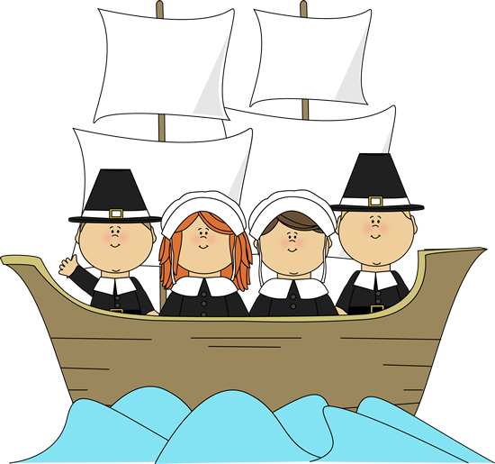
Those people were pilgrims. The pilgrims left England for America to start a better life. They were men, women and their children

Slide 7
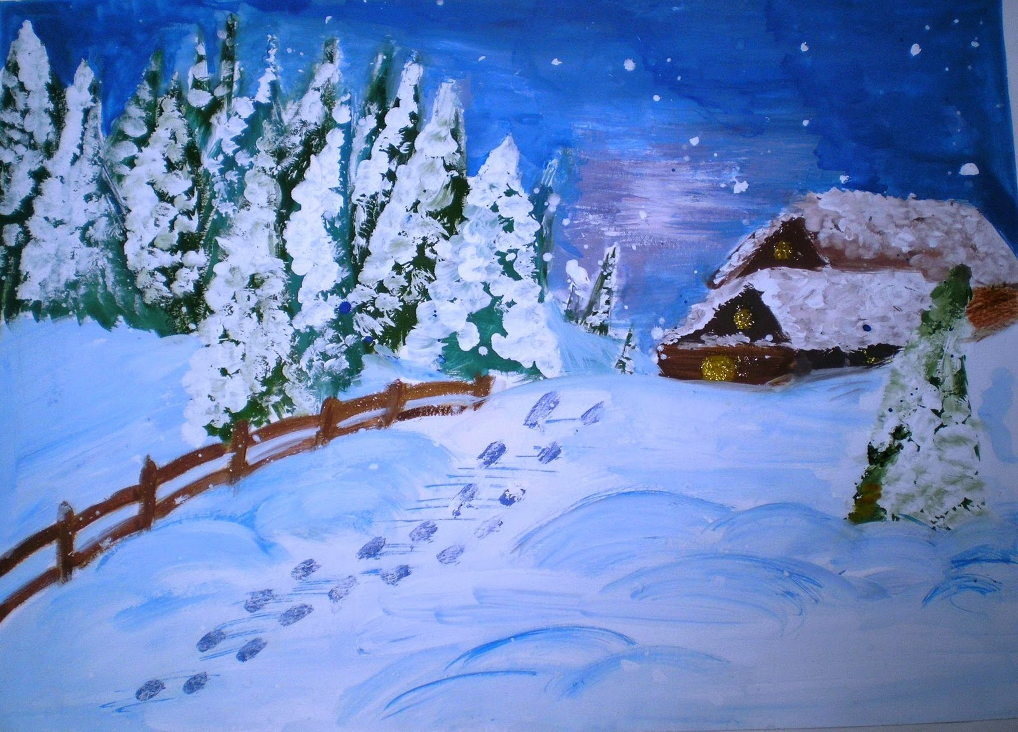
They began a new life there. It was very hard.
Some of them had colds and were badly ill.

Slide 8
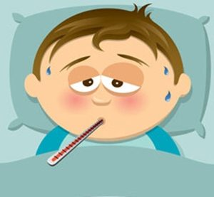
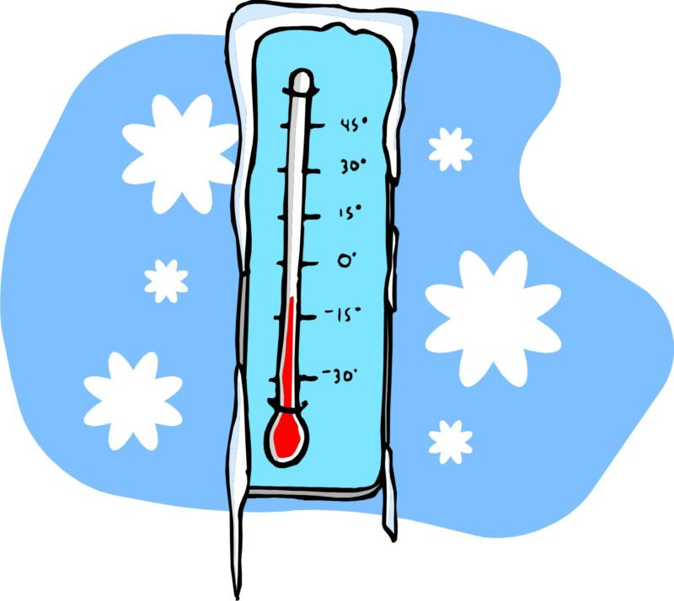
It was a difficult year. Many of them died in winter because they were hungry and sick.

Slide 9
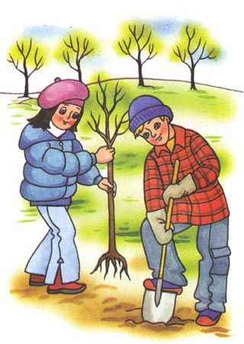
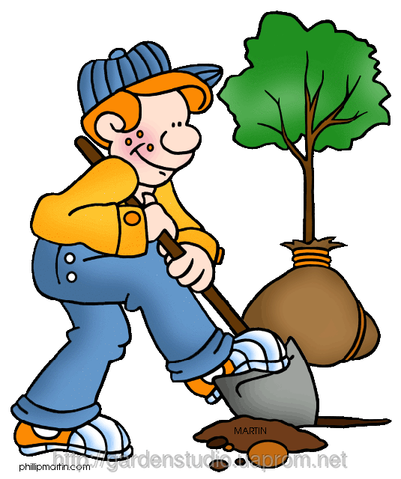
The next spring the colonists started to farm the land. The work was difficult and full of danger.

Slide 10
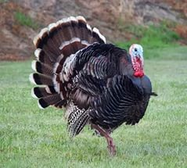
There were a lot of wild birds in the place where they lived. They were like chickens but much bigger. They were turkeys.

Slide 11
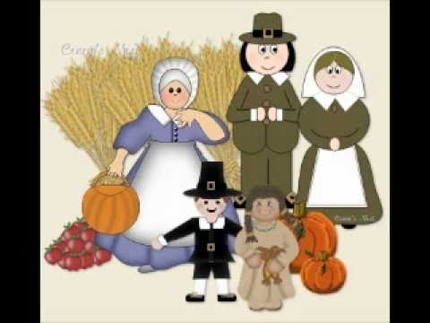
In the autumn of 1621 they had their first harvest. It was so large and good that they could eat it for 3 years long.

Slide 12
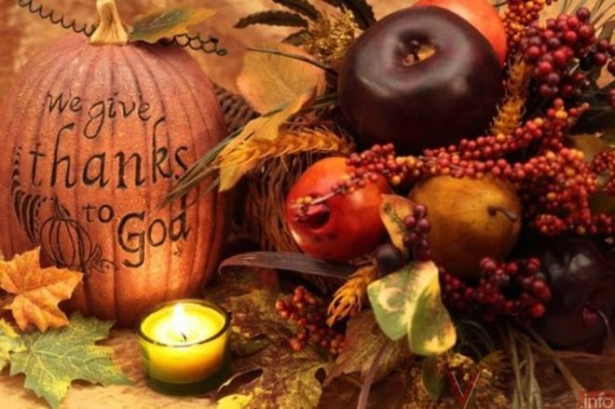
They made a lot of tasty food. The colonists had a great dinner.

Slide 13
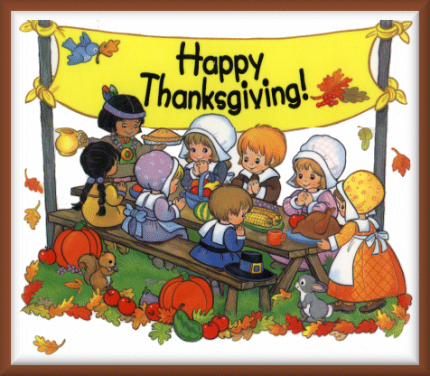
They wanted to thank God – to give Him their thanks for many things.

Slide 14
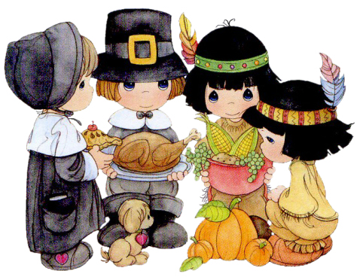
The colonists had a thanksgiving dinner for all the people. They got together and called their new good friends – the Indians.

Slide 15
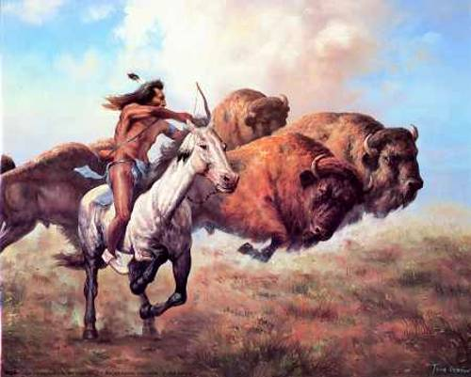
The Indians helped the colonists a lot. They showed them how to catch turkeys and how to hunt animals and to fish.

Slide 16
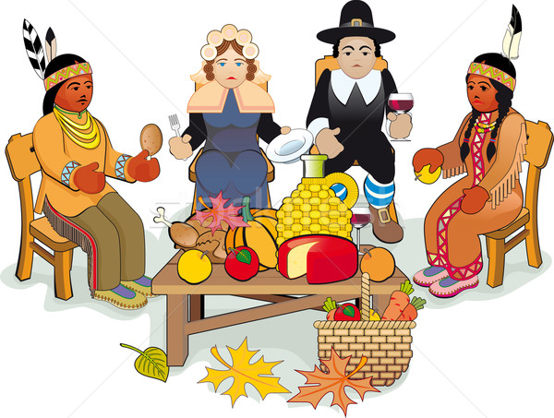
The colonists gave thanks for their rich harvest and hoped for a happy year in a new land. They sang songs and danced a lot.

Slide 17
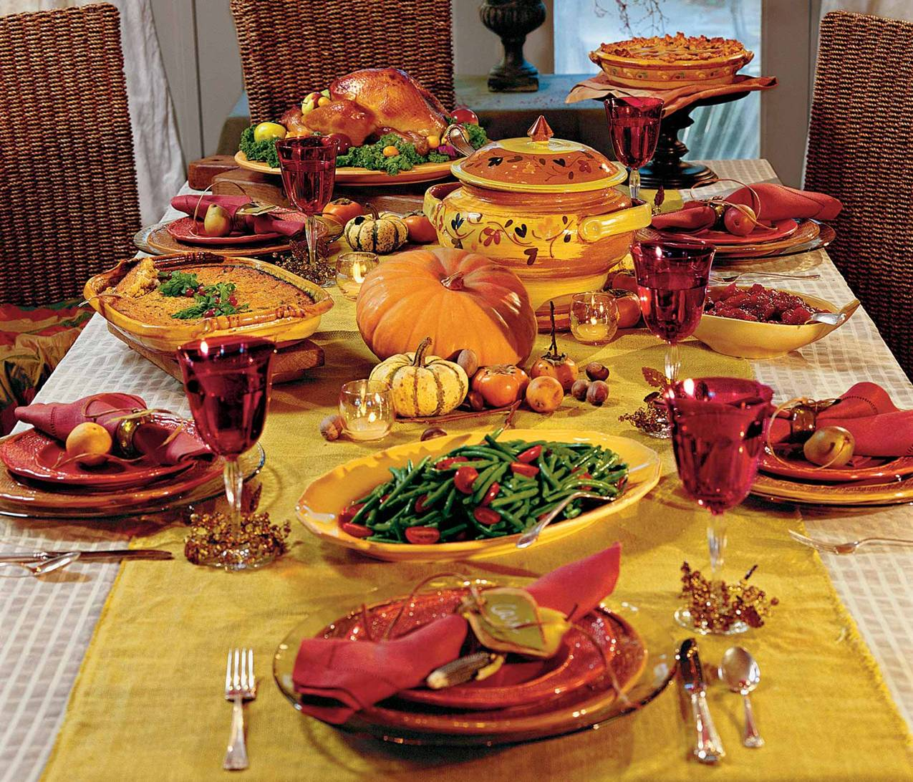
Nowadays people in America and Canada get together with their families and have a family dinner on Thanksgiving Day.

Slide 18
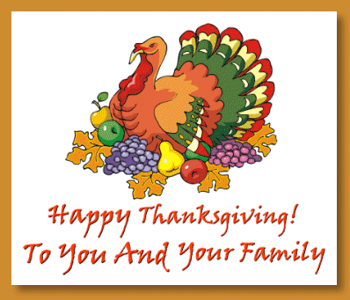
Wild turkeys were on the table on that holiday. The turkey became the symbol of Thanksgiving Day.

Slide 19
