Slide 1
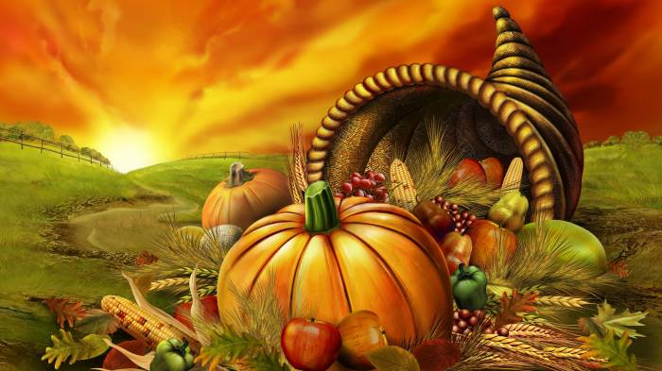
THE HISTORY OF THANKSGIVING DAY
by Alexandre Korjev-Chuvelev
Form 8, “Sosny” school
Teacher T.V. Kosormygina
November, 2016

Slide 2
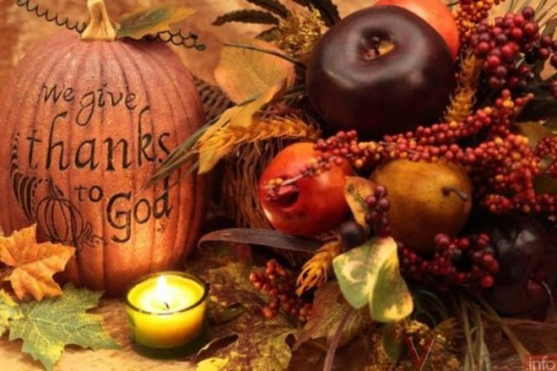
They decorate their houses with the fruit and flowers of autumn and have traditional American food: roast turkey, potatoes and pumpkin.

Slide 3
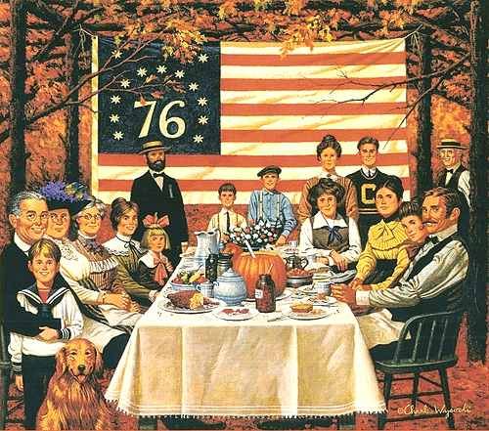
Тhere is one day a year when all Americans stay at home with their families and eat a big dinner. This is Thanksgiving Day.

Slide 4
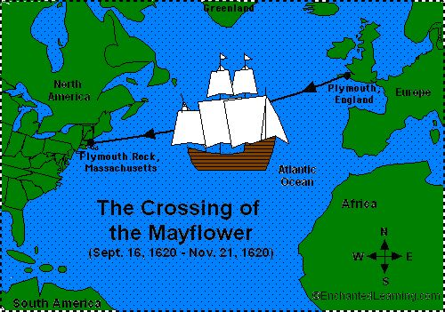
The Pilgrims sailed to America from Plymouth, England, in September, 1620.
They came to America for religious freedom.

Slide 5
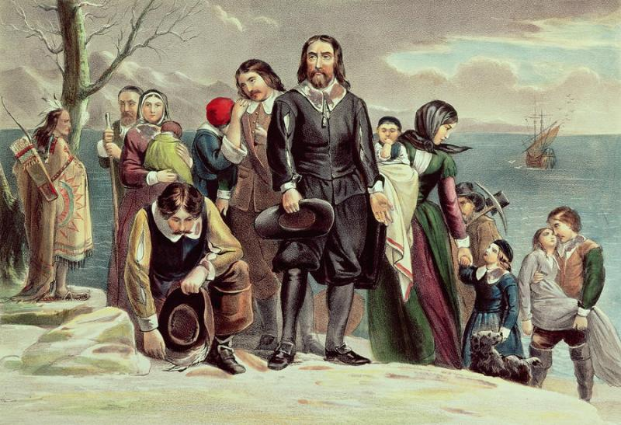
The name of their ship was the Mayflower. They landed at Plymouth Rock, in December, 1620.

Slide 6
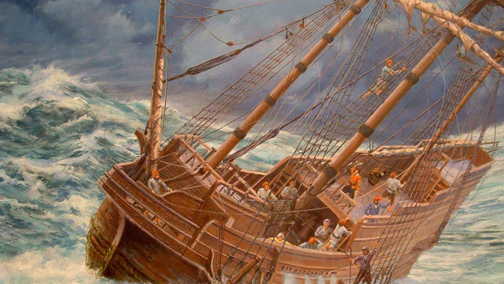
At first, the passengers enjoyed good weather at sea. But soon, strong winds and fierce storms developed. , one of the main beams broke. Some of the passengers wanted to return to England.

Slide 7
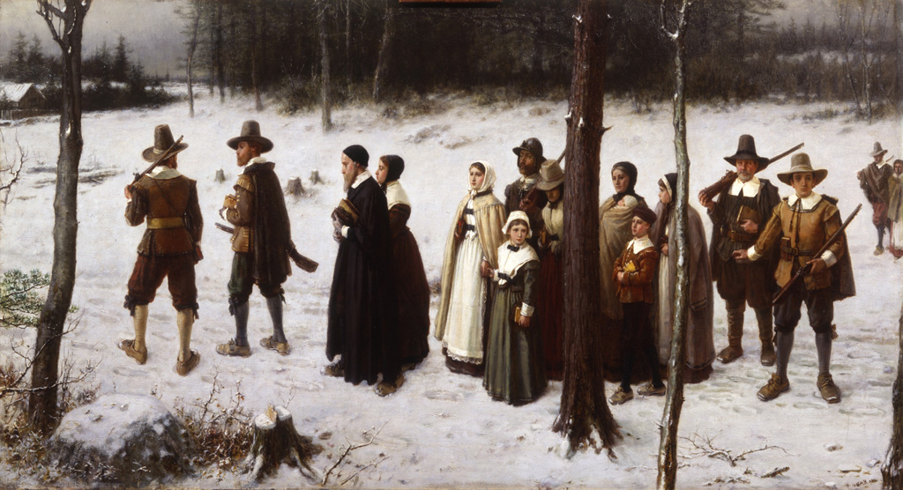
After a long struggle with the sea, the Mayflower came to land.

Slide 8
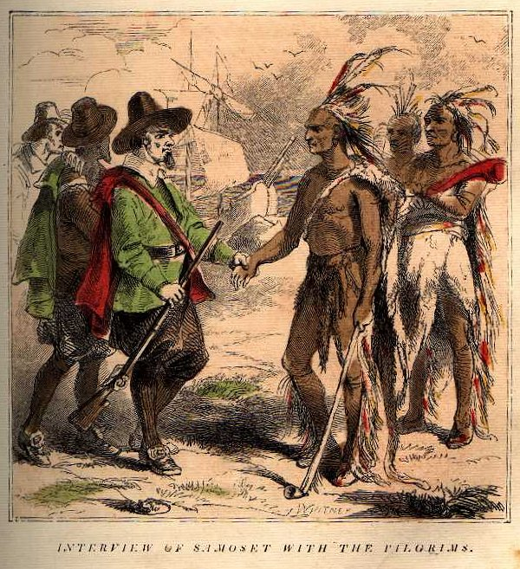
There were people living in America before the Pilgrims arrived. These people were the Native American Indians. The Indians began settling in America about 25,000 years ago. They hunted, fished, and farmed to survive. There were many tribes.

Slide 9
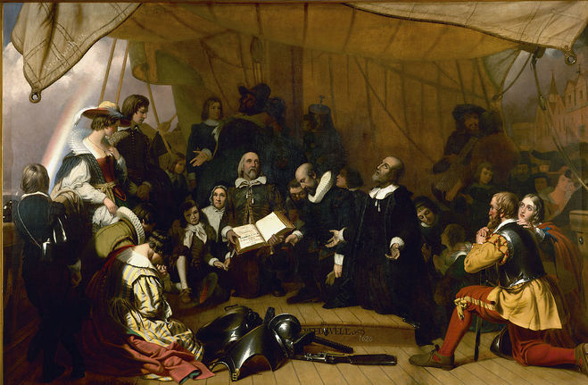
The Pilgrims’ first winter in the New World was difficult. They had arrived too late to grow any crops. Without fresh food, half of the Pilgrims died.

Slide 10
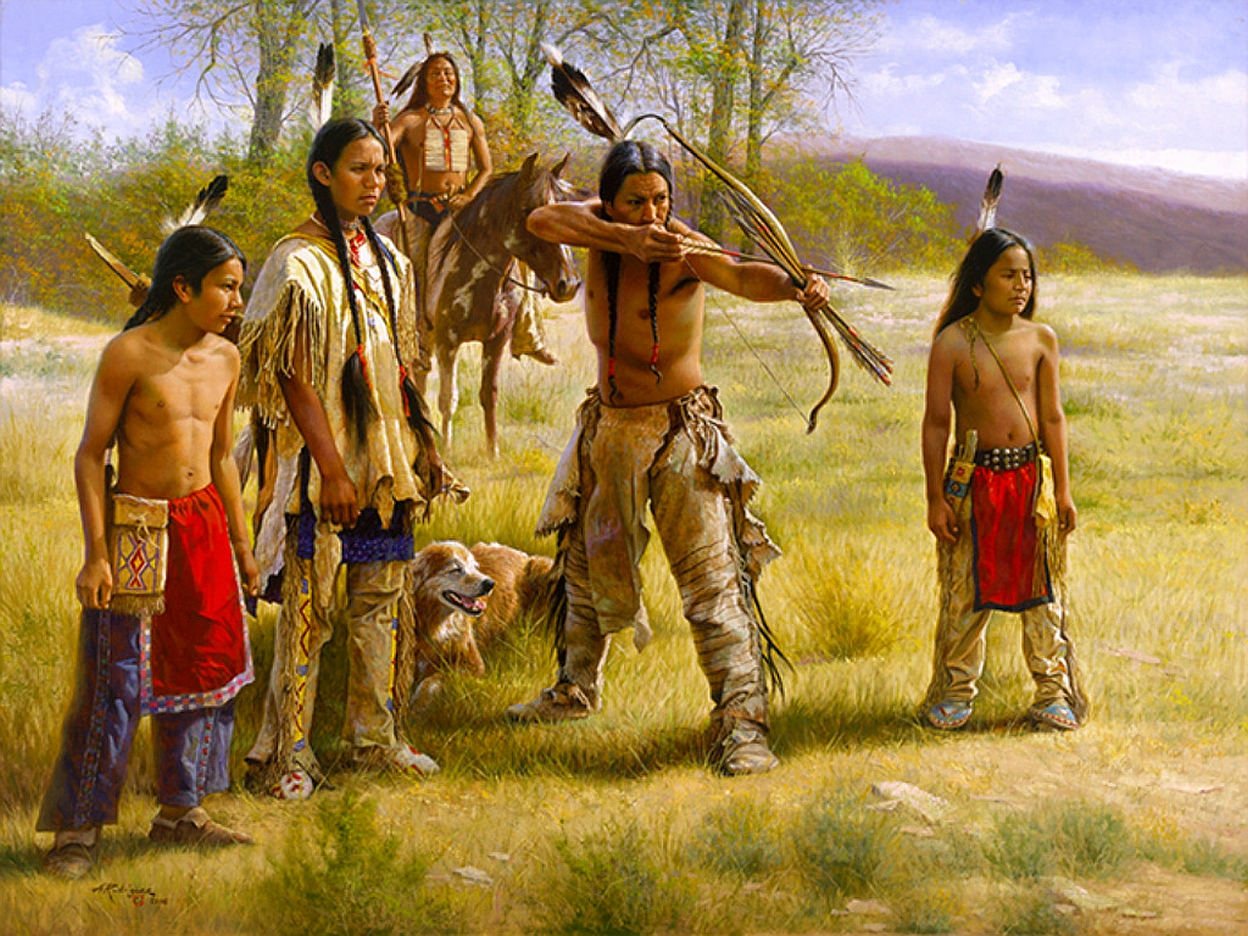
The following spring the Indians taught the Pilgrims how to hunt, fish, plant, and survive in America.

Slide 11
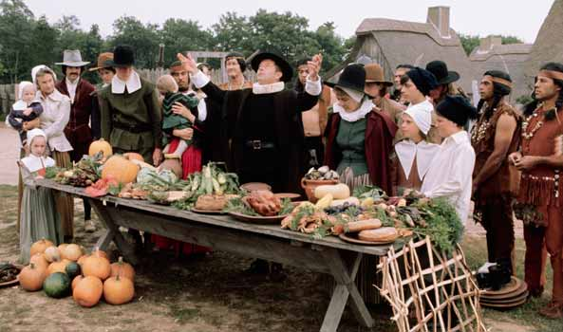
.The crops did well, and in the fall of 1621 the Pilgrims had a great harvest. They were thankful and decided to celebrate it with a Thanksgiving feast.

Slide 12
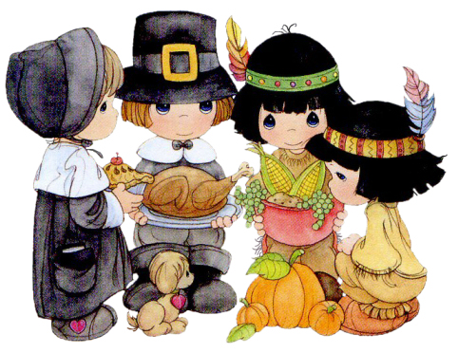
They prepared a dinner of turkey, corn, beans, and pumpkins.

Slide 13
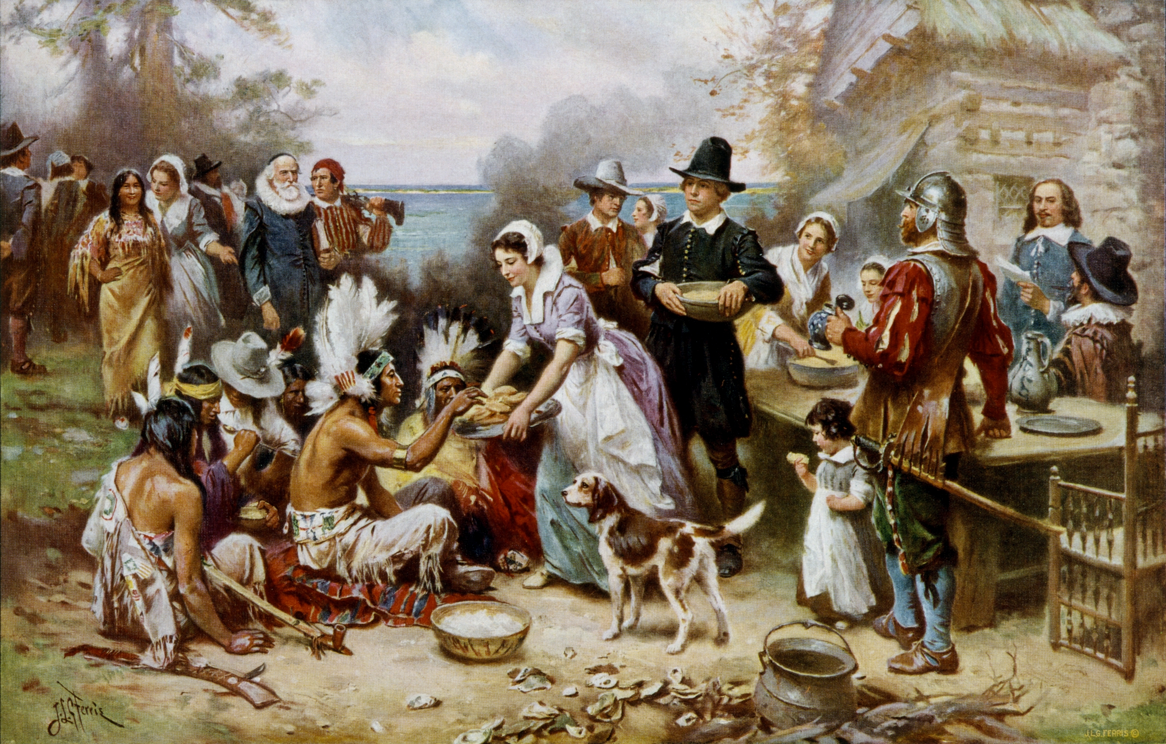
They invited their Indian friends to share this three-day feast. The Indians brought food to the feast, too (they even brought popcorn!).

Slide 14
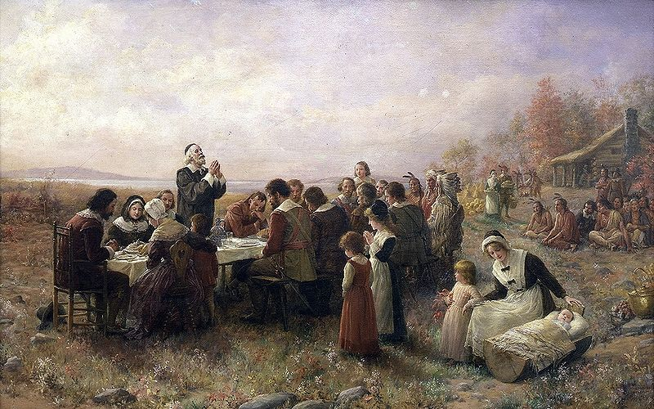
They prepared a dinner of turkey, corn, beans and pumpkins. The crops did well, and in the fall of 1621 the pilgrims had a great harvest. They were thankful and decided to celebrate it with a Thanksgiving feast.

Slide 15
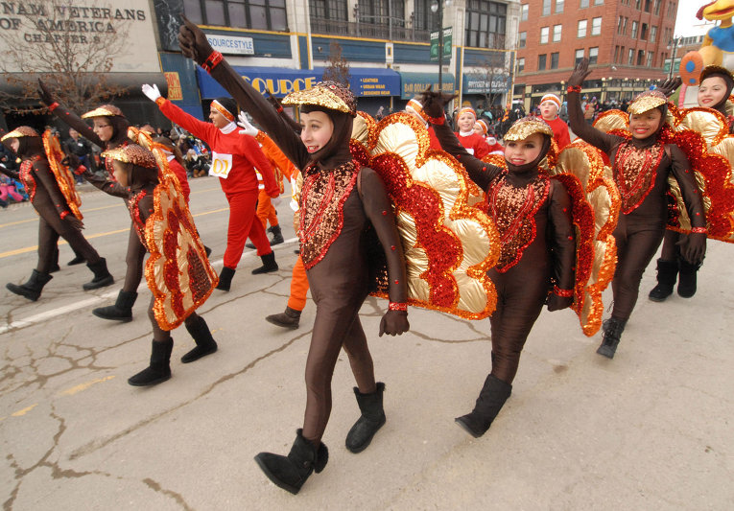
Americans still celebrate Thanksgiving Day in the fall. It is celebrated on the fourth Thursday in November.

Slide 16
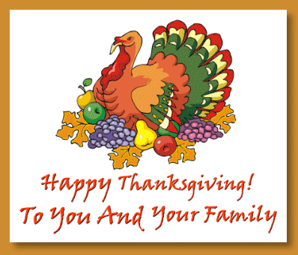
Turkey is still the main dish and pumpkin pie is the most popular dessert.

Slide 17
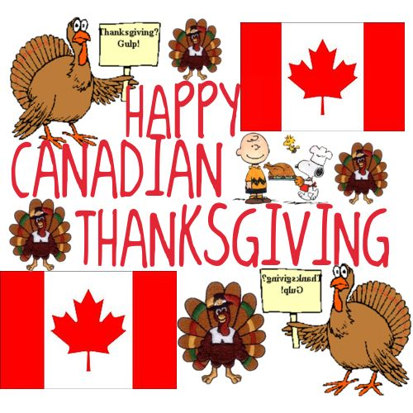
Not only Americans celebrate Thanksgiving Day. So do the Canadians on the second Monday in October. They give thanks to God Almighty for a rich harvest.

Slide 18
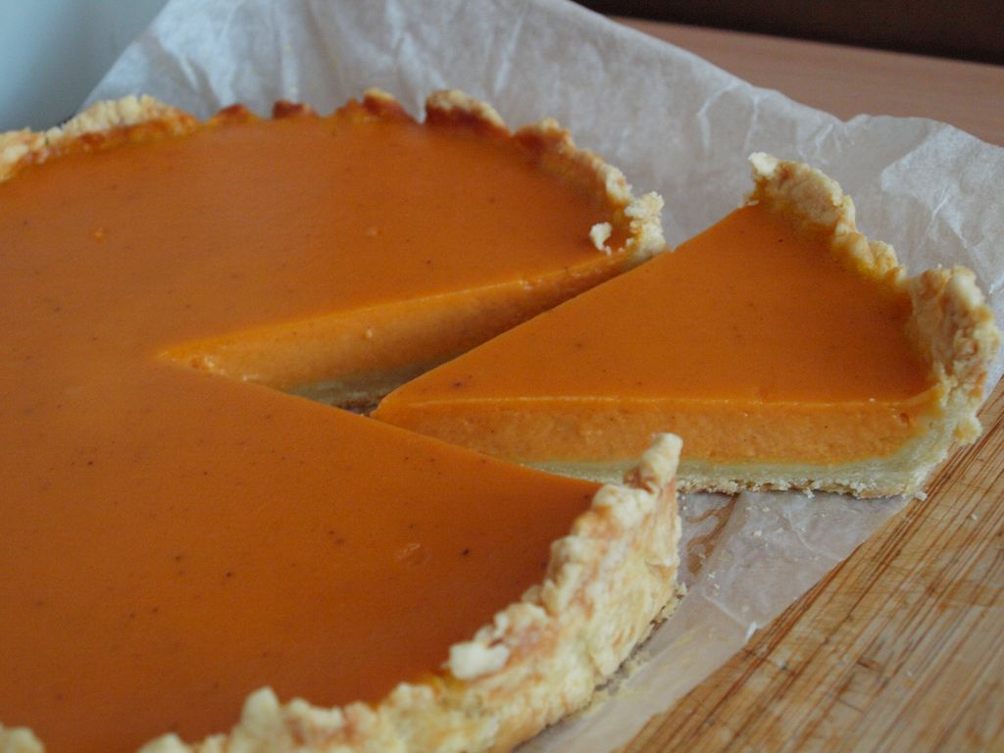
‘Pumpkin pie is still a staple at almost every Thanksgiving table. They were a part of all traditional meals long before the arrival of the pilgrims.

Slide 19
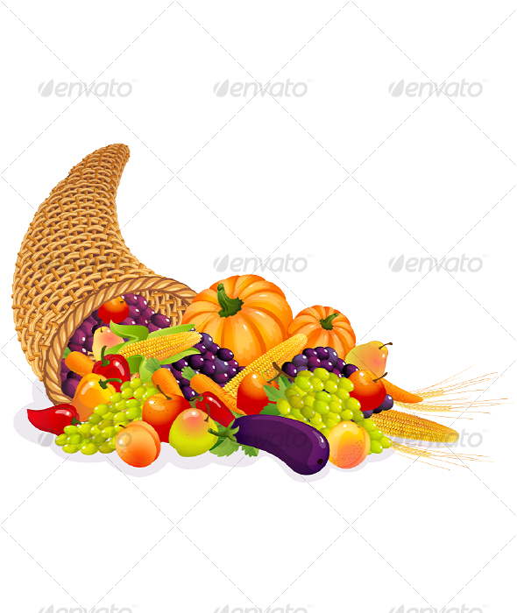
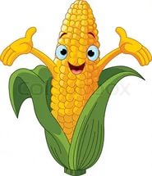
Corn were a part of the first thanksgiving dinner. Corn reminds us of the importance
and heritage of the famous
harvest festival.

Slide 20
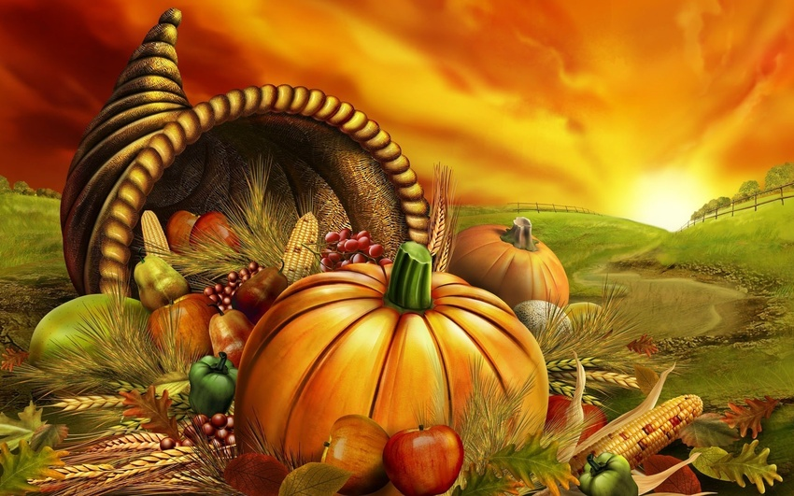
Cornucopia is the most famous symbol of the harvest festival. It is known as the ‘horn of plenty’.

Slide 21
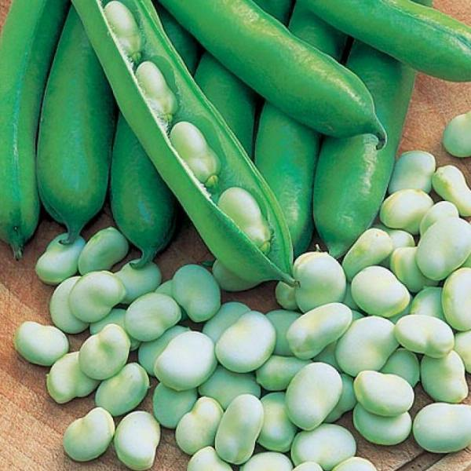
Beans are a special symbol of Thanksgiving.
Native Americans are believed to have taught the pilgrims to grow beans next to the cornstalks.

Slide 22
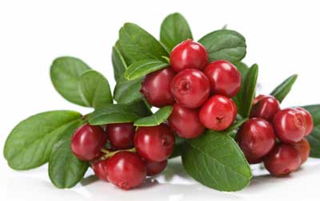
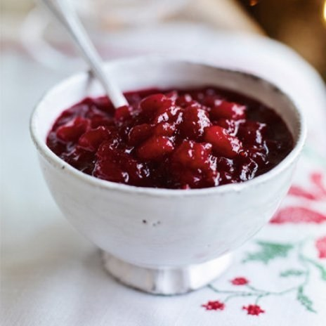
Cranberry is a symbol and a modern diet staple of Thanksgiving. Cranberry sauce is a permanent companion of turkey during thanksgiving feast.

Slide 23
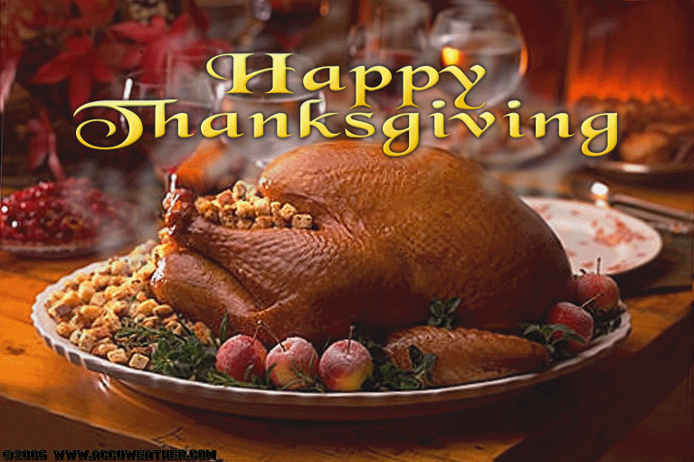
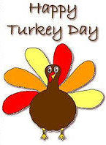
The celebration of Thanksgiving is incomplete without legendary turkey.

Slide 24
