Slide 1
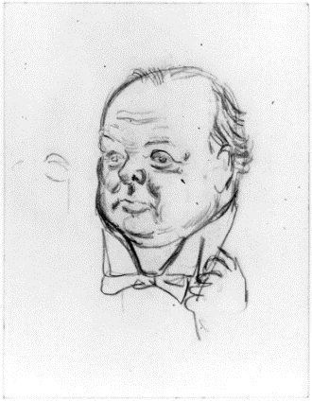
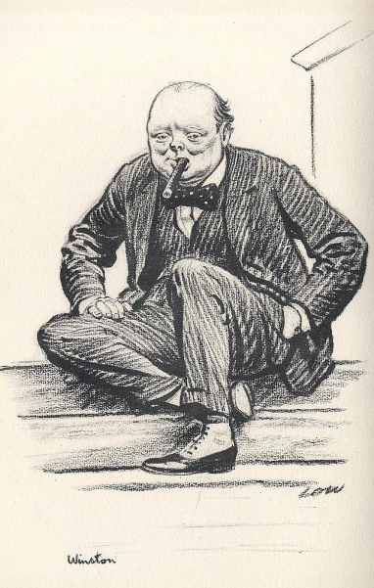
Winston Churchill`s actions during THE Second World War
By Maria Ishimova
Form 10
“Sosny” school
Teacher T.V. Kosormygina
09.03.15

Slide 2
Winston Churchill was a British politician who was the Prime Minister of the United Kingdom from 1940 to 1945 and again from 1951 to 1955. Widely regarded as one of the greatest wartime leaders of the 20th century, Churchill was also an officer in the British Army, a historian, a writer and an artist. Before the First World War, he served as President of the Board of Trade, Home Secretary, and First Lord of the Admiralty as part of Asquith's Liberal government.
(30 November 1874 – 24 January 1965)

Slide 3
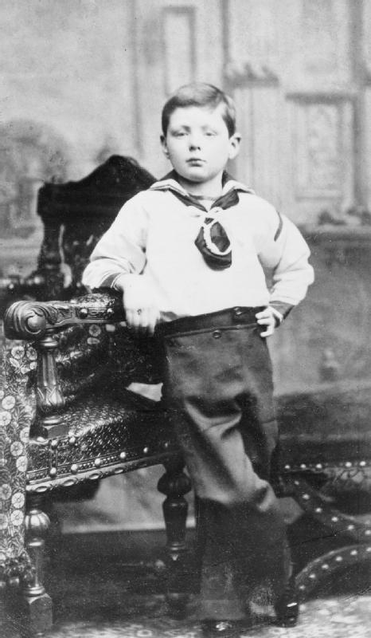
HIS CHILDHOOD AND EARLY YEARS
Sir Winston Leonard Spencer-Churchill was born on the 30th of November in 1874 in Blenheim Palace, Woodstock, Oxfordshire, England in the aristocratic family of the Dukes of Marlborough. Both Churchill's father, a politician, and his mother, the daughter of American millionaire Leonard Jerome, didn`t pay much attention to bringing their son up, so young Winston spent most of his time with his nanny, Elizabeth Anne Everest, who was believed to be one of Churchill`s closest friends.

Slide 4
Young Churchill was described as an independent and rebellious child, probably that`s why he generally had a poor academic record in school, for which he was punished rather often. He was educated at three schools. After his graduation Winston applied to attend the Royal Military College in Sandhurst. He tried three times before passing the entrance exam.

Slide 5
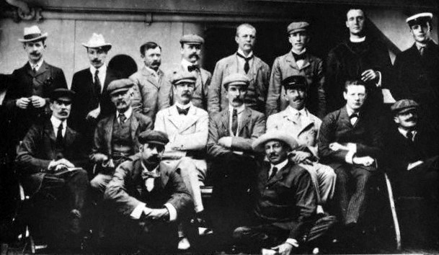
In his youth he acted as a war correspondent for several London newspapers and wrote his own books about the campaigns, he took part in. During The Second Boer War Churchill was captured and imprisoned in a Prisoner-of-war camp. Luckily, he managed to get himself free.

Slide 6
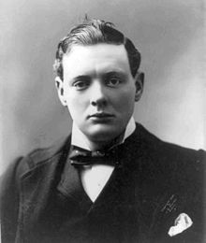
His political career
In Parliament Winston Churchill was a member of the Conservative Party. In 1910 at the age of 35 he became Home Secretary and he was appointed First Lord of the Admiralty one year later. After the outbreak of the Second World War Churchill replaced Arthur Neville Chamberlain as prime minister.

Slide 7
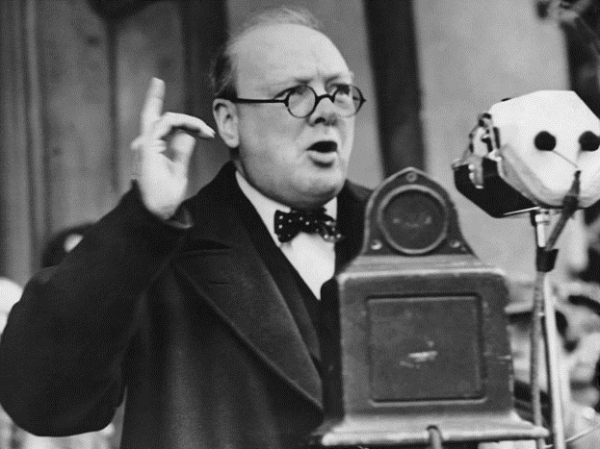
His actions during and after the Second World War
In 1939 Churchill appointed himself to be Minister of Defence in order to control the British army. He visited the places of bombing and met the victims regularly. Winston Churchill also made 21 speeches on the radio during the Second World War, because he wanted to encourage his fellow people, which made him extremely popular with the British.
«I have nothing to offer but blood, toil, tears, and sweat»

Slide 8
In February 1945 the Yalta Conference was held and Winston Churchill was one of the three heads of government that came to that meeting along with the US President Franklin D. Roosevelt and the USSR Premier Joseph Stalin. There they discussed Europe's post-war reorganization.

Slide 9
After the war had come to its end, Winston Churchill appealed Germany, France and the UK to «bury the hatchet» and to create «the United States of Europe».
His famous speech «Sinews of Peace», he made on the 5th of March 1946, is believed to be the initial point of the Cold War.

Slide 10
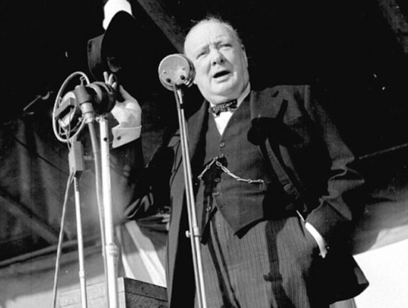
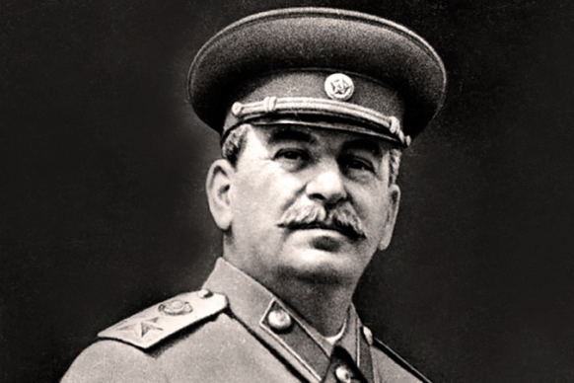
His Attitude towards the soviet union
Winston Churchill never tolerated communists: neither before, nor after the war. He believed that the UK had to take part in the intervention in the Russian Civil War and declared that Bolshevism must be "strangled in its cradle". In 1947 Churchill tried to convince the USA President, Harry Truman, to make a preventive nuclear strike on the USSR. He also was the first person to talk about the Iron Curtain.
Despite these facts, he admitted the Soviet Union to be the UK ally during the Second World War and he actually respected Stalin as a leader.

Slide 11
«The Nazi regime is indistinguishable from the worst features of Communism. It is devoid of all theme and principle except appetite and racial domination. It excels in all forms of human wickedness, in the efficiency of its cruelty and ferocious aggression. No one has been a more consistent opponent of Communism than I have for the last twenty-five years. I will unsay no words that I've spoken about it. But all this fades away before the spectacle which is now unfolding… Any man or State who fights against Nazism will have our aid. Any man or State who marches with Hitler is our foe…»
Winston Churchill, 1941

Slide 12
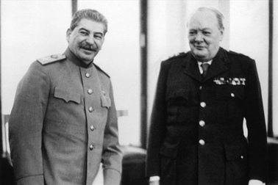
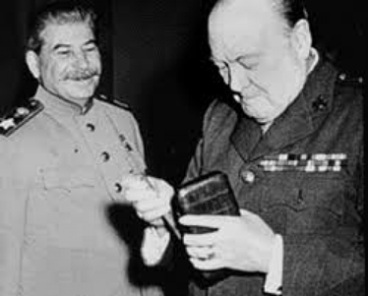
Churchill`s opinion on stalin
«It is very fortunate for Russia in her agony to have this great rugged war chief at her head. He is a man of massive outstanding personality, suited to the sombre and stormy times in which his life has been cast; a man of inexhaustible courage and will-power and a man direct and even blunt in speech …»

Slide 13
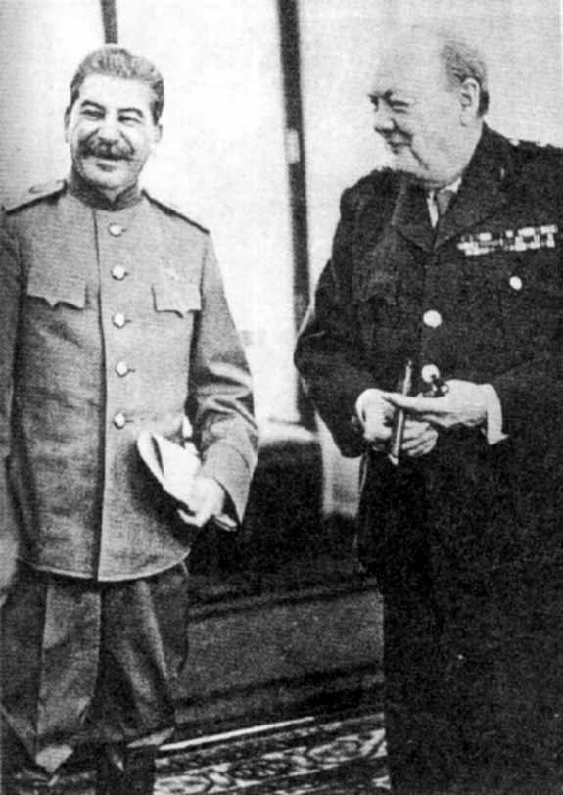
«…Above all, he is a man with that saving sense of humour which is of high importance to all men and all nations, but particularly to great men and great nations. Stalin also left upon me the impression of a deep, cool wisdom and complete absence of illusions of any kind. I believe I made him feel that we were good and faithful comrades in this war — but this, after all, is a matter which deeds not words will prove.»

Slide 14
Some interesting facts about Winston Churchill
He won the Nobel Prize in Literature in 1953
He was the first person to be made an honorary citizen of the United States
He smoked 8-10 cigars a day and he didn`t give this bad habit up
He was also told to have a passion for Armenian cognac (brandy)
Winston Churchill was a member of a Masonic lodge
Winston's nickname at school was "Copperknob" for his red hair
He was a great orator, in spite of having a lateral lisp

Slide 15
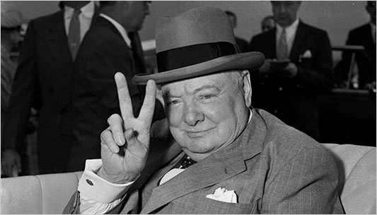
According to the public opinion poll, which was carried out by the BBC in 2002, Churchill`s nationals consider him to be
«the greatest Briton of all time».

